Slide 1

MAEA Youth Art Month Exhibition
2021

Slide 2




Thank you to our sponsors

Slide 3
Cameron Intermediate School/ Parkview Elementary
Cameron R-1
Mrs. Elizabeth Bogle
MAEA District #1

Slide 4
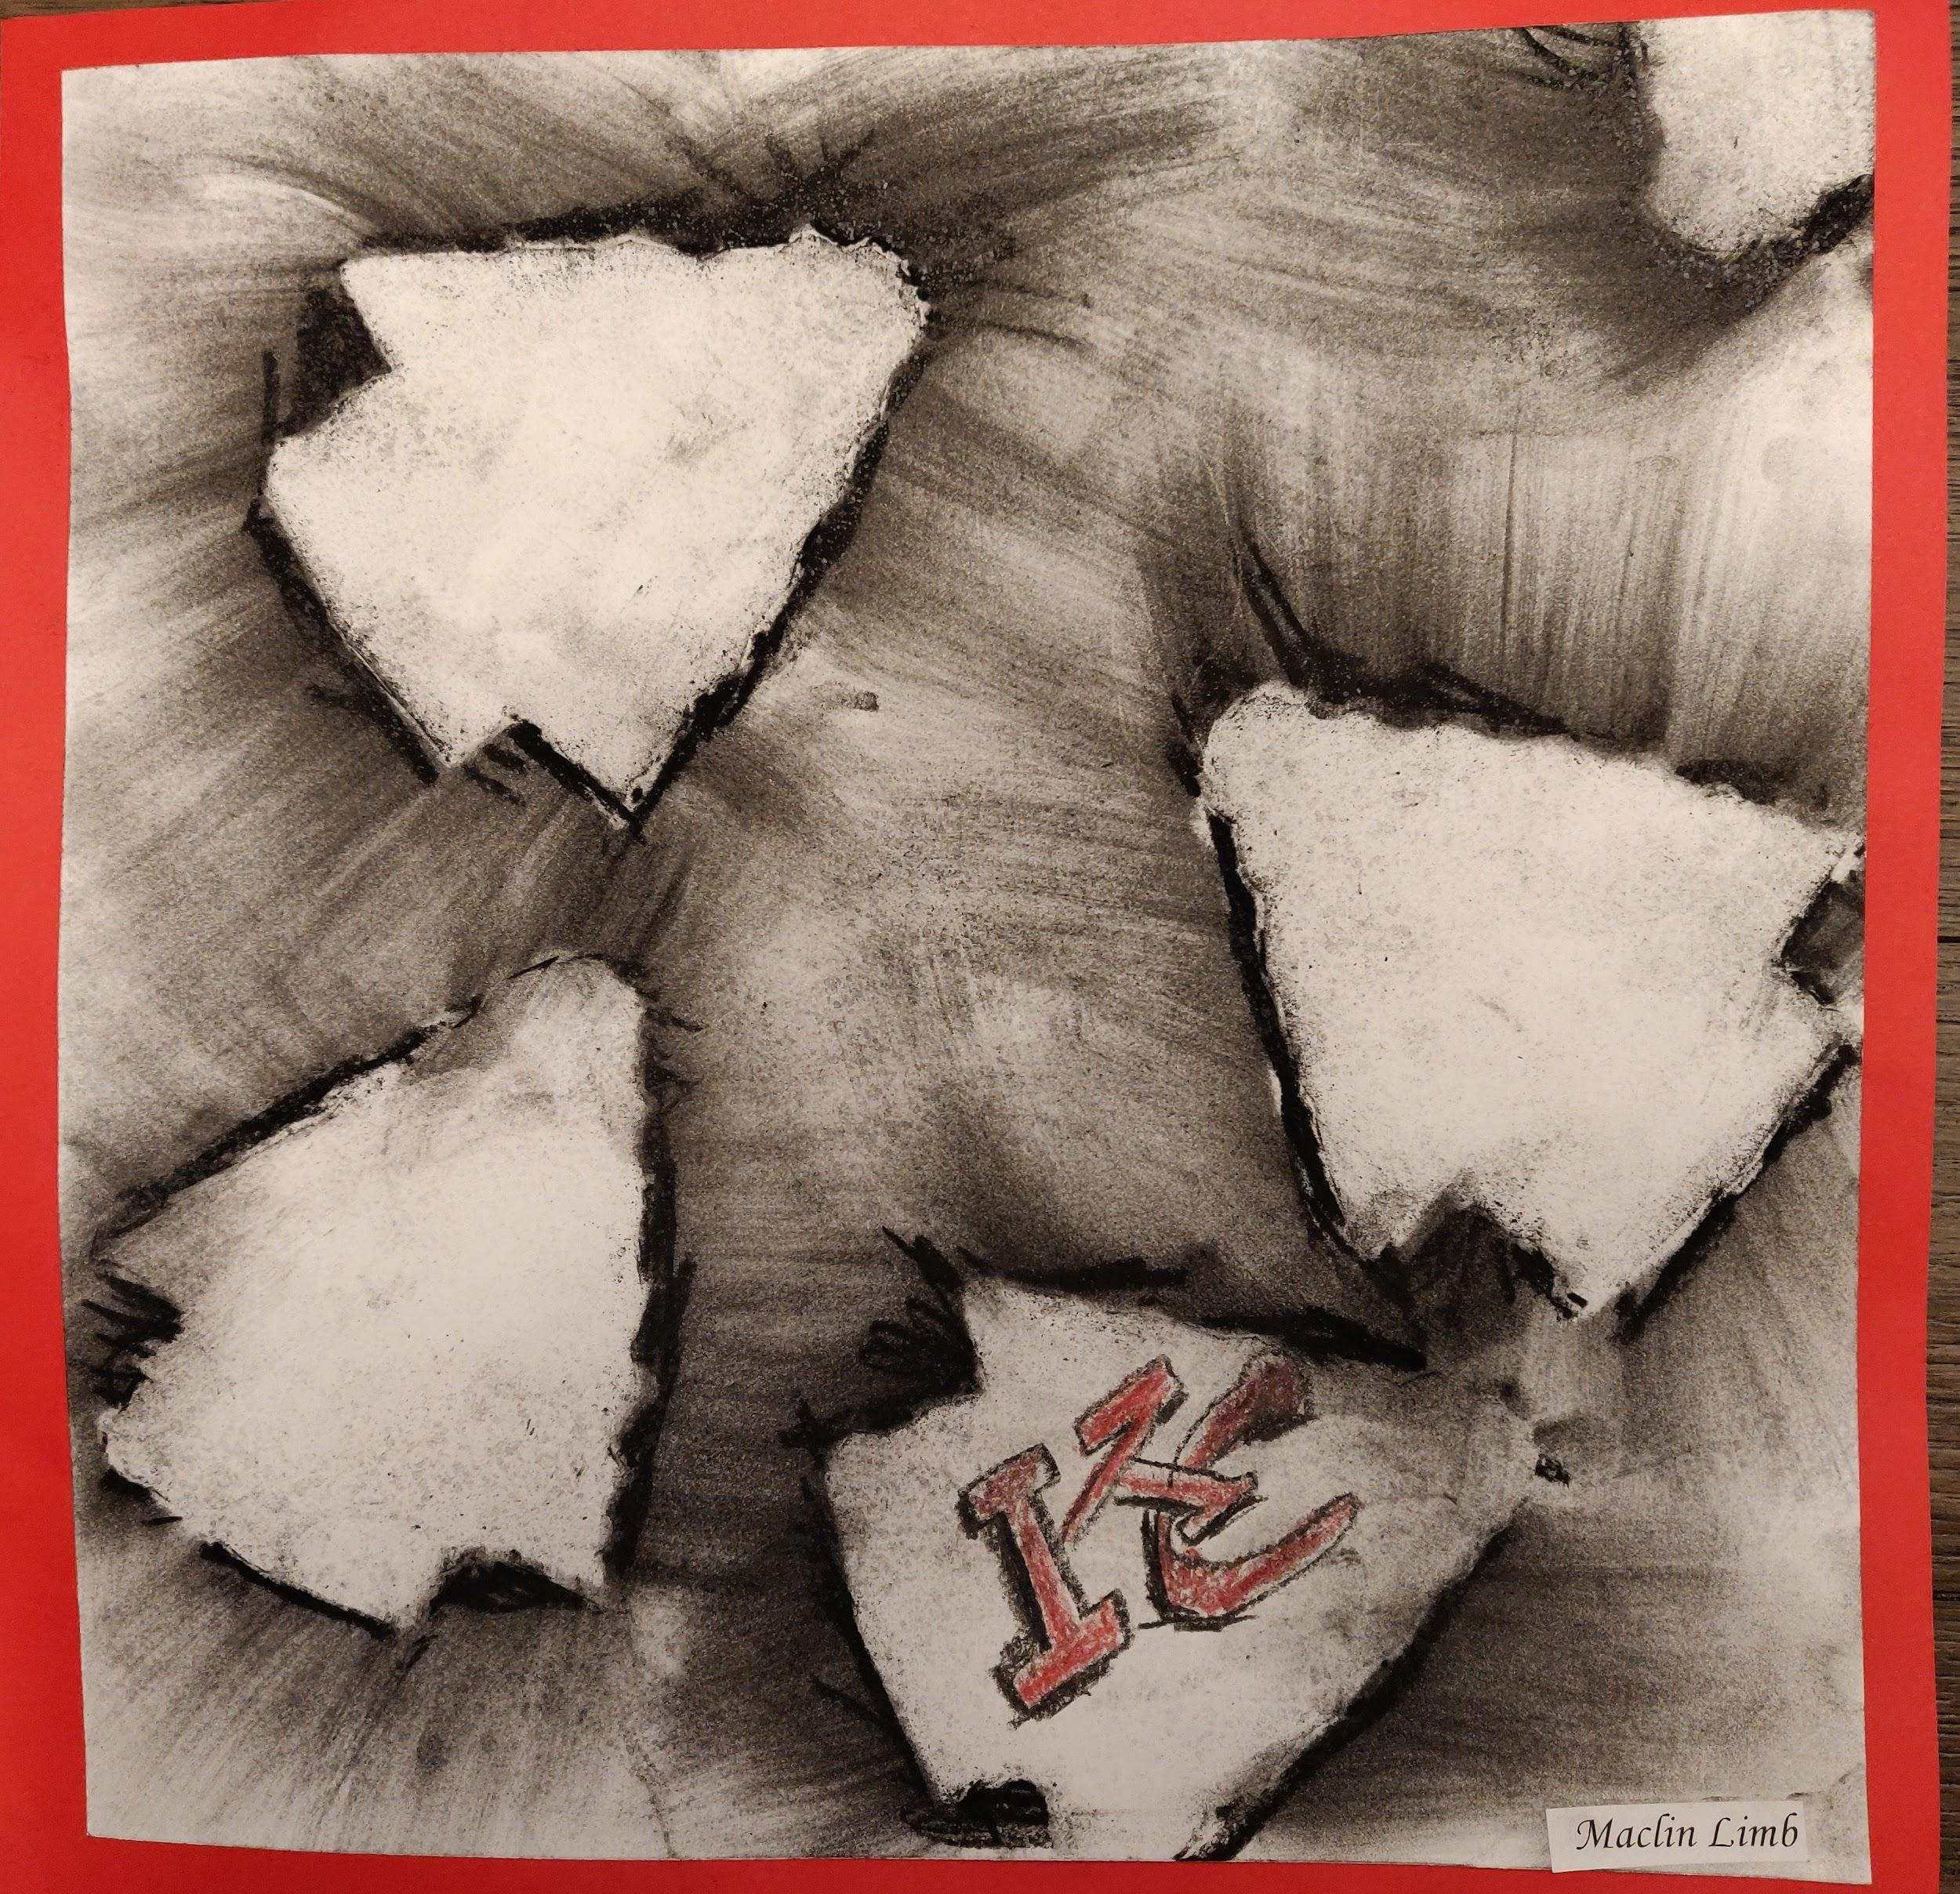
Maclin Limb, Grade 4

Slide 5
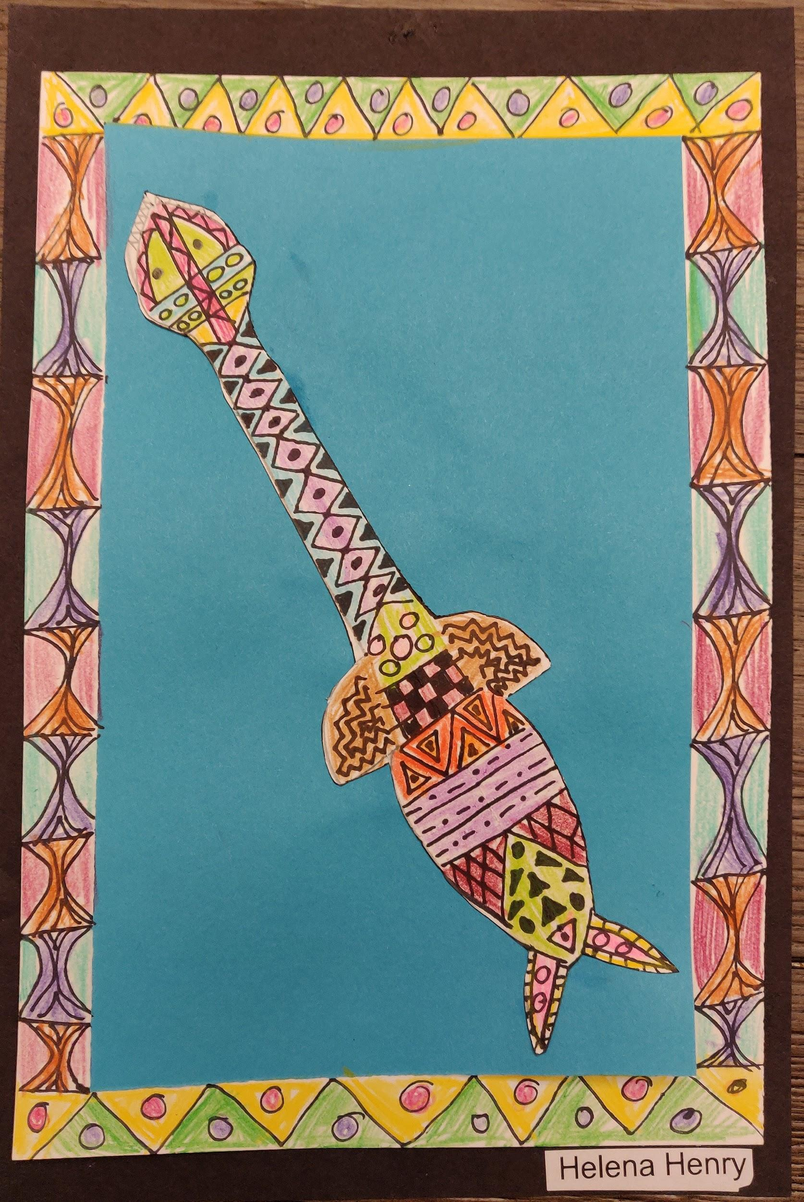
Helena Henry, Grade 3

Slide 6
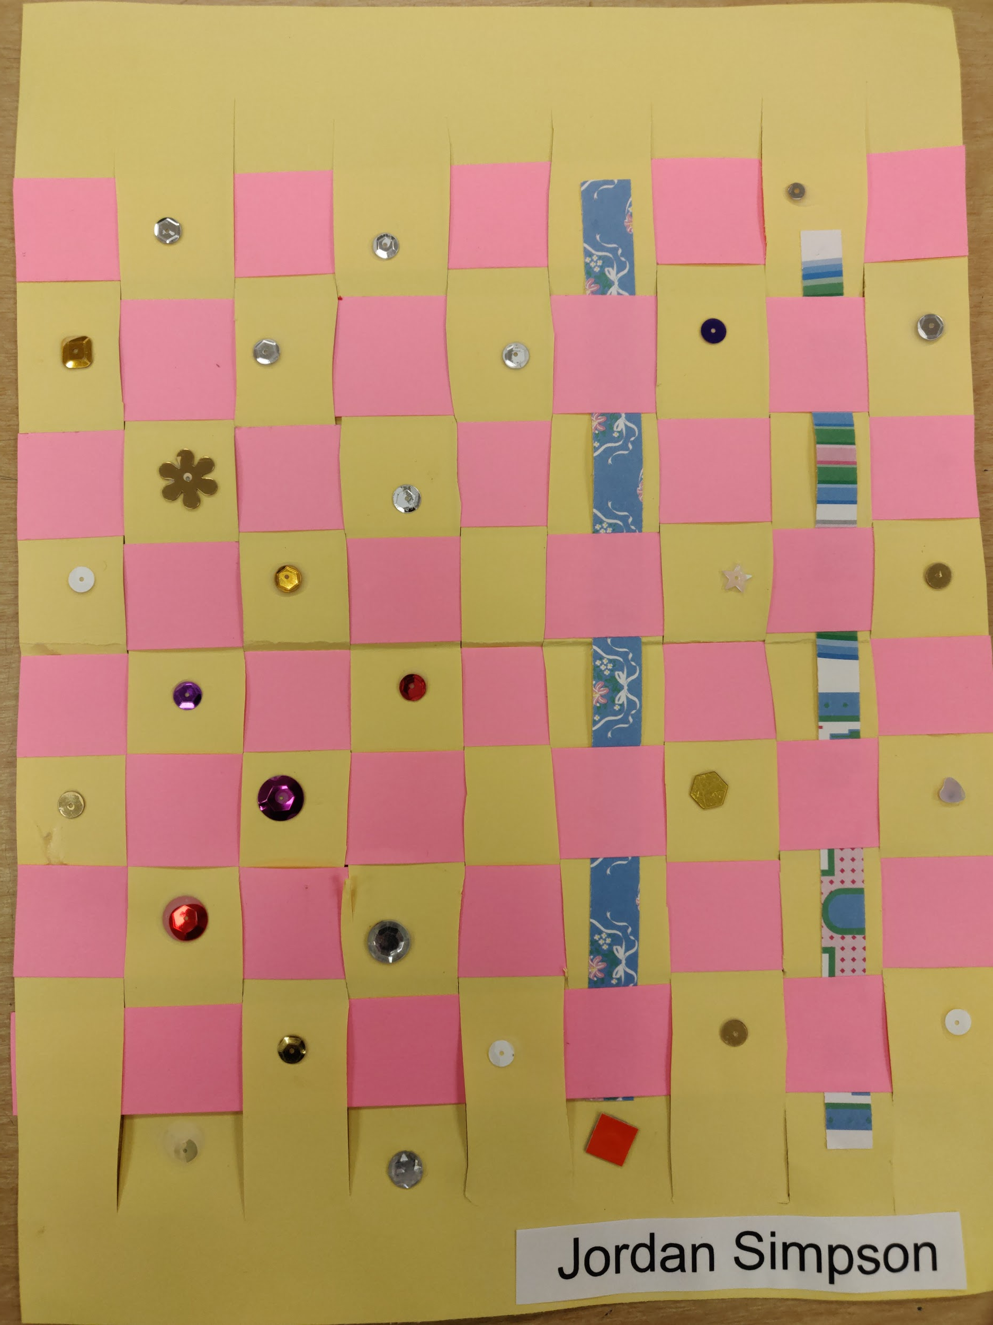
Jordan Simpson, Grade 2

Slide 7
Jefferson Eagles
Jefferson C-123 Schools
Mrs. Carla Peery
MAEA District # 1

Slide 8
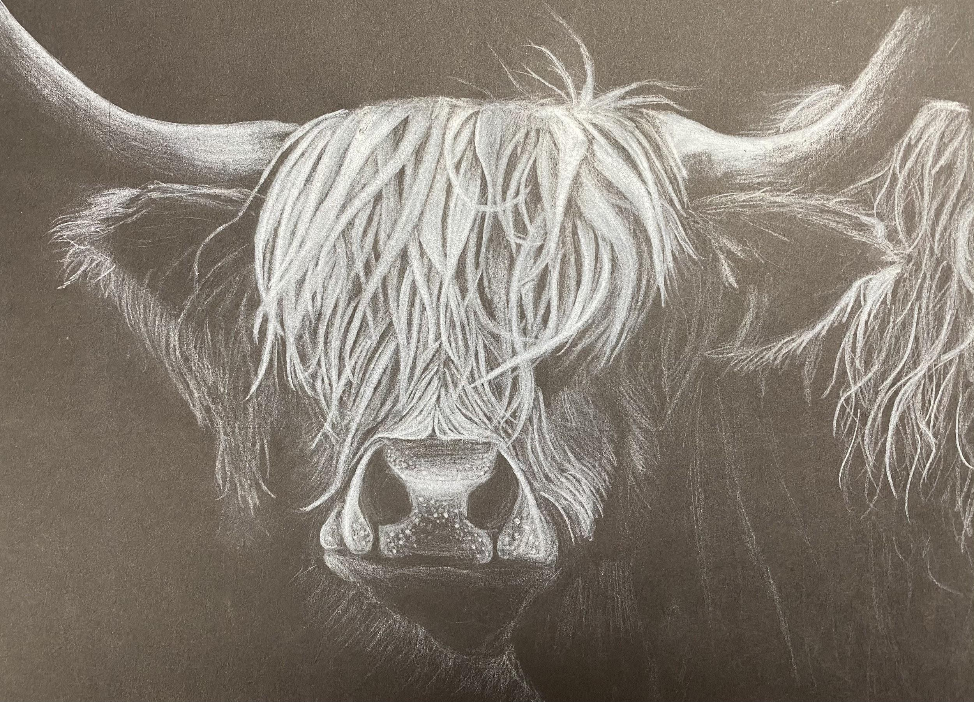
Claire Galbraith, Grade 11

Slide 9
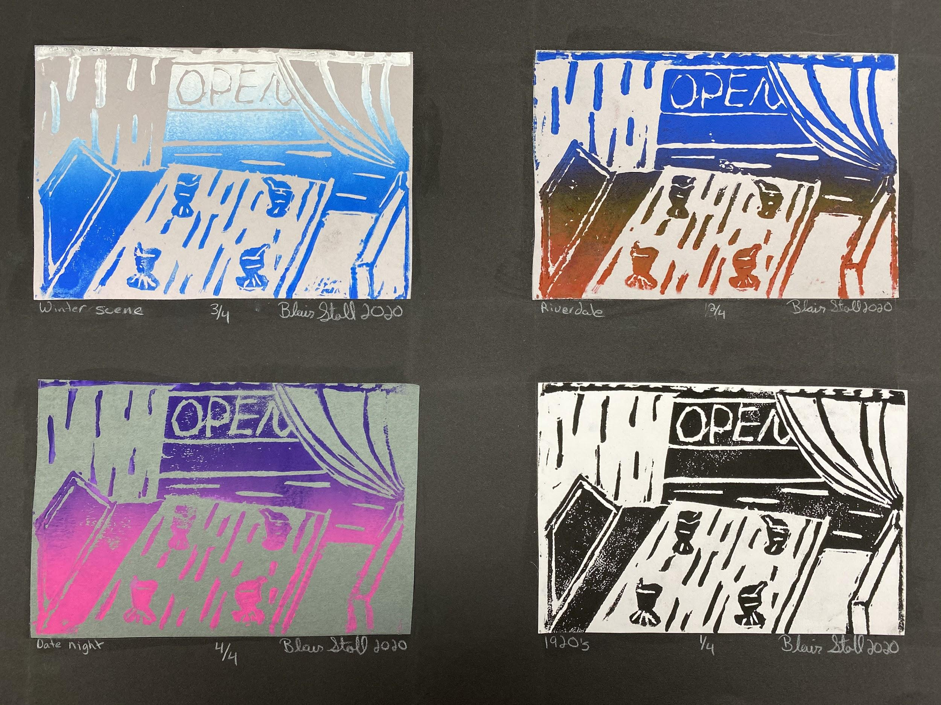
Blair Stoll, Grade 12

Slide 10
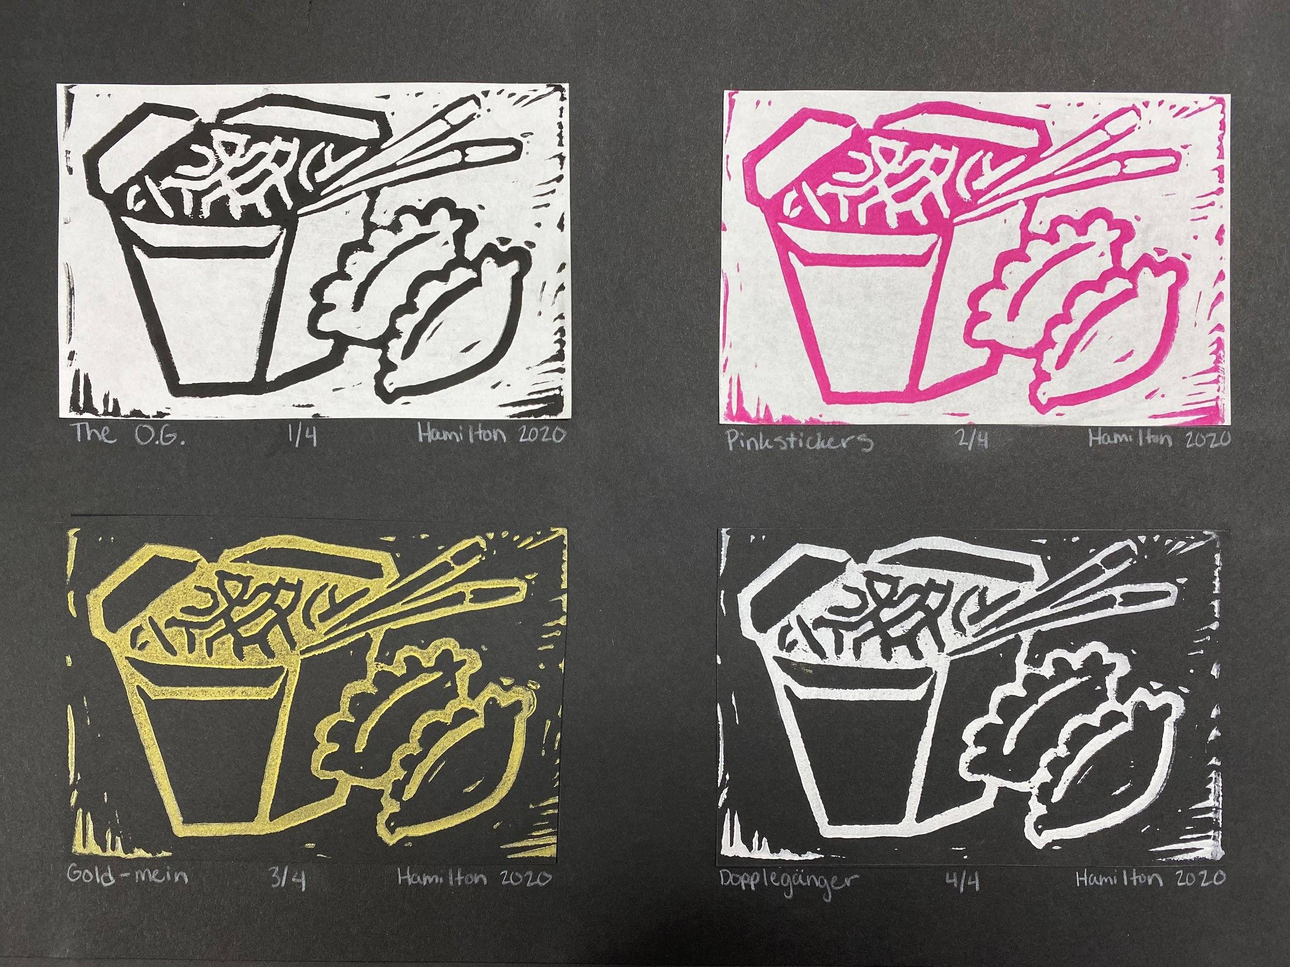
Kaylee Hamilton, Grade 12

Slide 11
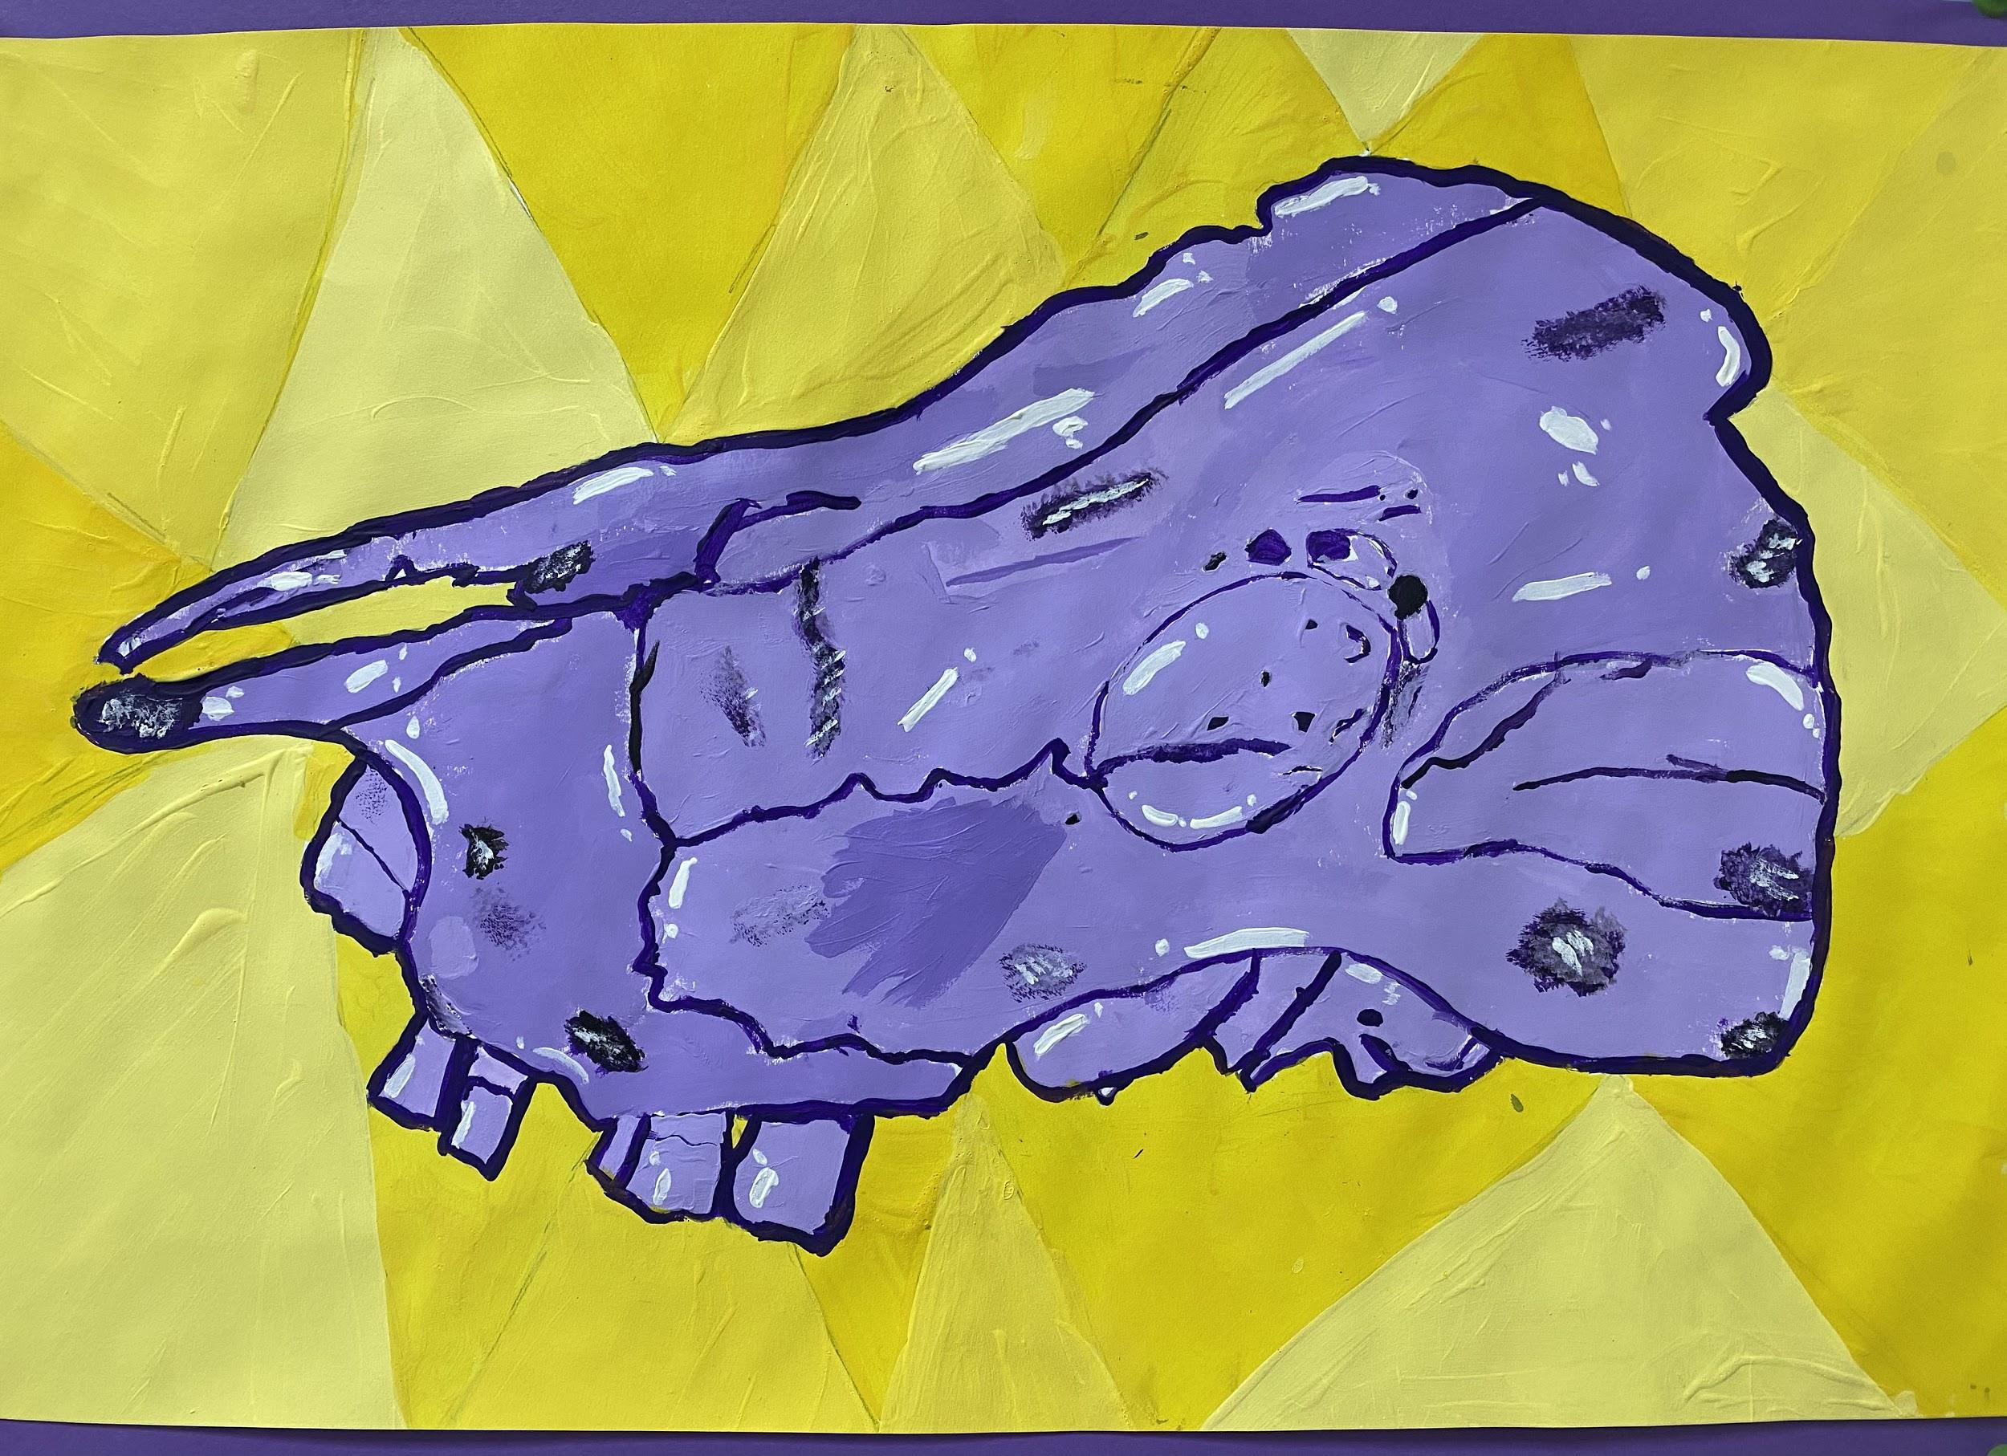
Lily Terry, Grade 6

Slide 12
Putnam Co RI
Megan Hines
MAEA District #2

Slide 13
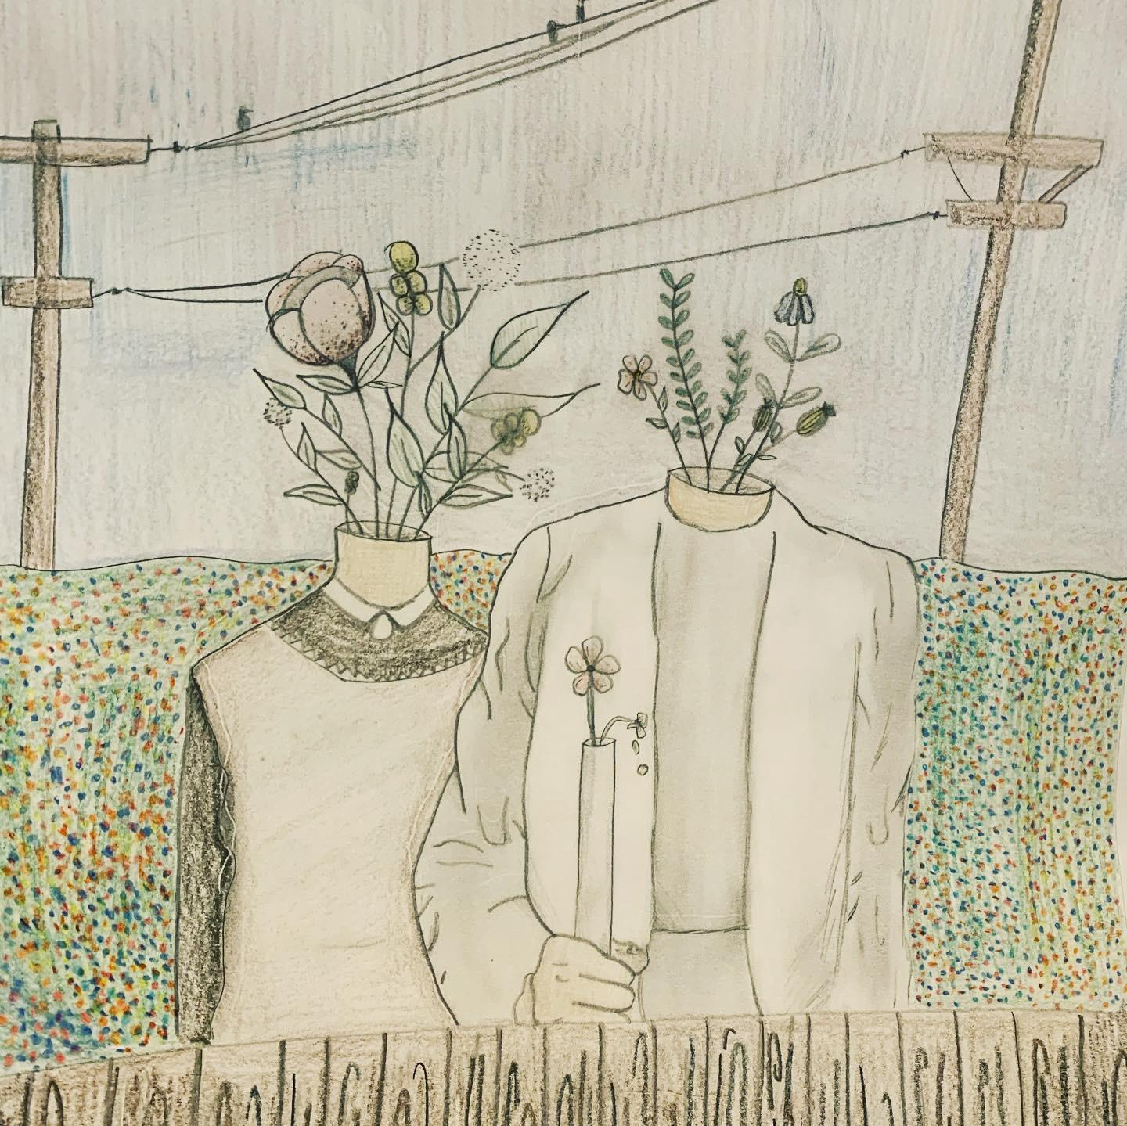
Tori Guffey, 12th Grade

Slide 14
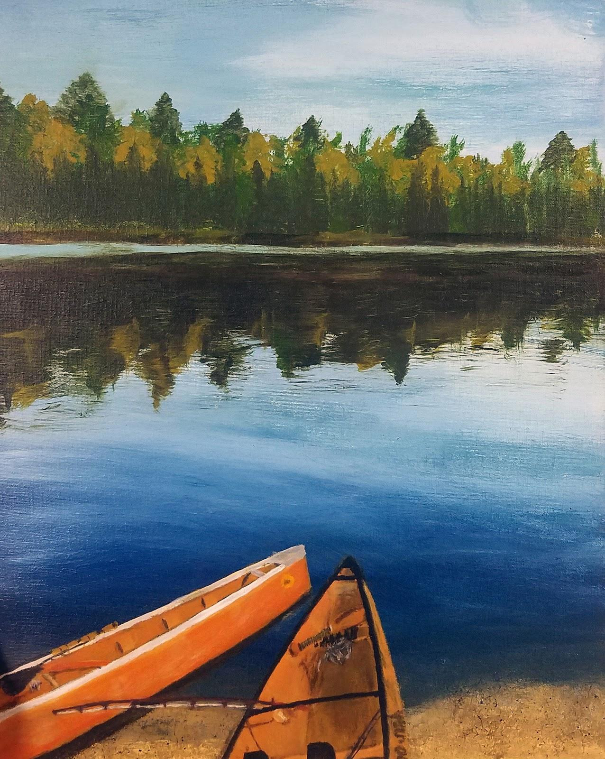
Grace Rowland, 12th Grade

Slide 15
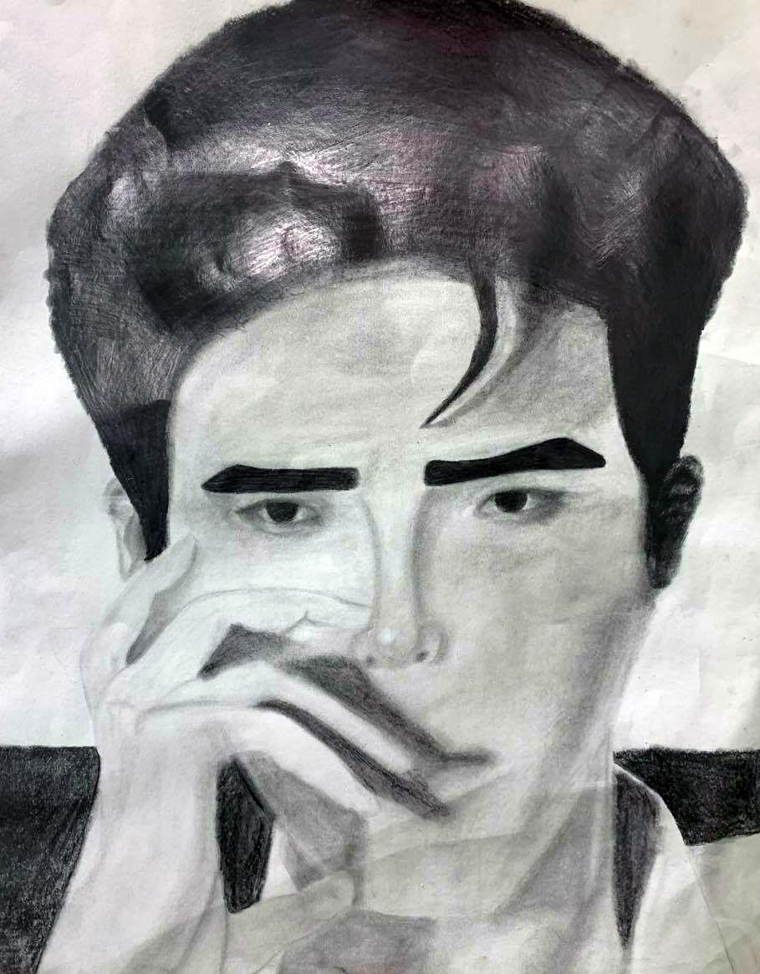
Jenna Bradshaw, 10th Grade

Slide 16
Benton, Southeast & Eastwood Elementary
Marshall Public Schools
Melissa Gann
MAEA District #4

Slide 17
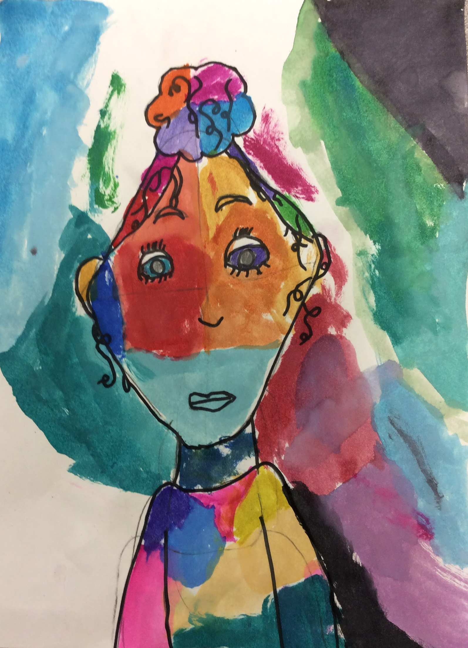
Yavonne Harris, 4th Grade

Slide 18
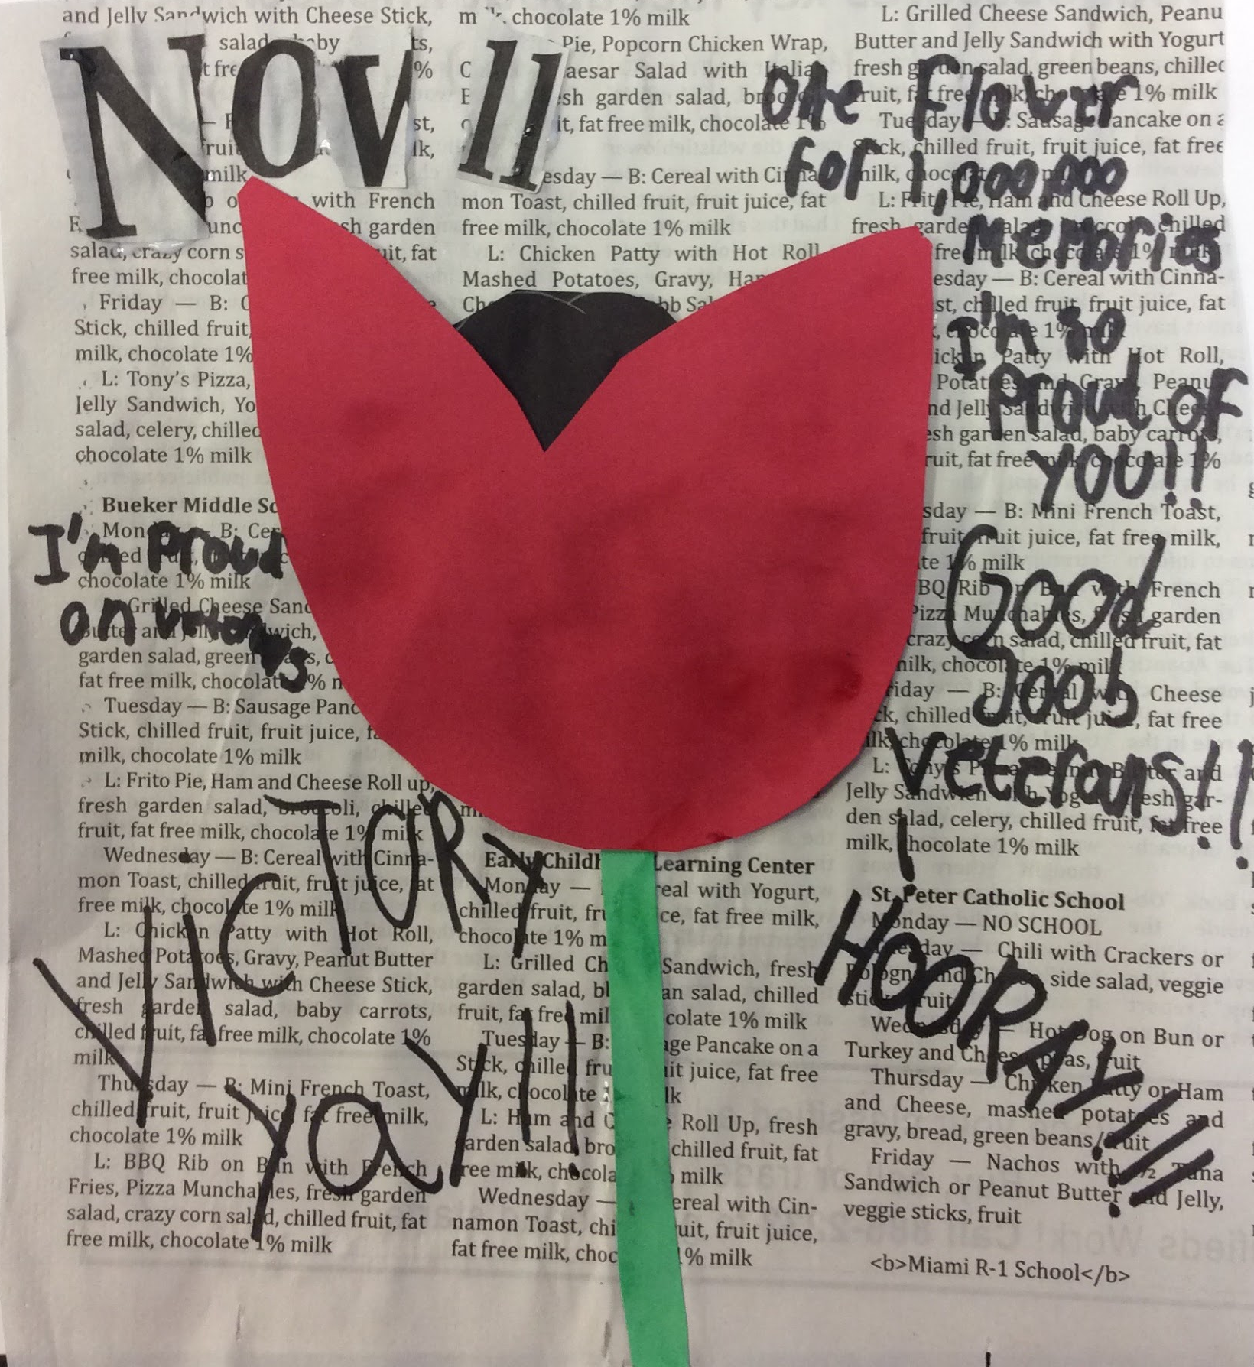
Emma Garay, 4th Grade

Slide 19
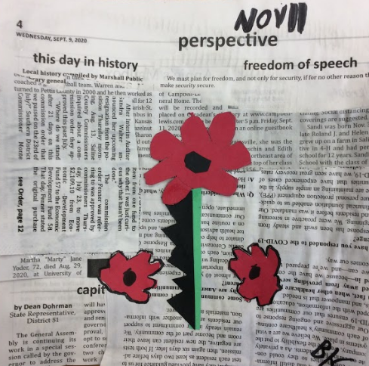
Bennett Kueker, 4th Grade

Slide 20
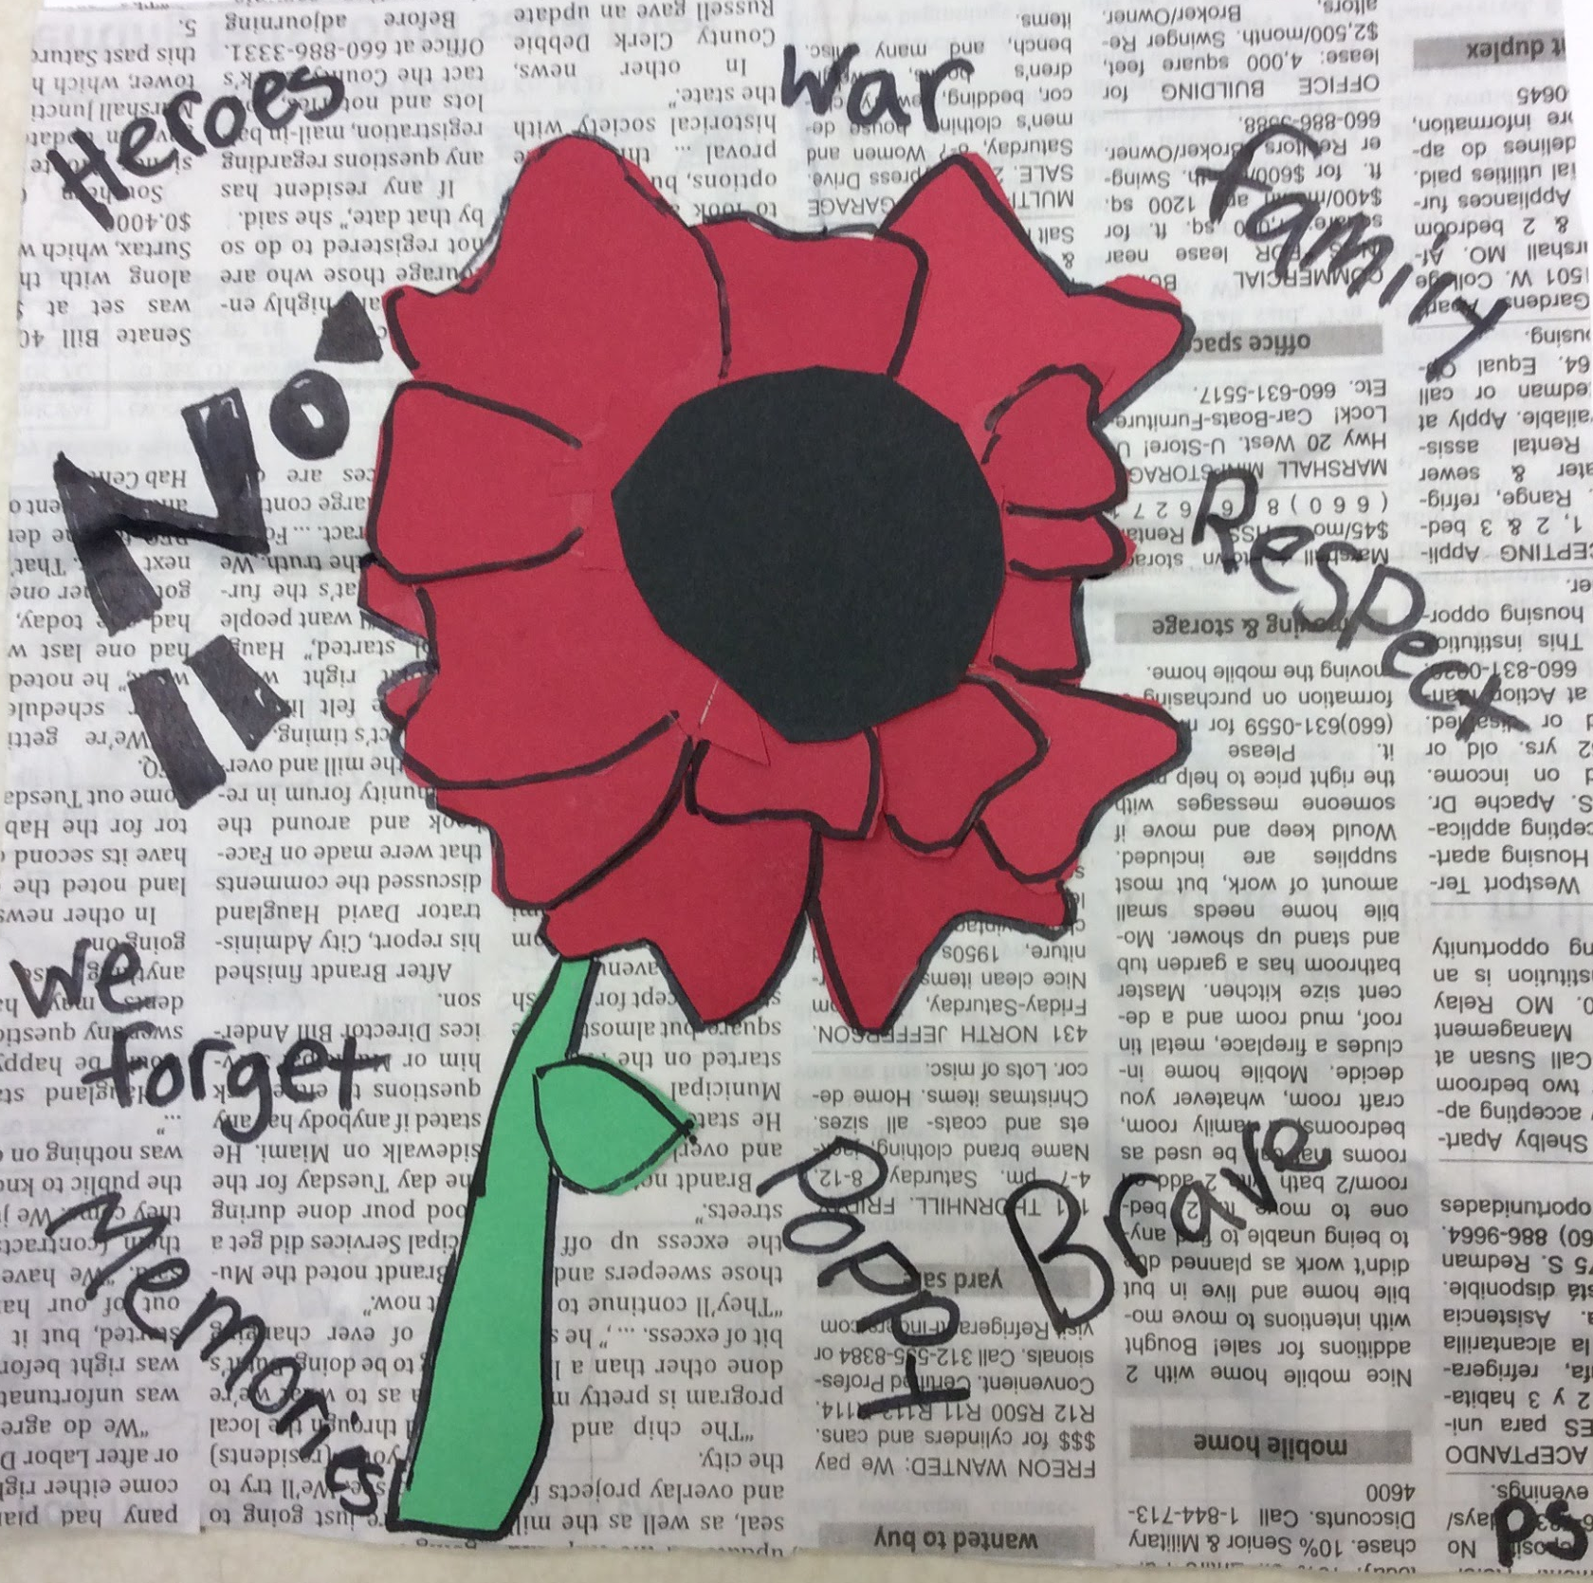
Priyalyn Sammy, 4th Grade

Slide 21
Mexico High School
Mexico Public Schools
Linda Malott
MAEA District #5

Slide 22
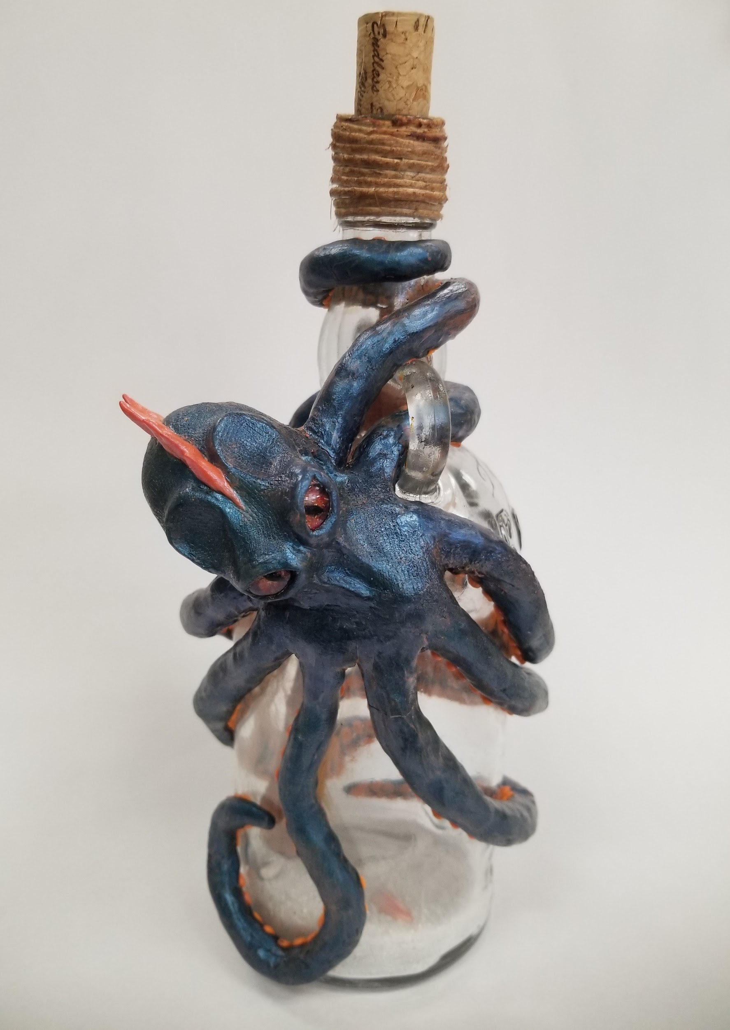
Rhiannon Hoyle, 11th grade

Slide 23
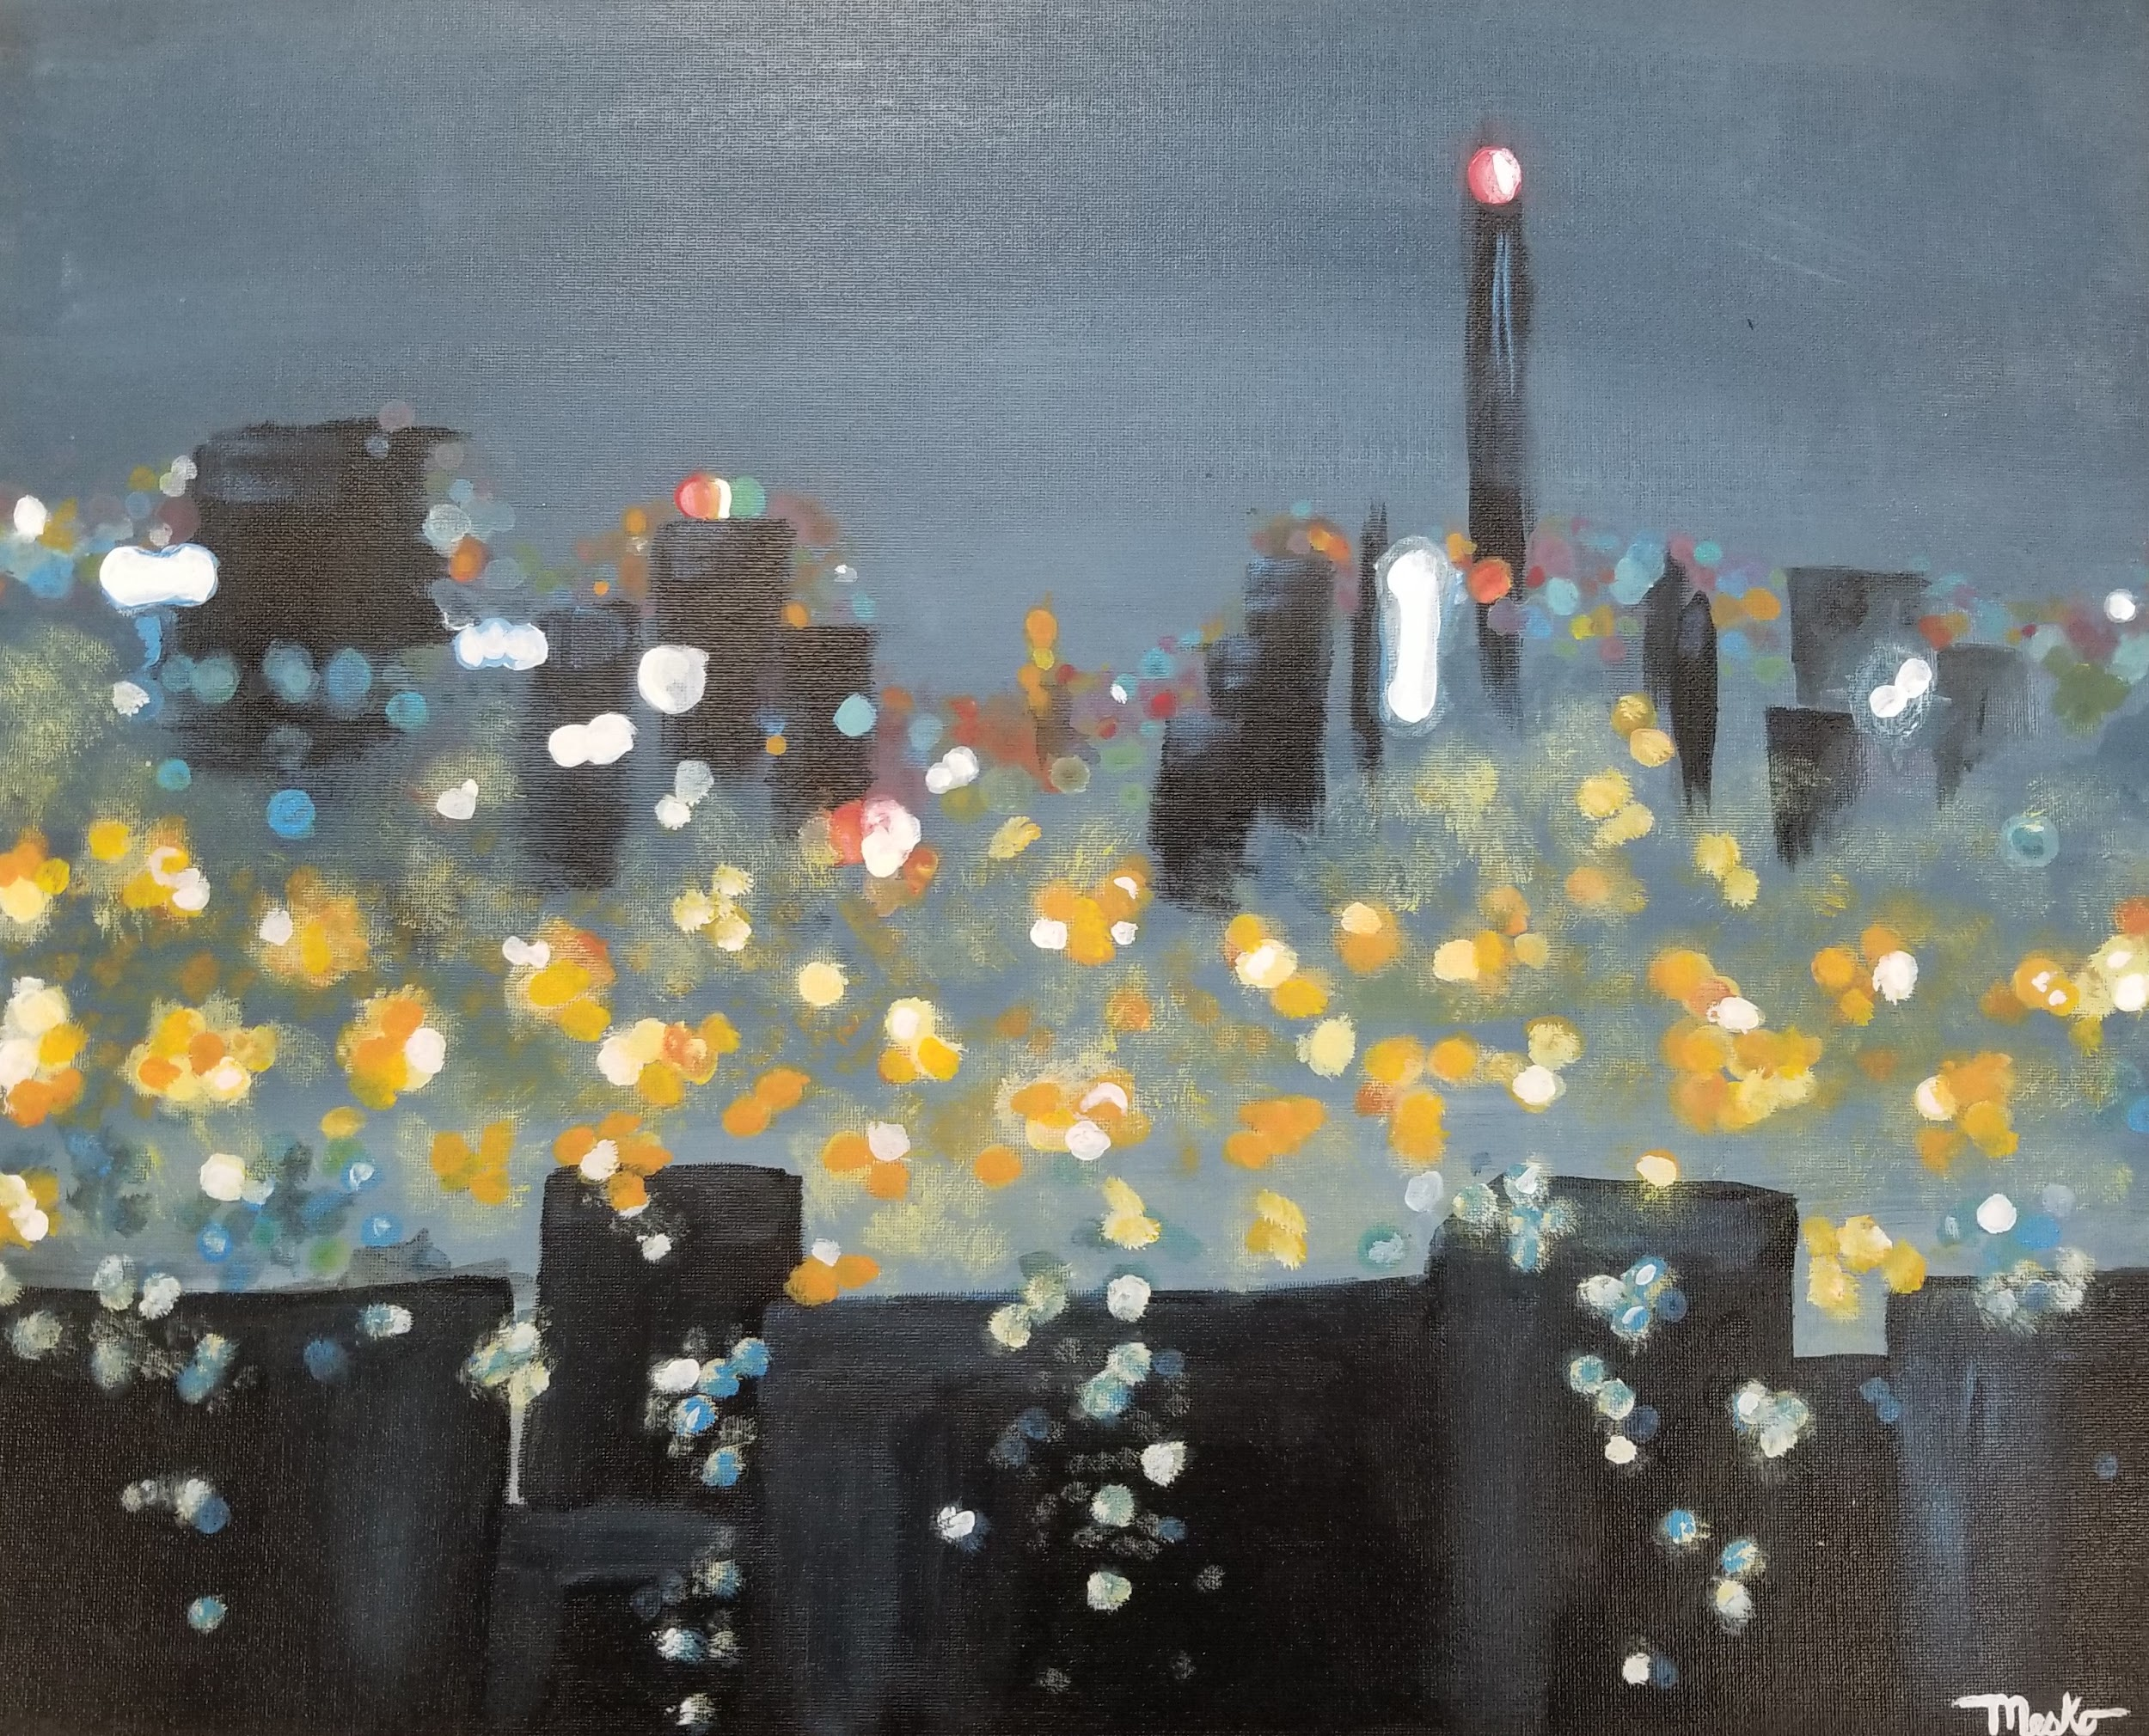
Halie Mesko, 11th grade

Slide 24
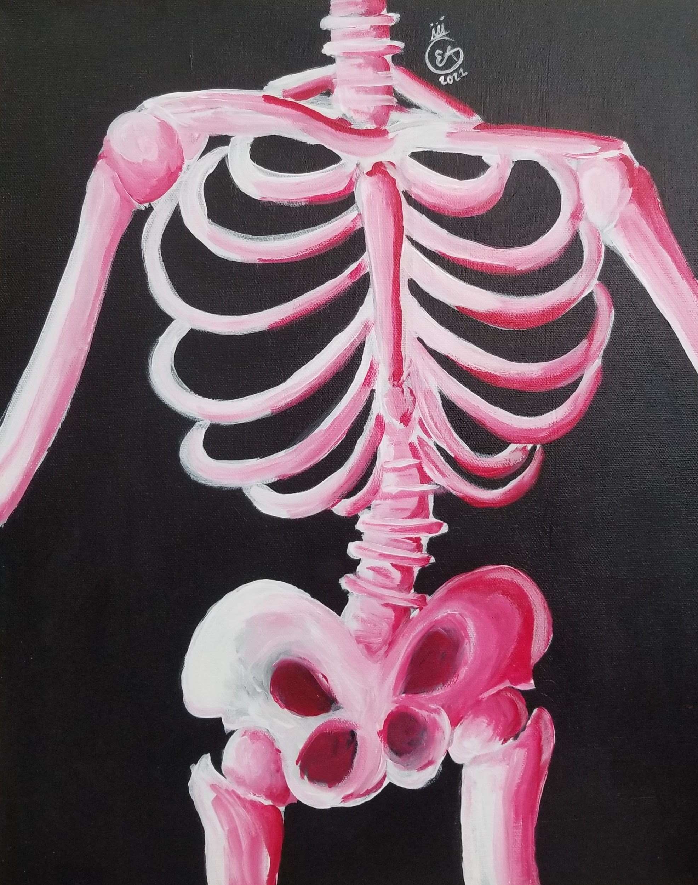
Emory Abbott, 10th grade

Slide 25
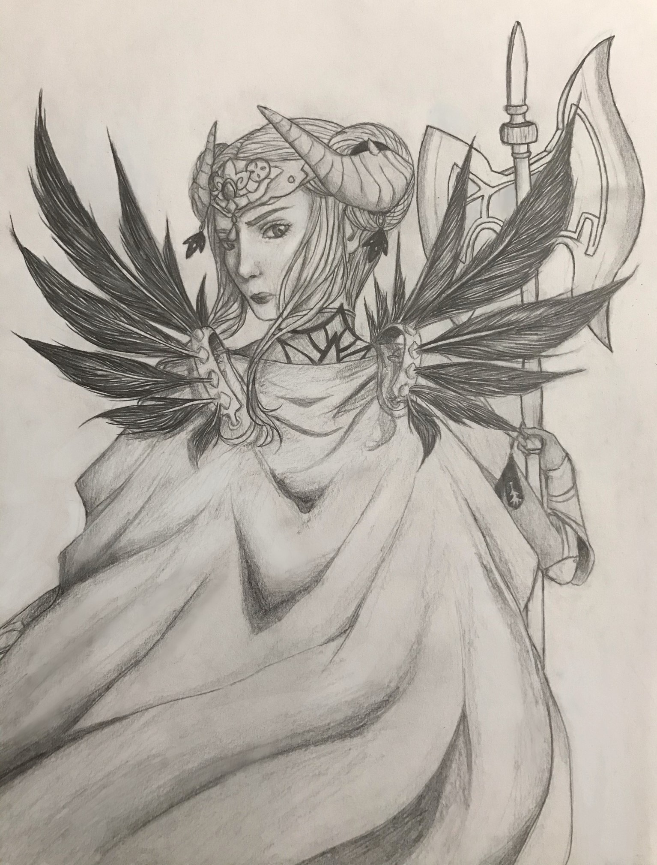
Josie Runyon, 12th Grade

Slide 26
Troy Buchanan High School
Lincoln County RIII
Rosemary Ziegler
MAEA District #5

Slide 27
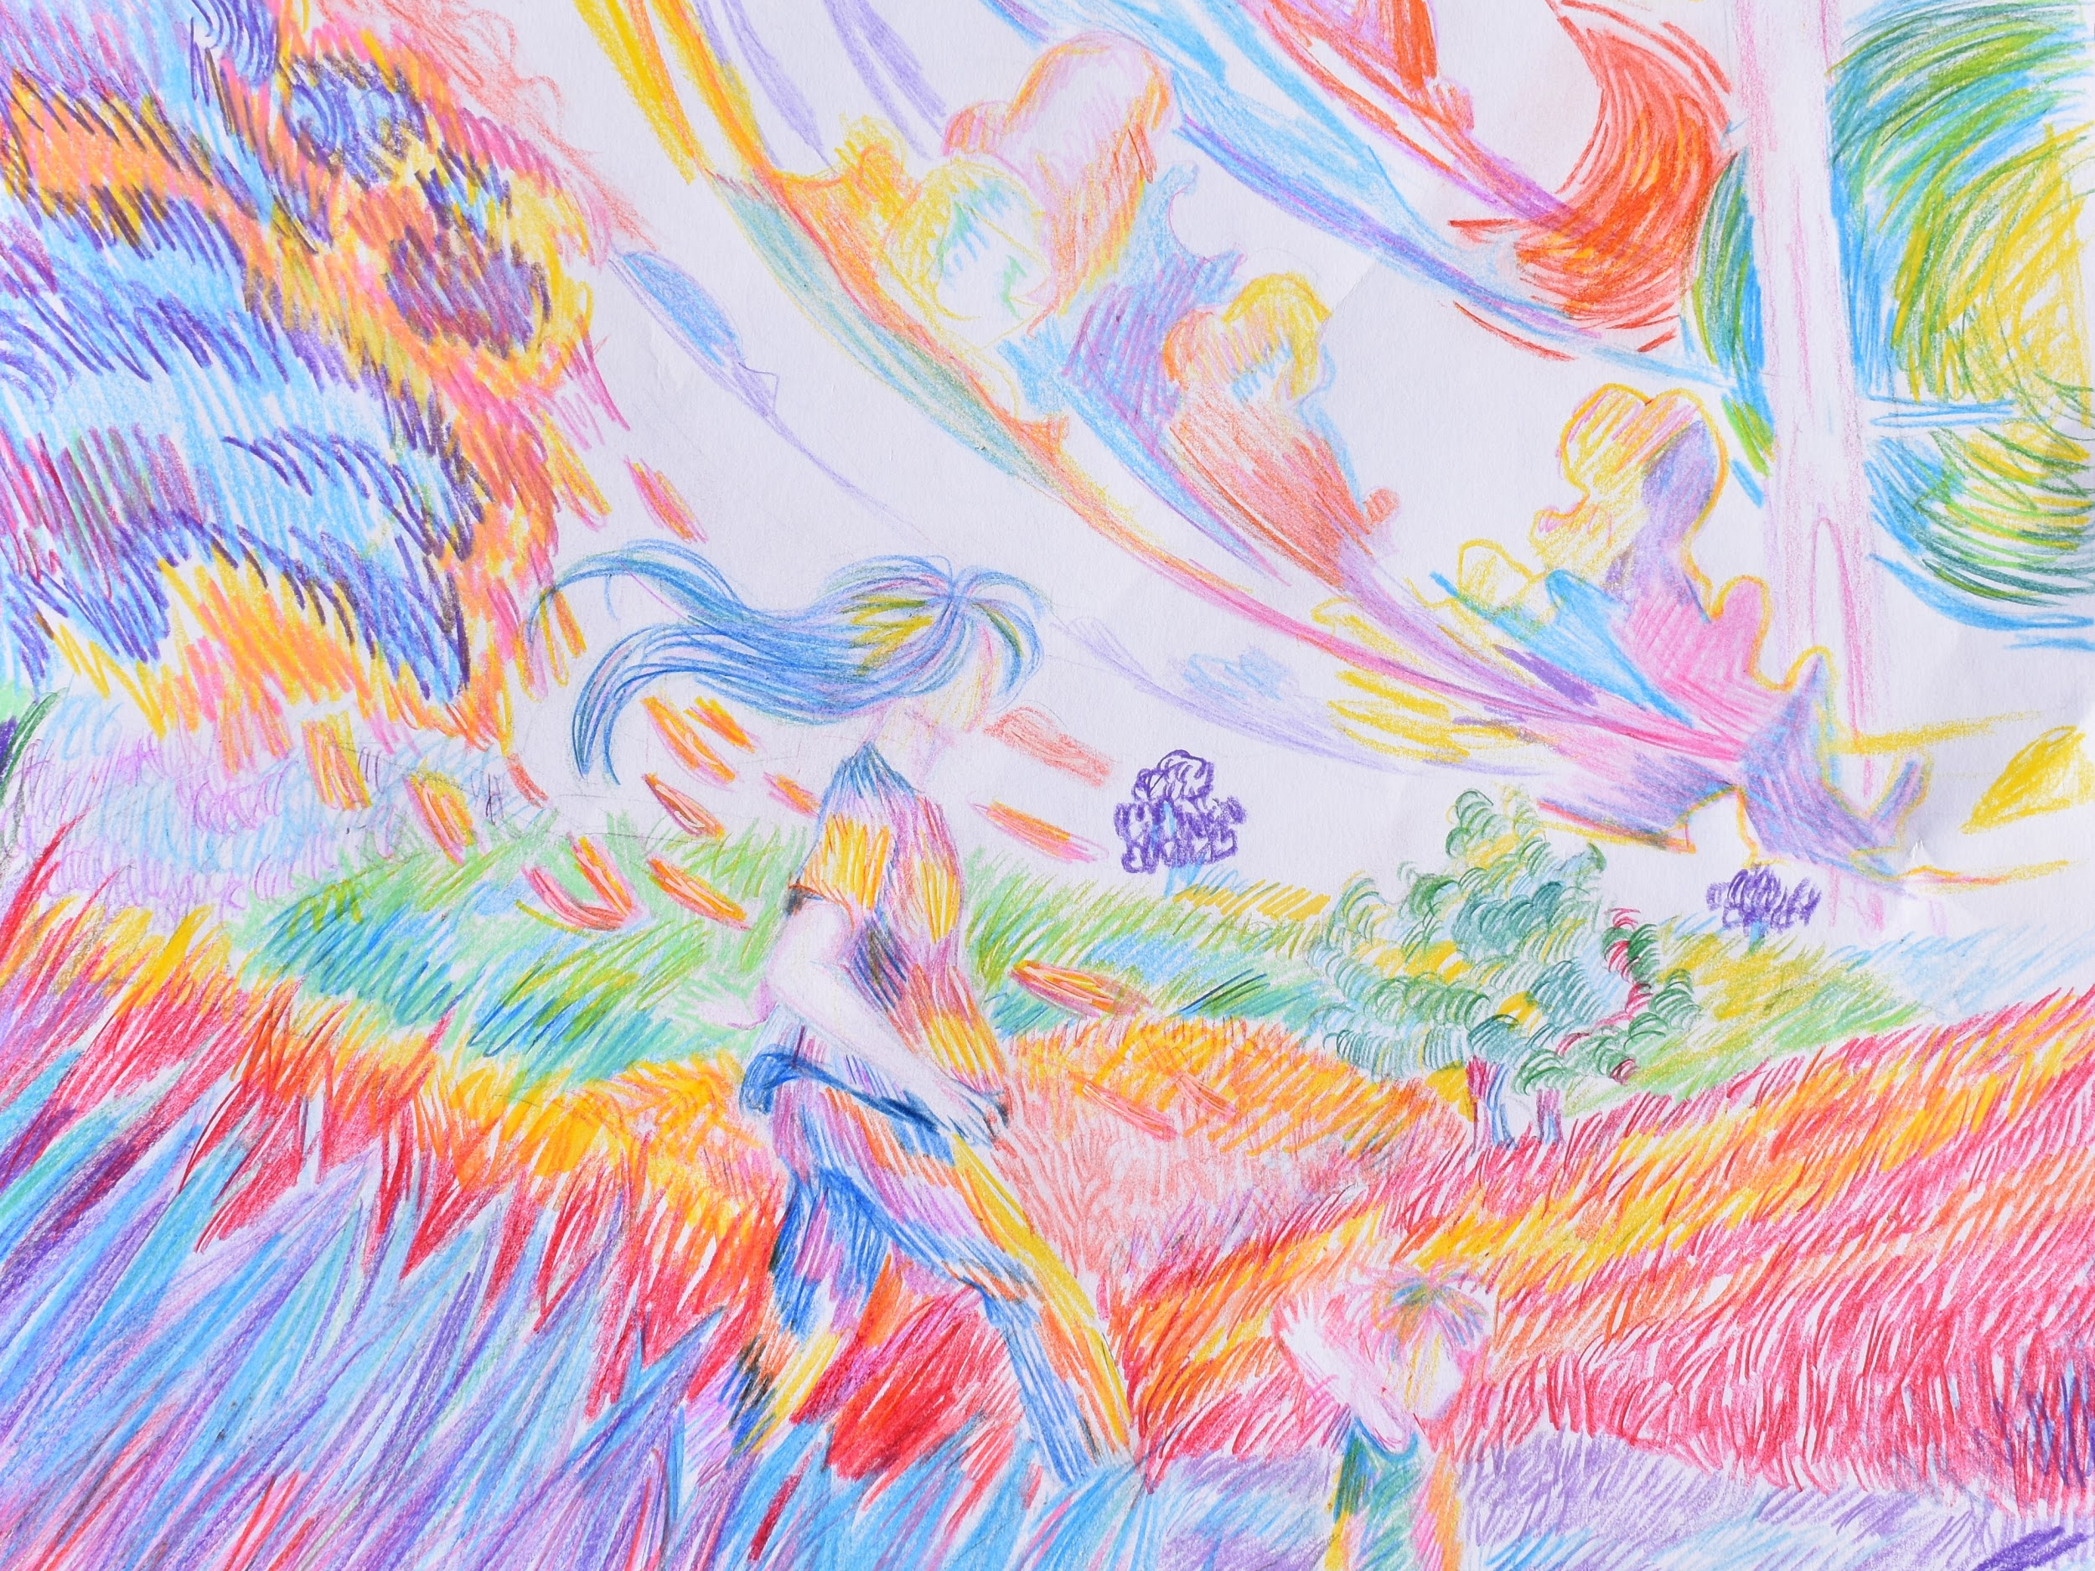
Elizabeth Channel, 12th Grade

Slide 28
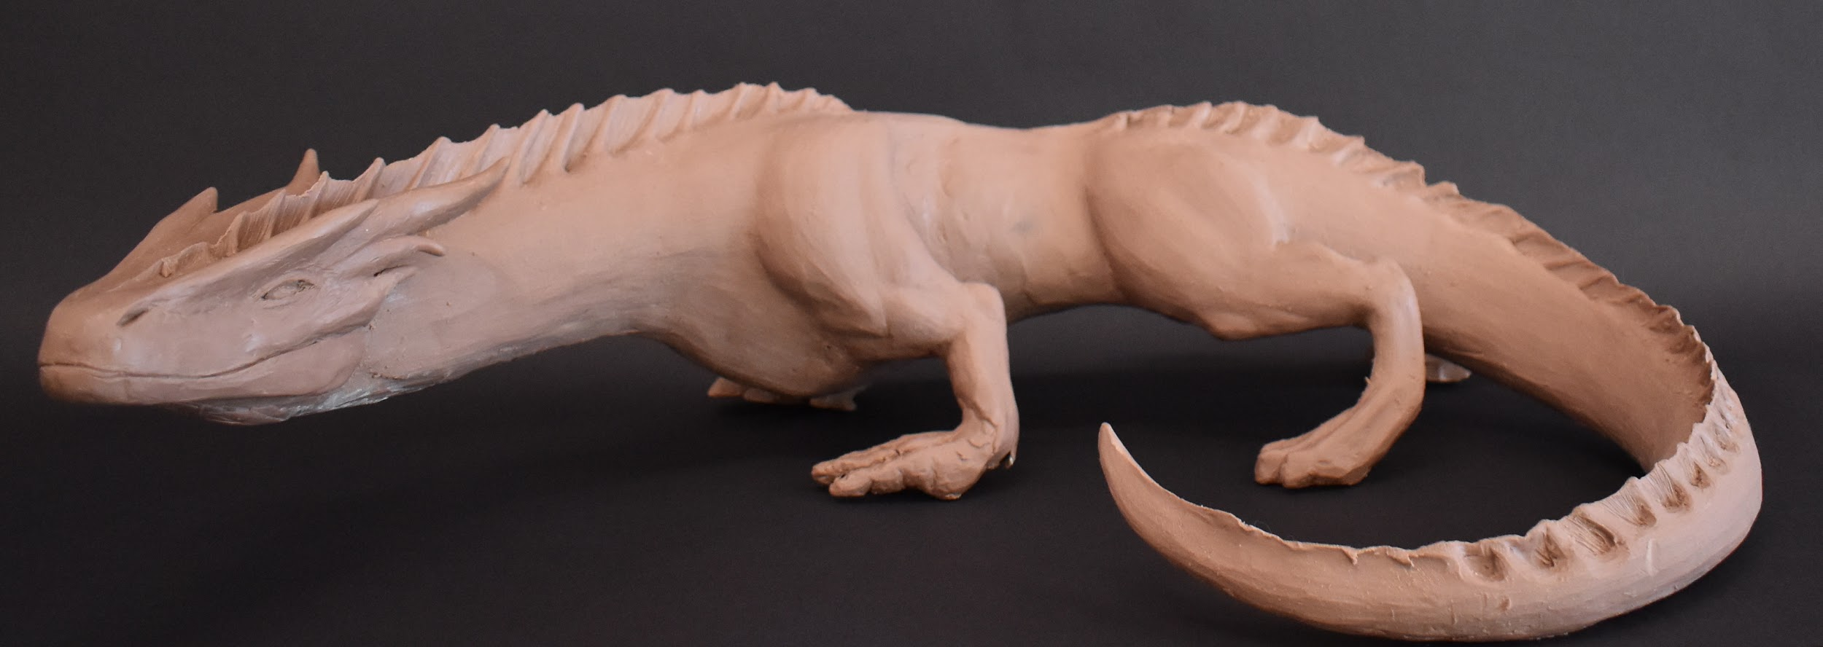
Morgan Ryan, 12th Grade

Slide 29
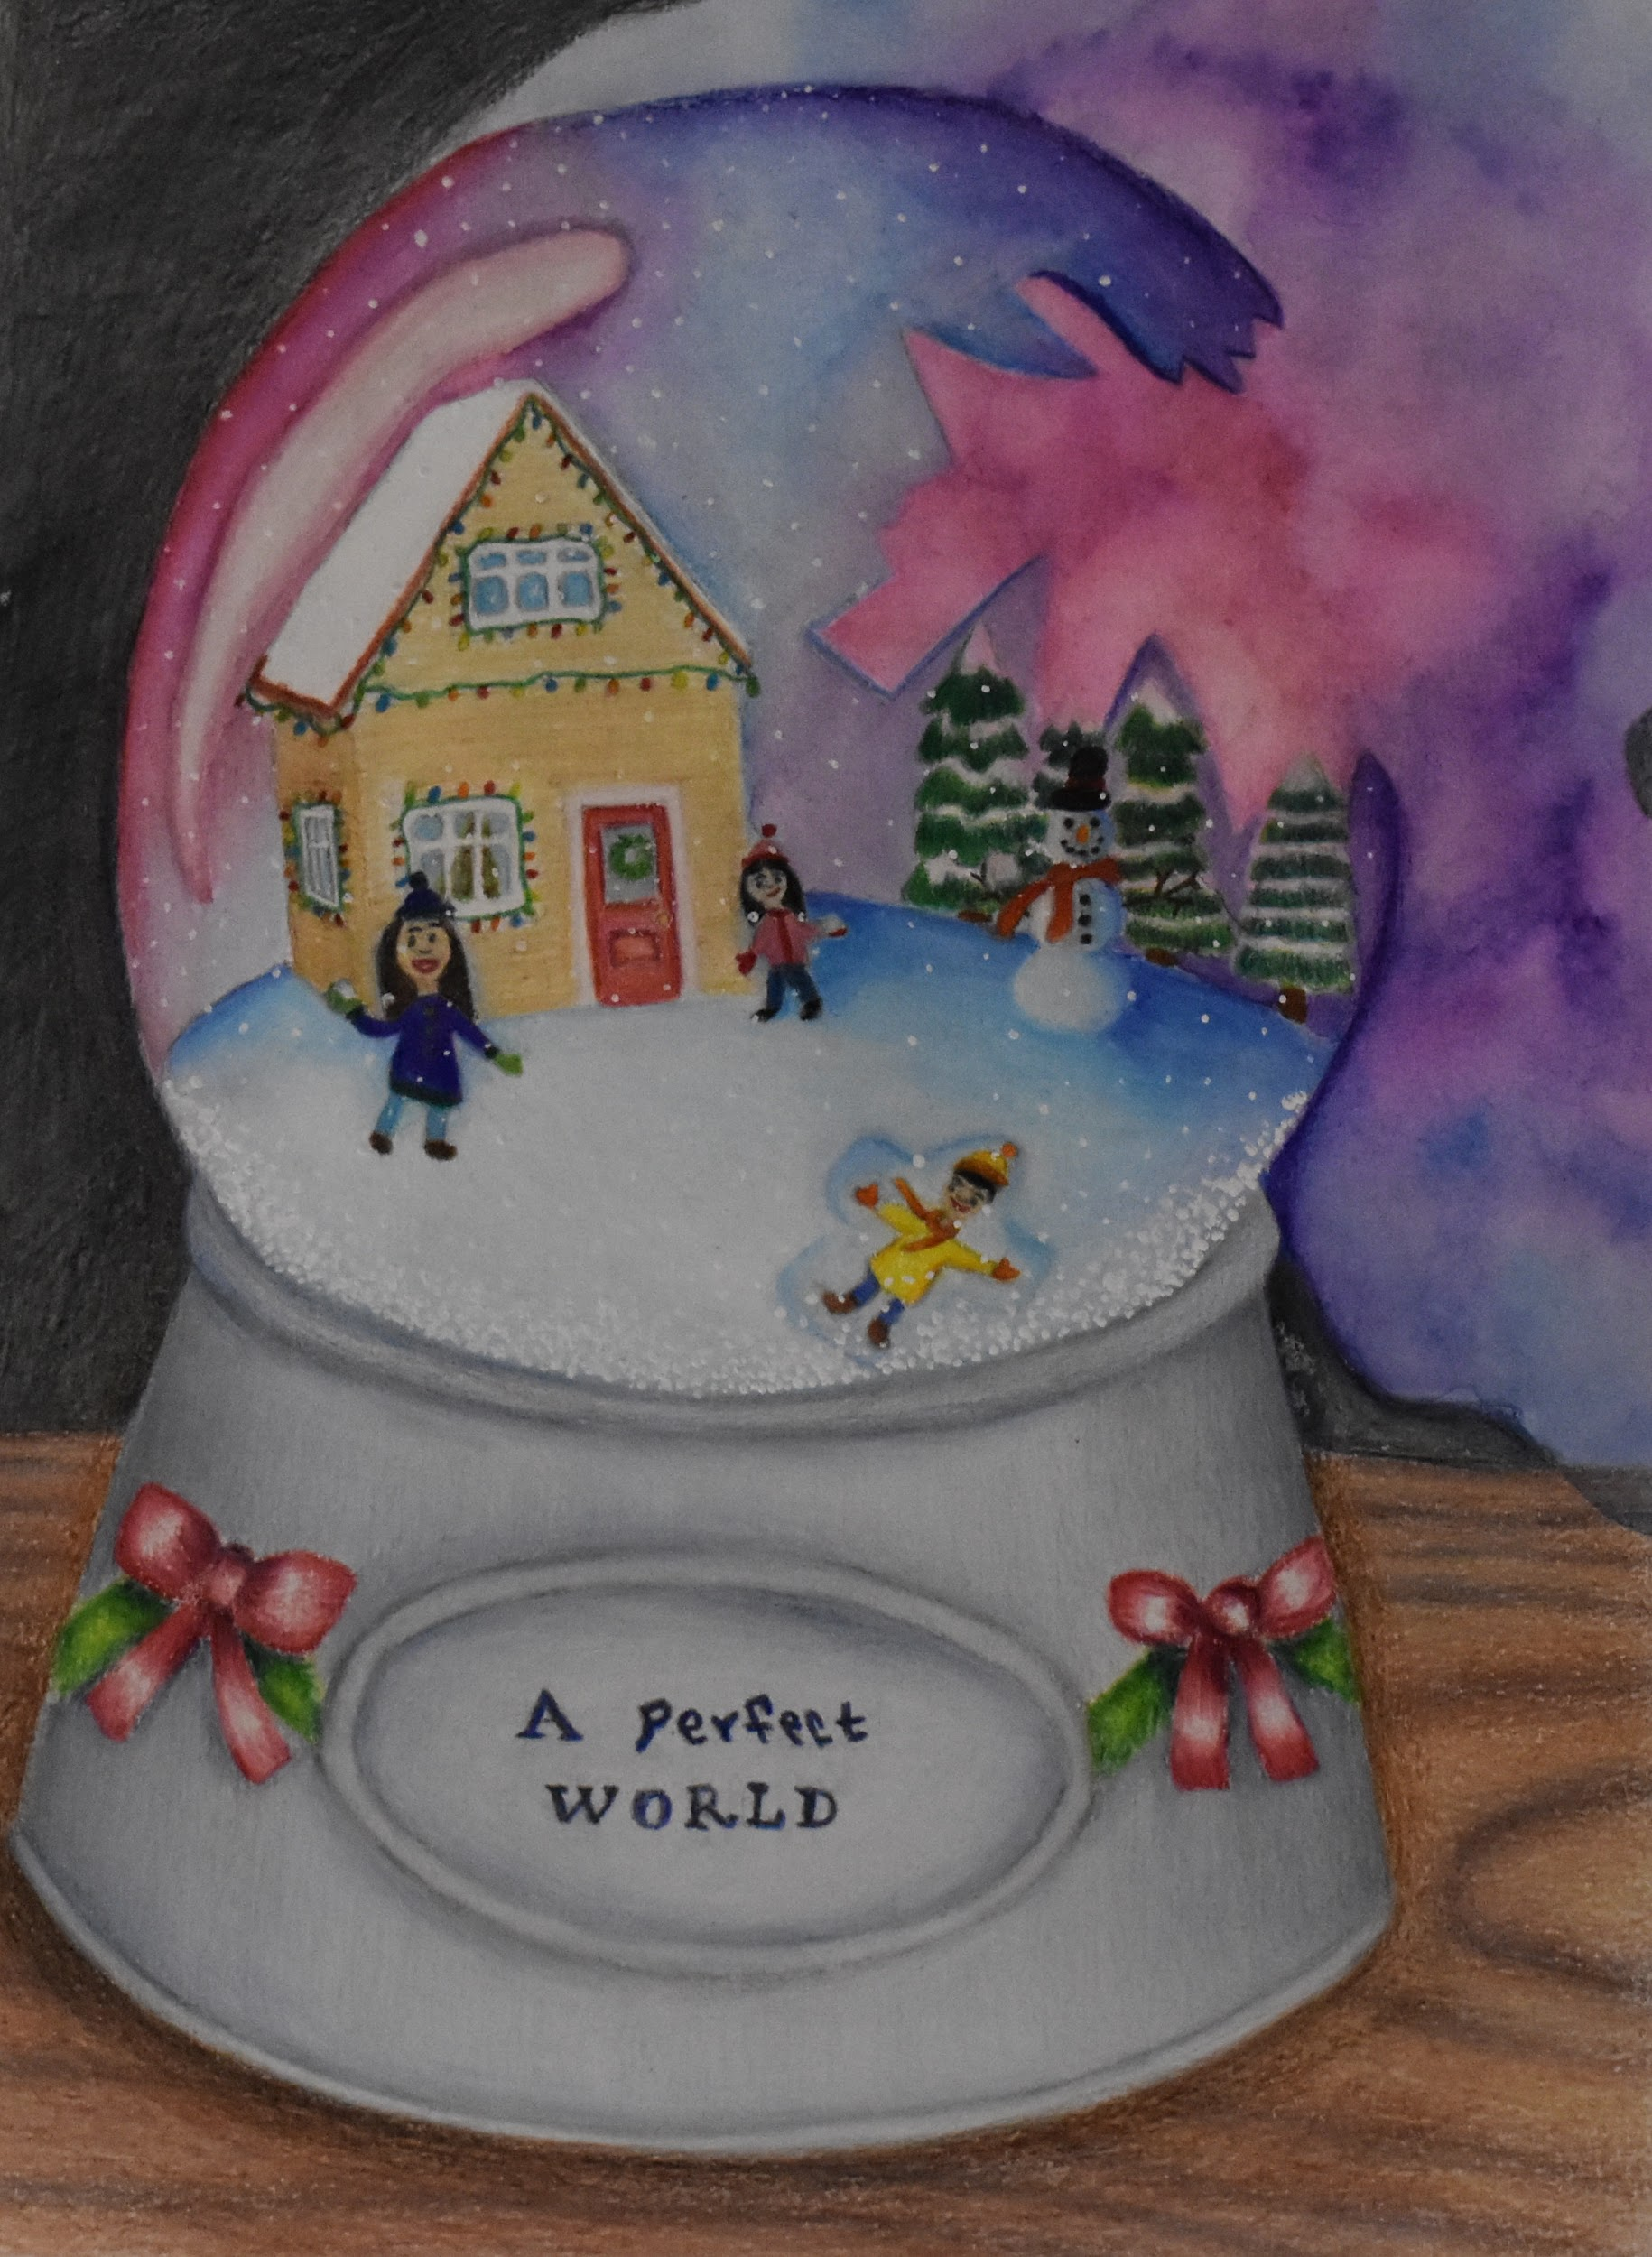
Daisy Ferguson, 12th Grade

Slide 30
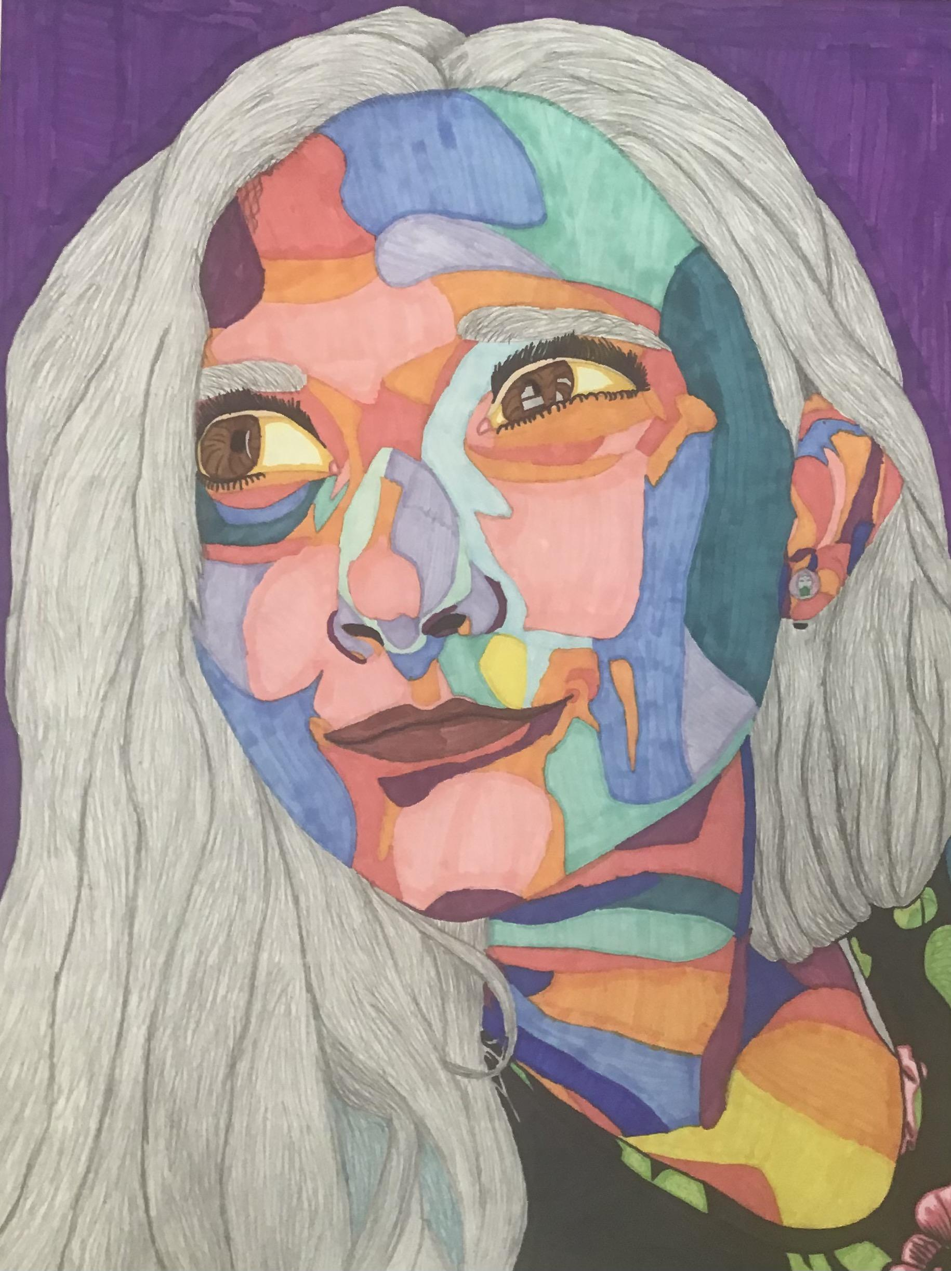
Mackinzie Huffman, 11th Grade

Slide 31
Gerald Elementary
Gasconade R-2 Schools
Jessie Bayless
MAEA District #6

Slide 32
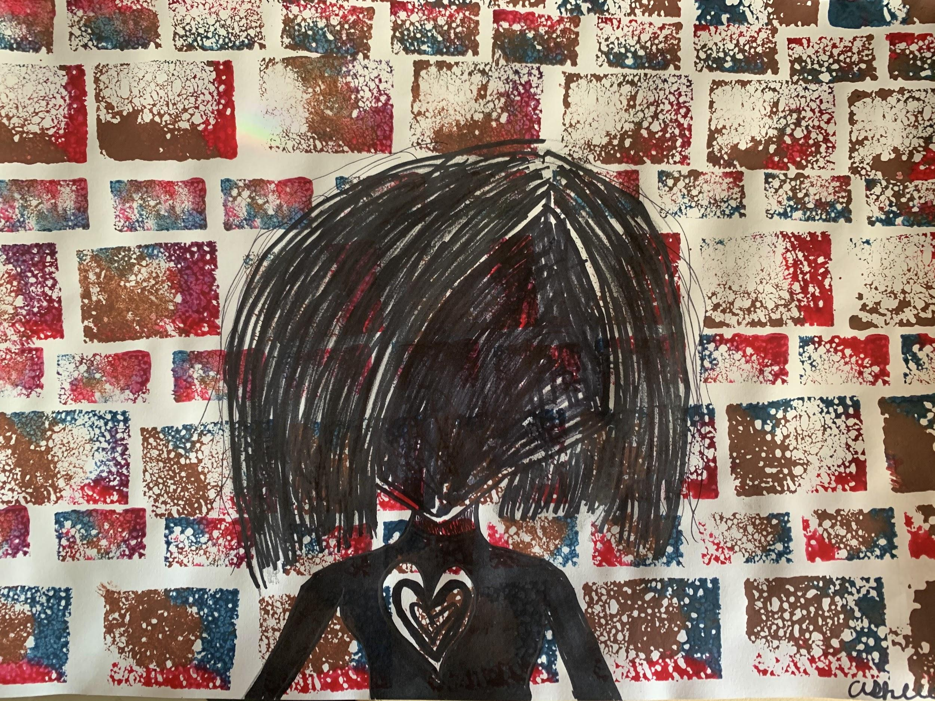

Ashlee Burkhart, 4th Grade
“Everyone Deserves Love”

Slide 33
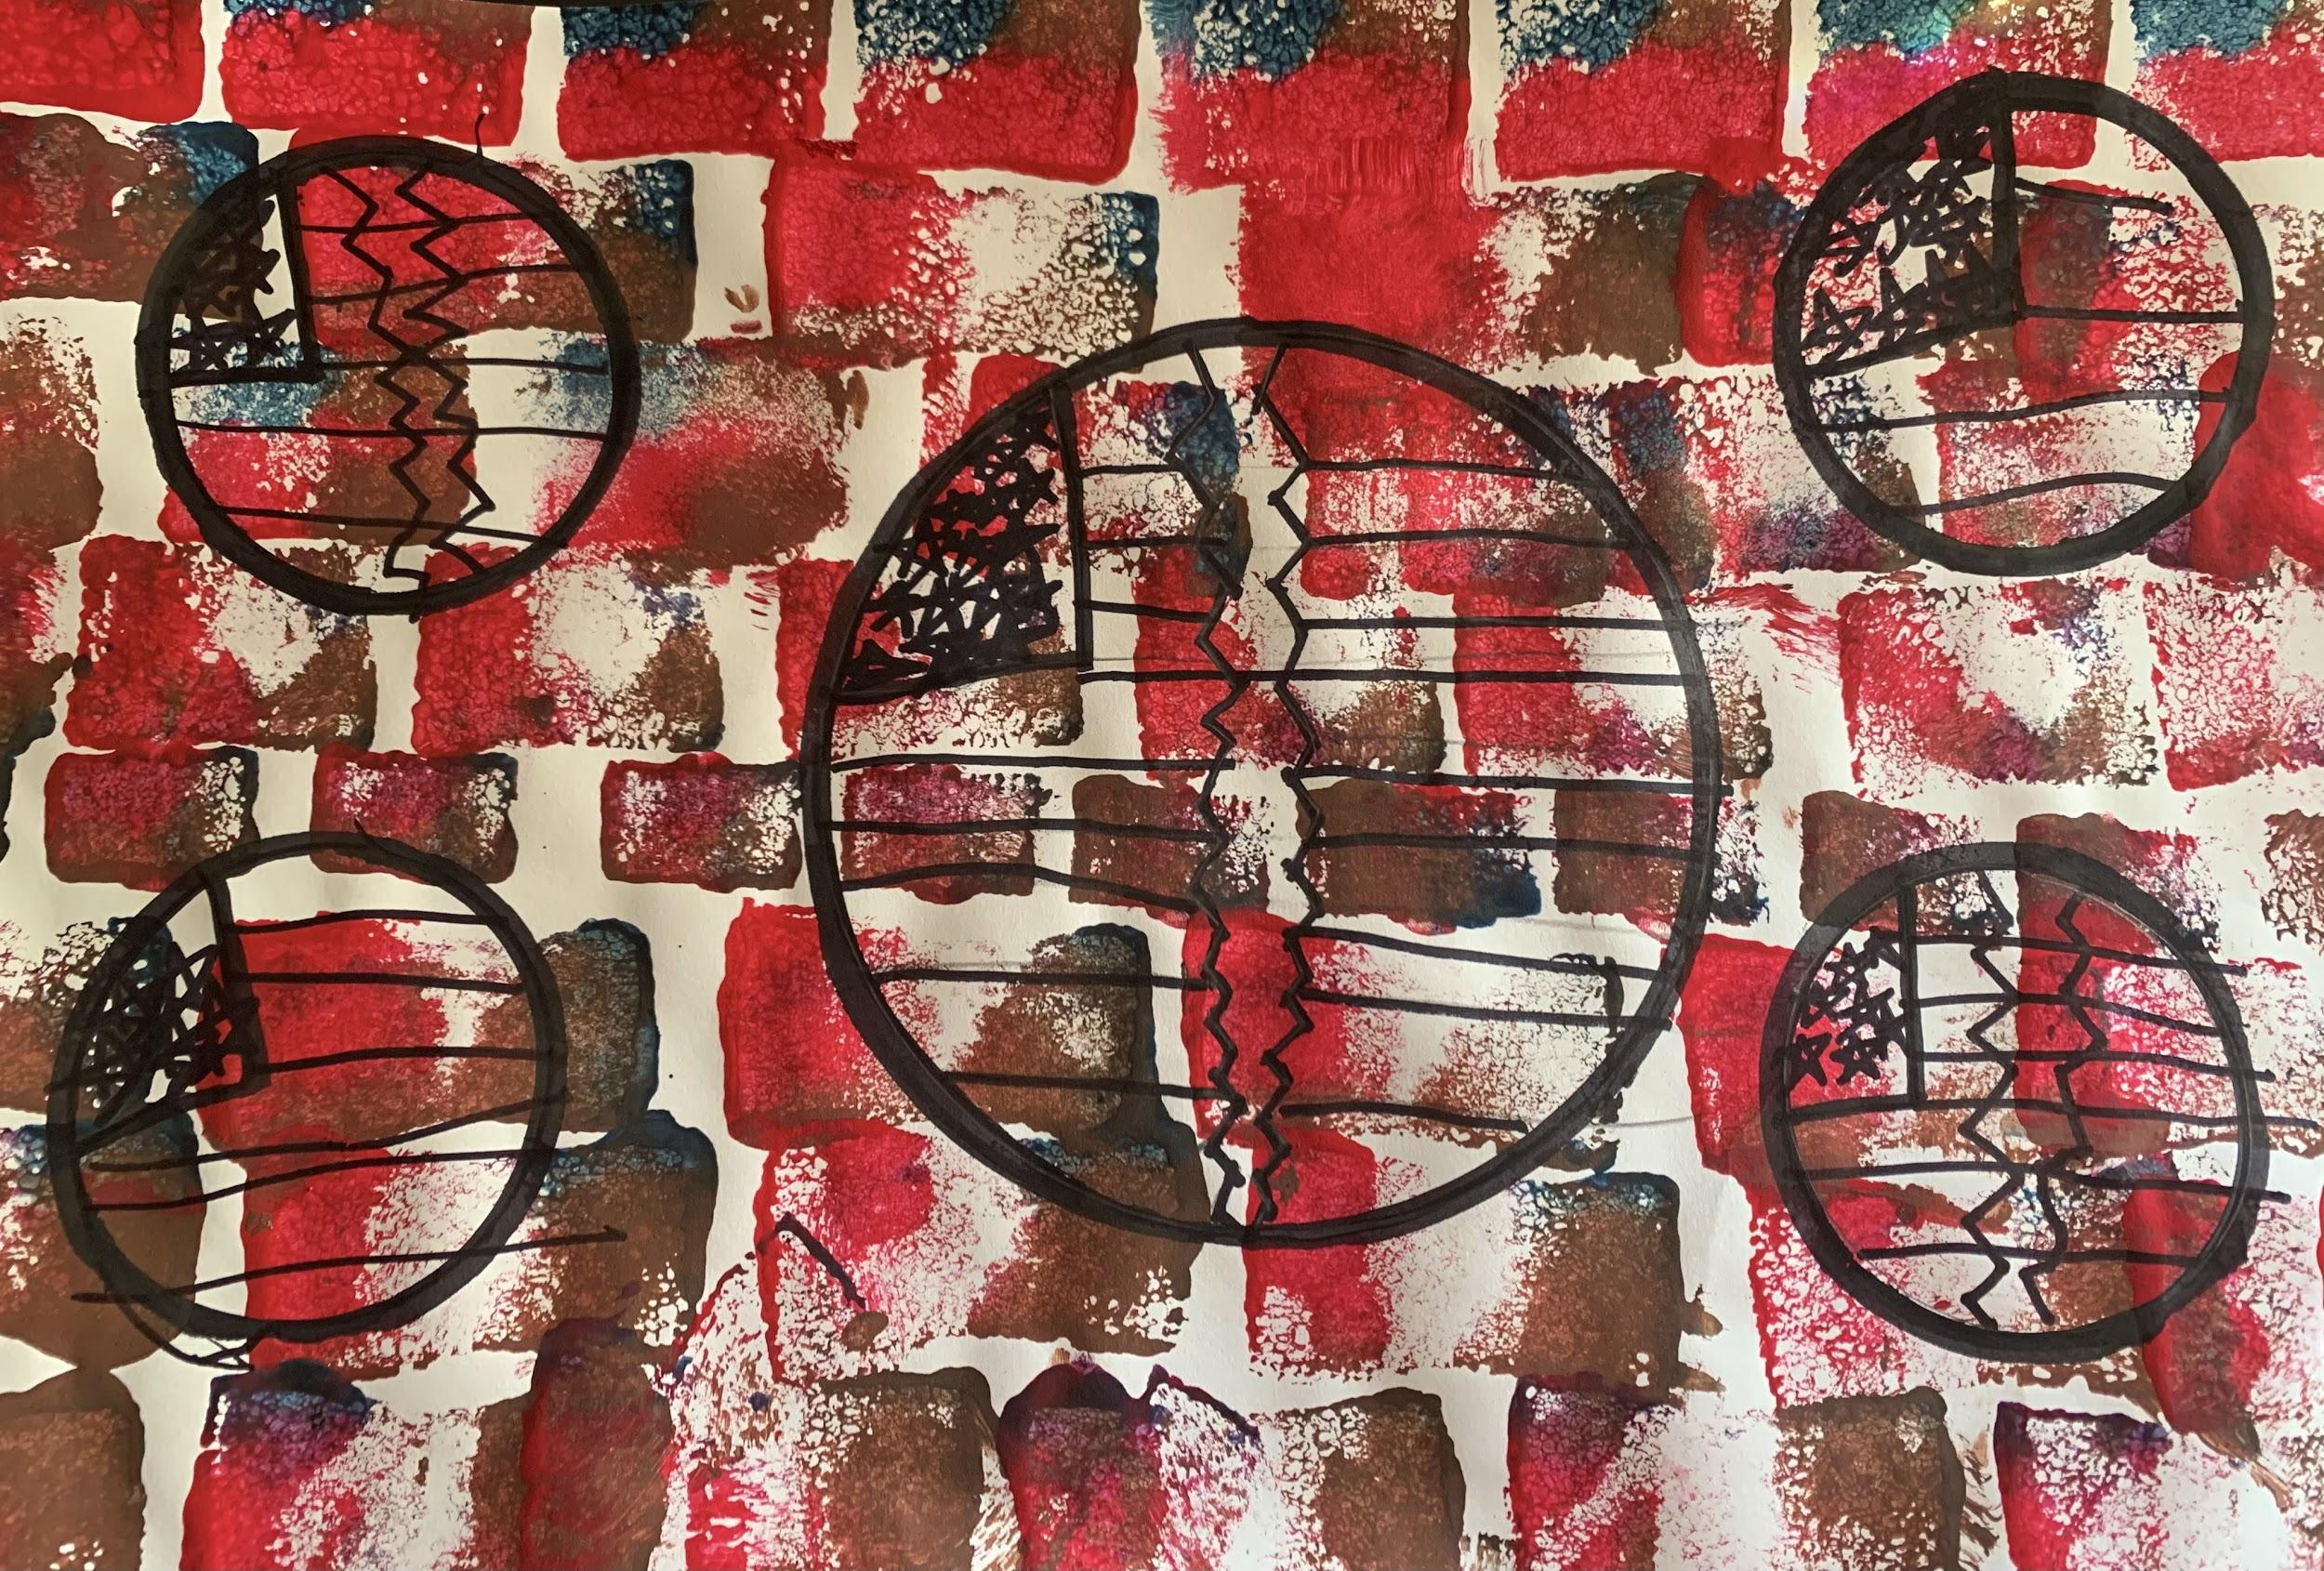
Masin Davis, 4th Grade
“Stop”

Slide 34
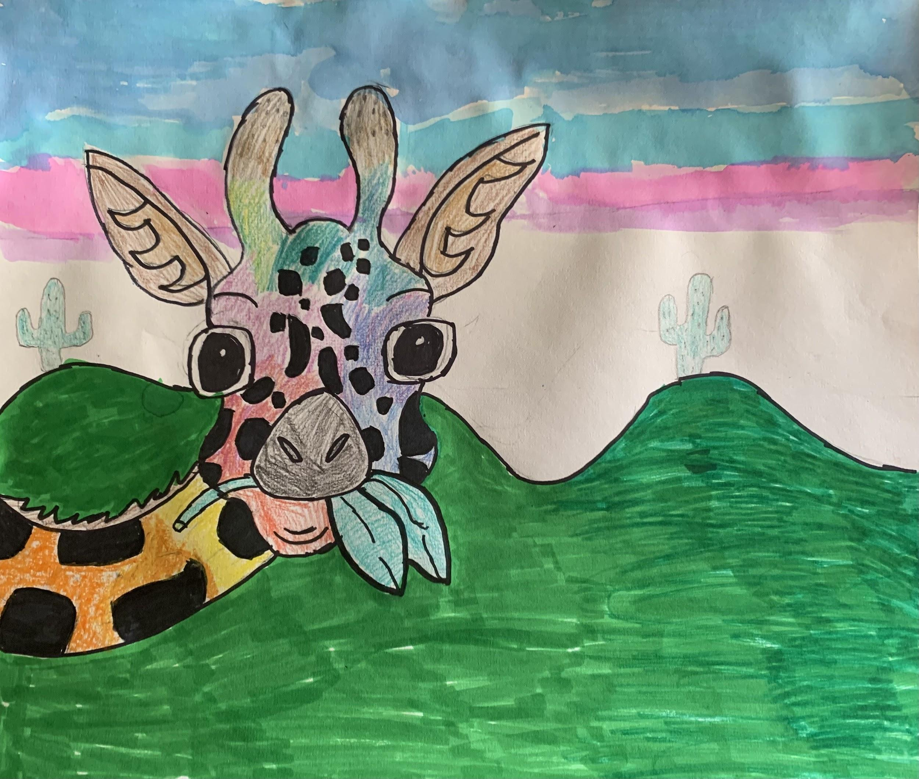
Ella Barker, 5th Grade

Slide 35
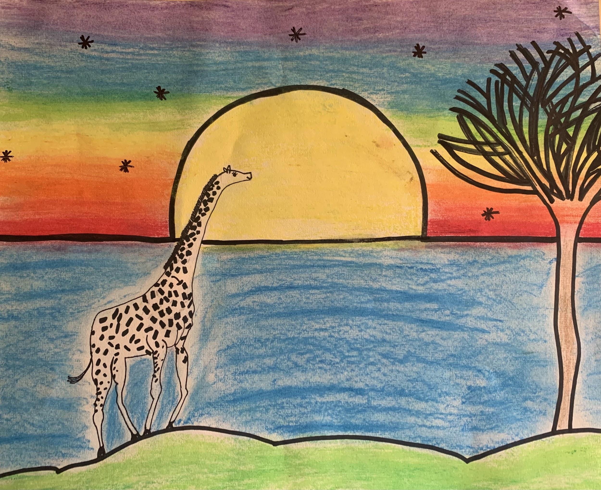
Haley Boland, 5th Grade

Slide 36
Thomas Jefferson Middle School
Jefferson City School District
Lana Dawson
MAEA District #6

Slide 37

Evelyn Christian - 8th Grade

Slide 38

Callysta Shepard - 6th Grade

Slide 39
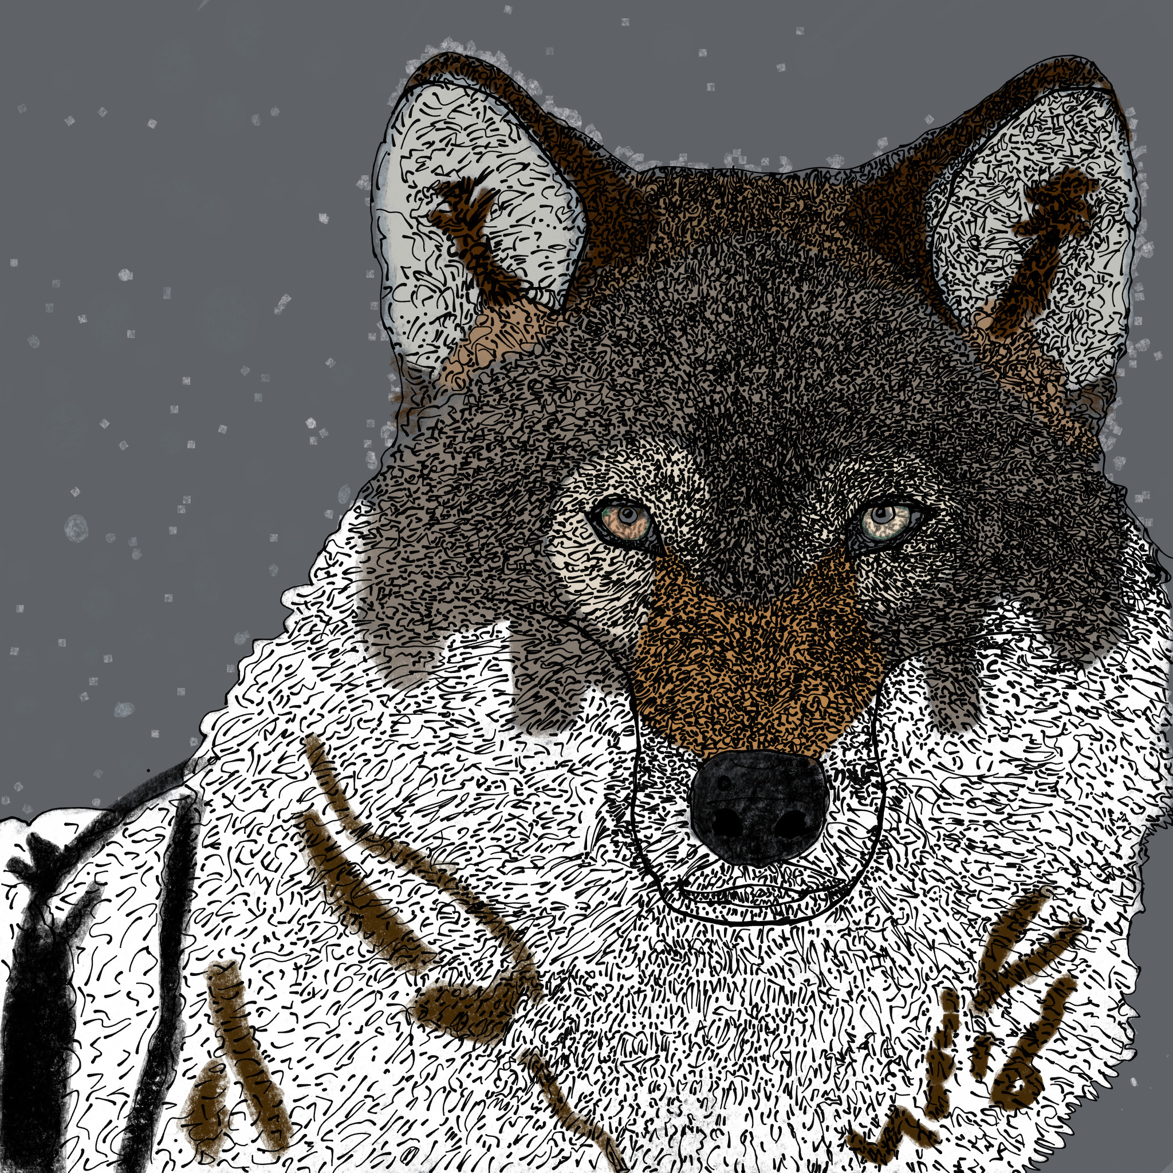
Vayda Peterson - 6th Grade

Slide 40
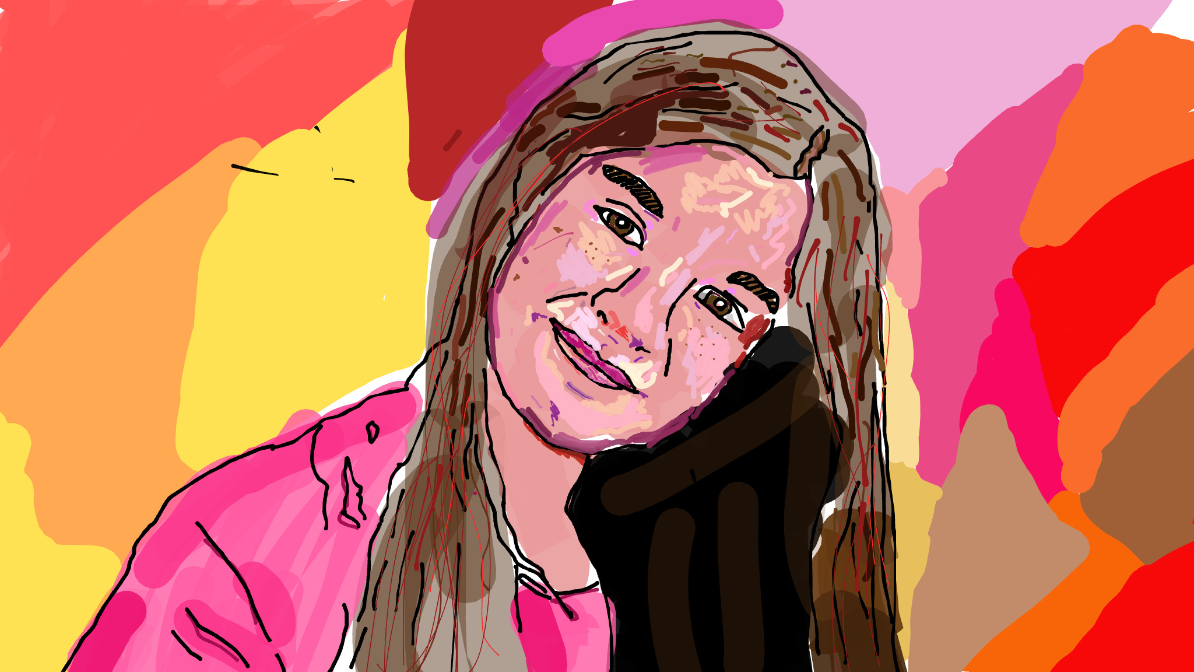
Abigail Rice - 6th Grade

Slide 41
Salem Middle and High School
Salem R-80 School District
Angela Dingess
MAEA District #6

Slide 42
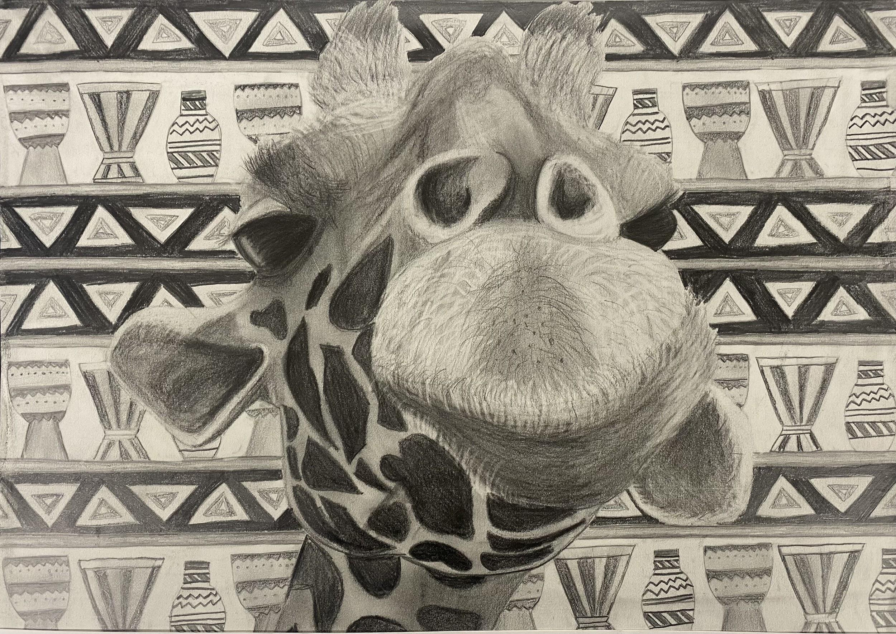
Katherine Jones, 10th Grade

Slide 43
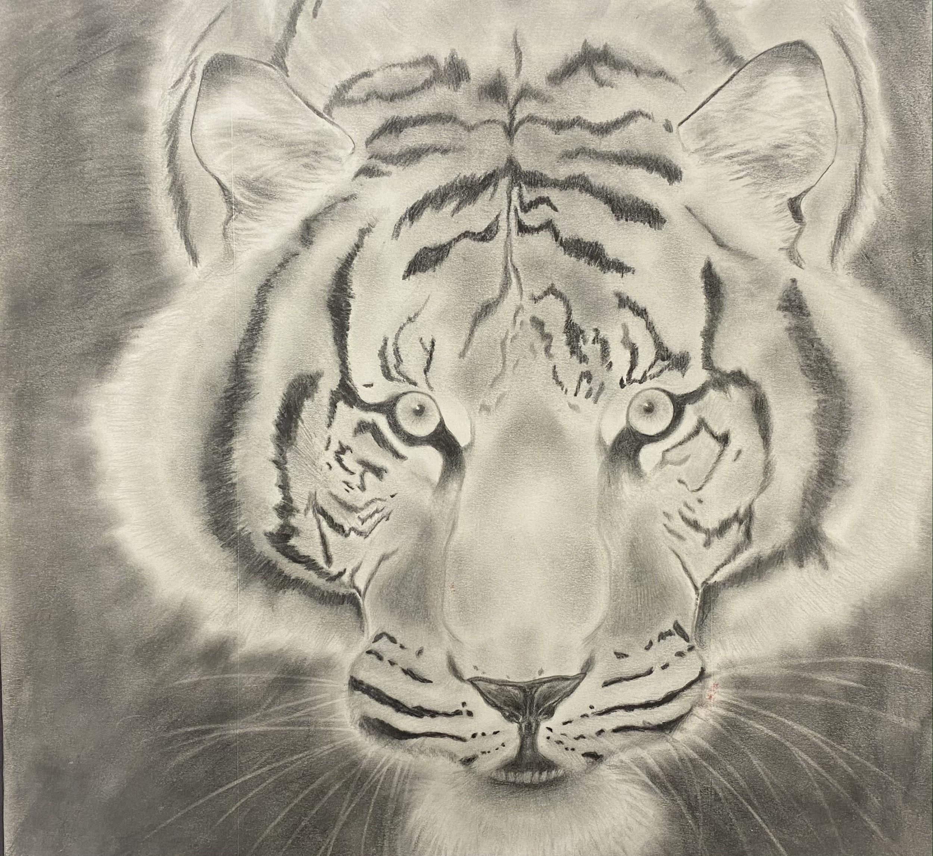
Ellavy Cooper, 10th Grade

Slide 44
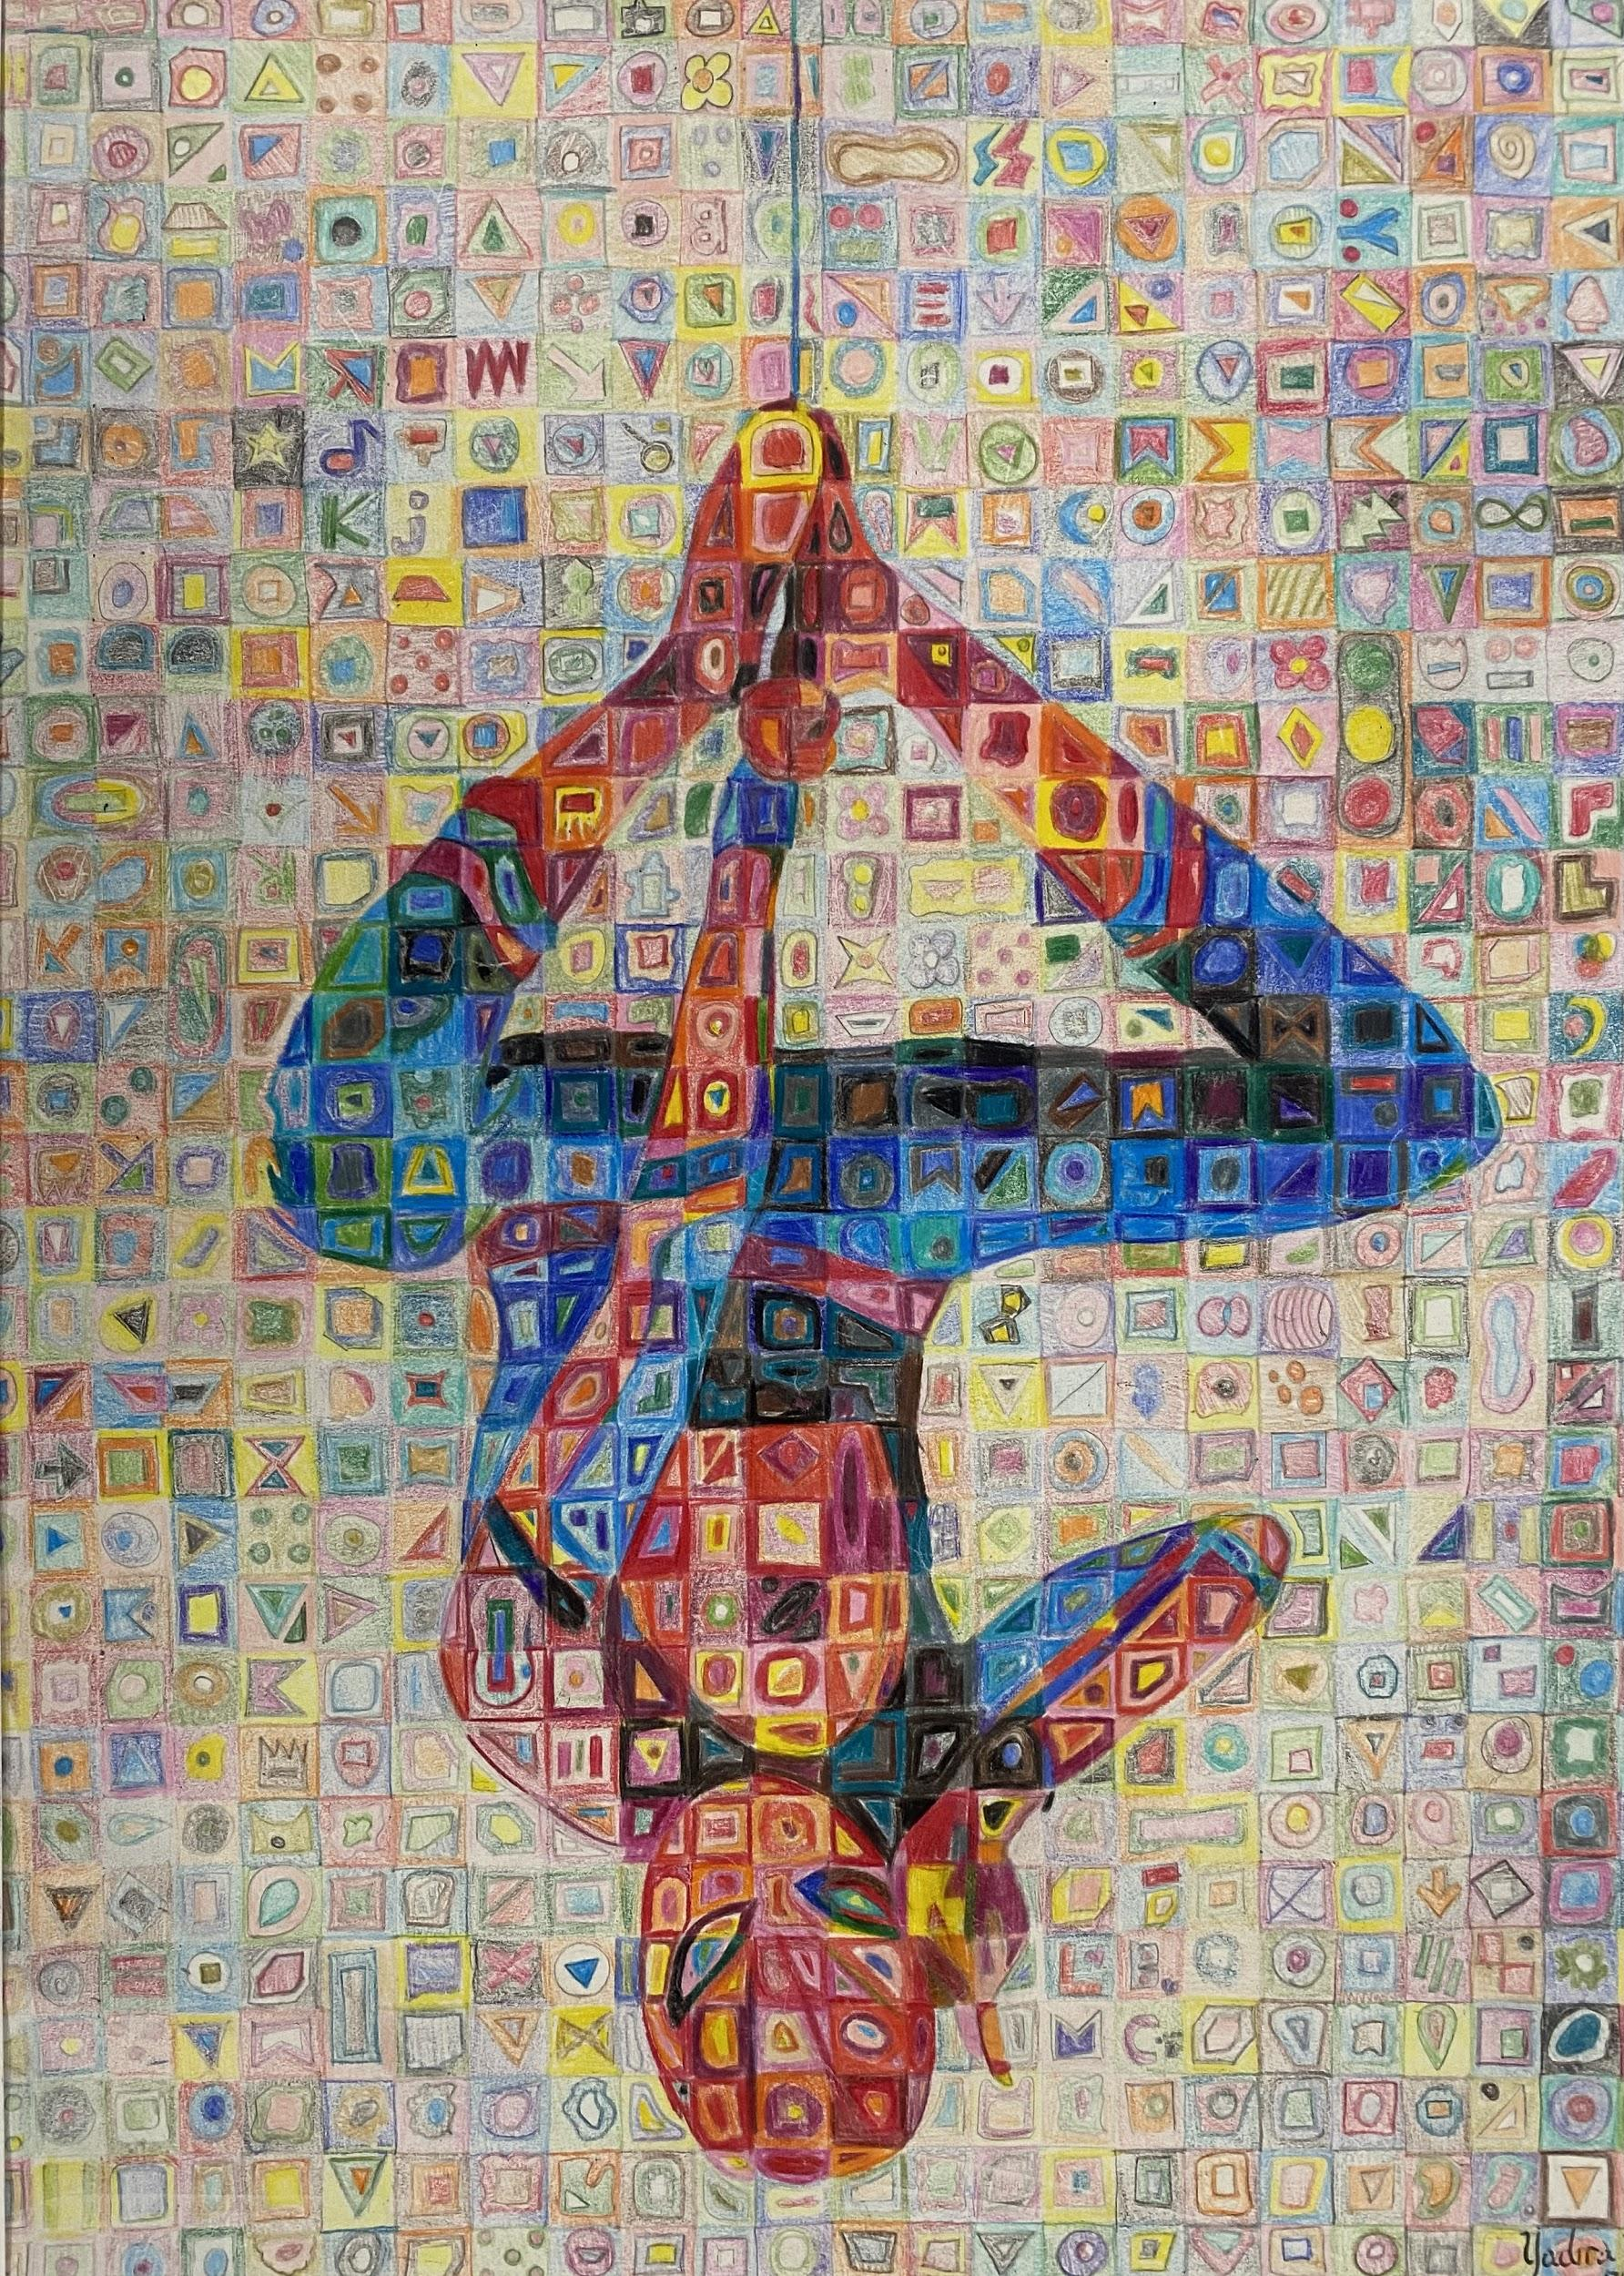
Yadira Blanco, 10th Grade

Slide 45
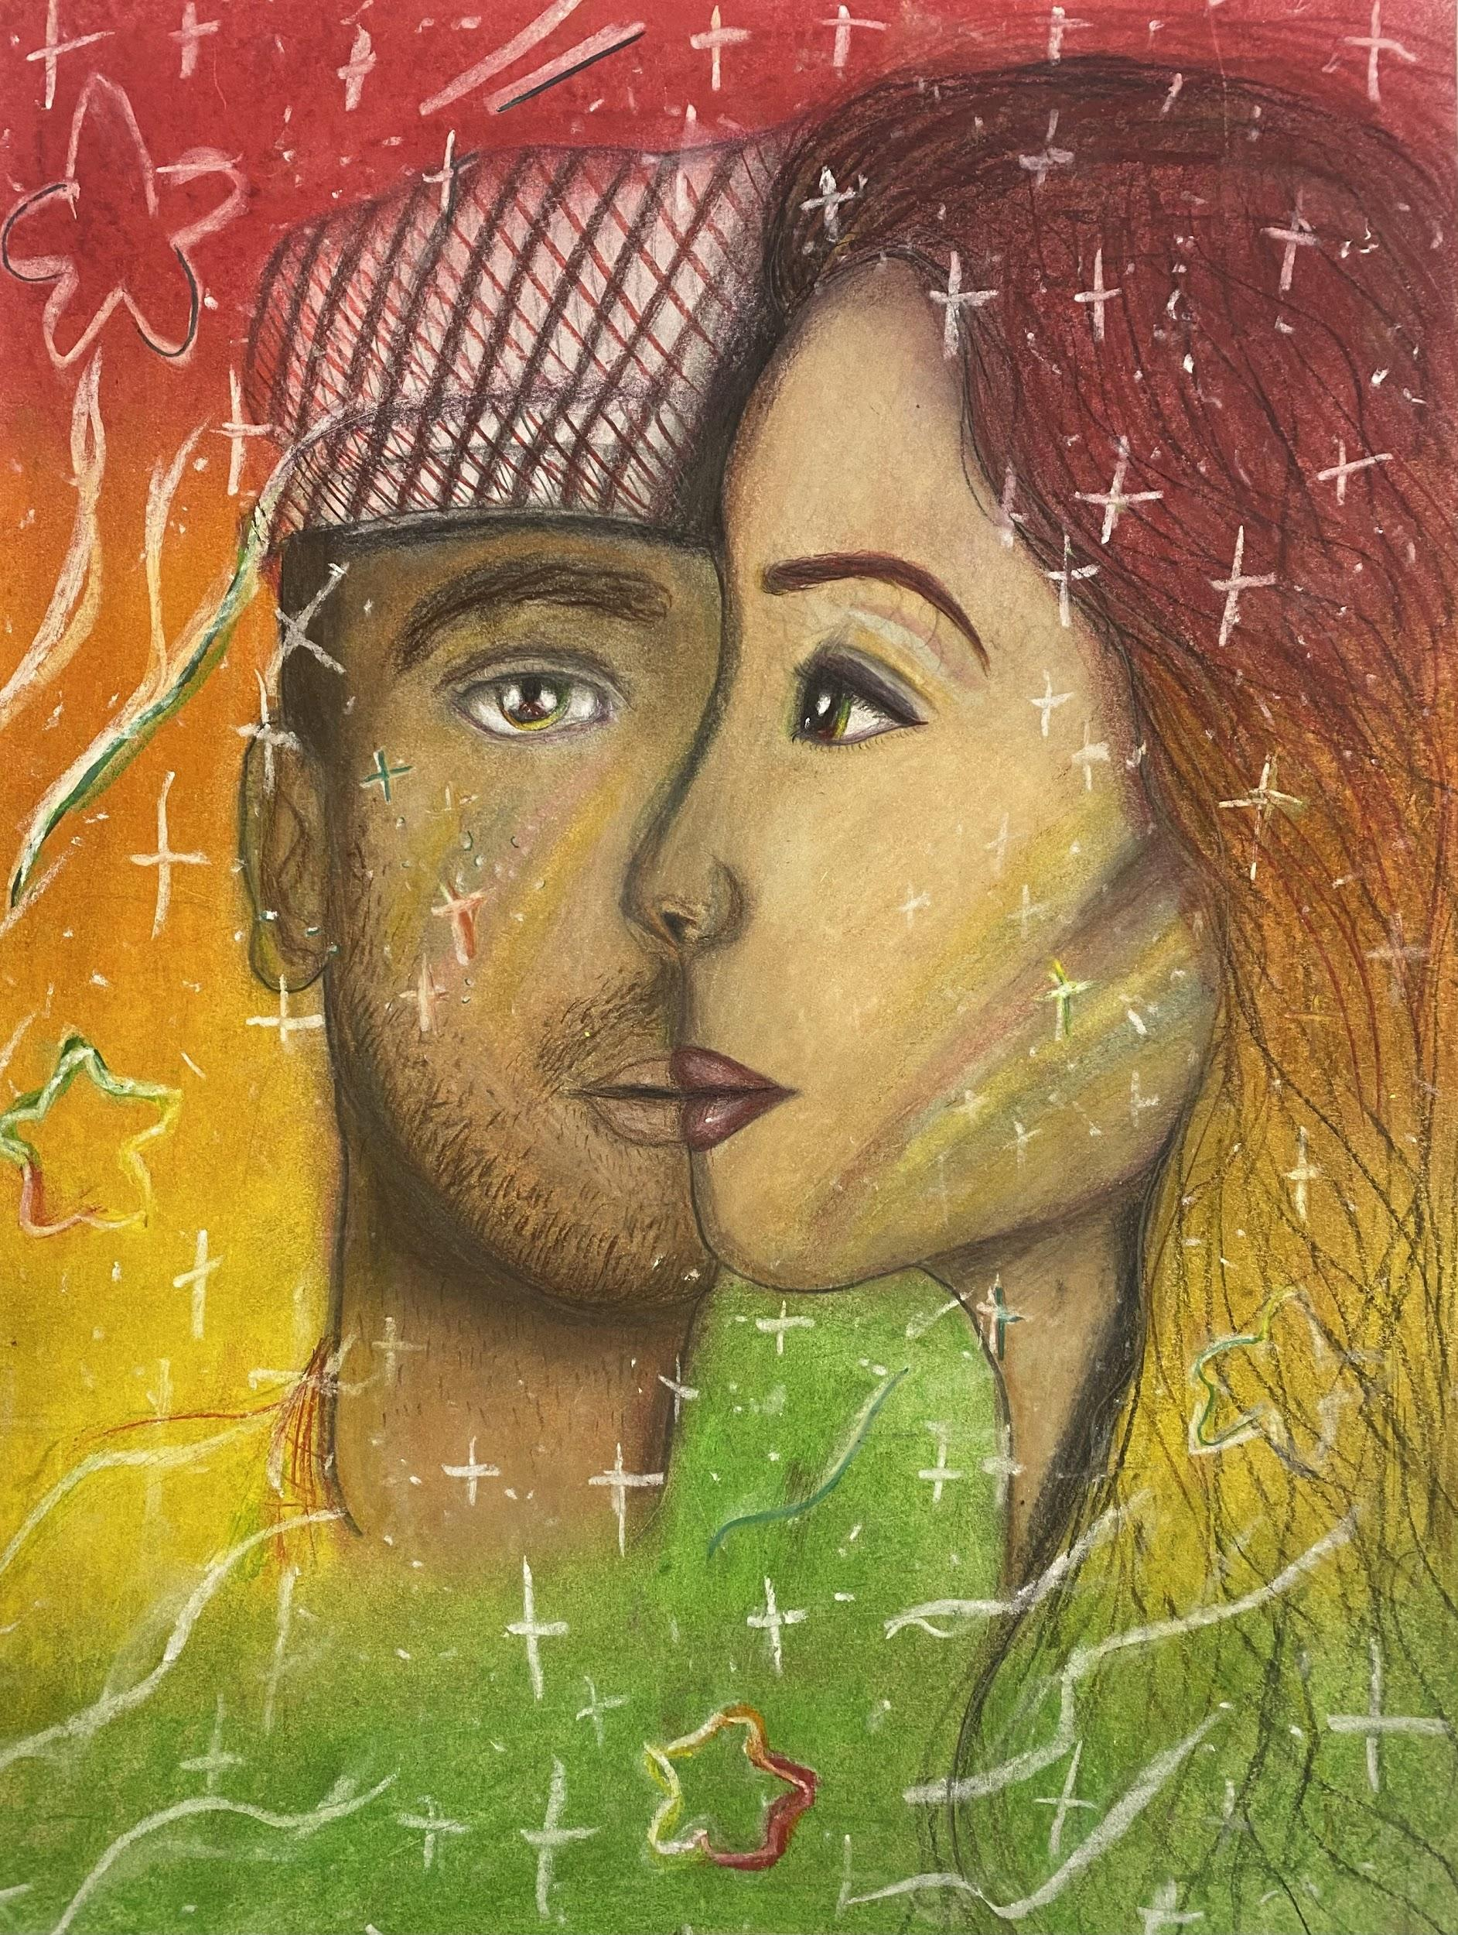
Jenna Piatt, 7th Grade

Slide 46
Salem High School
Salem R-80 School District
Tana Kettner
MAEA District #6

Slide 47
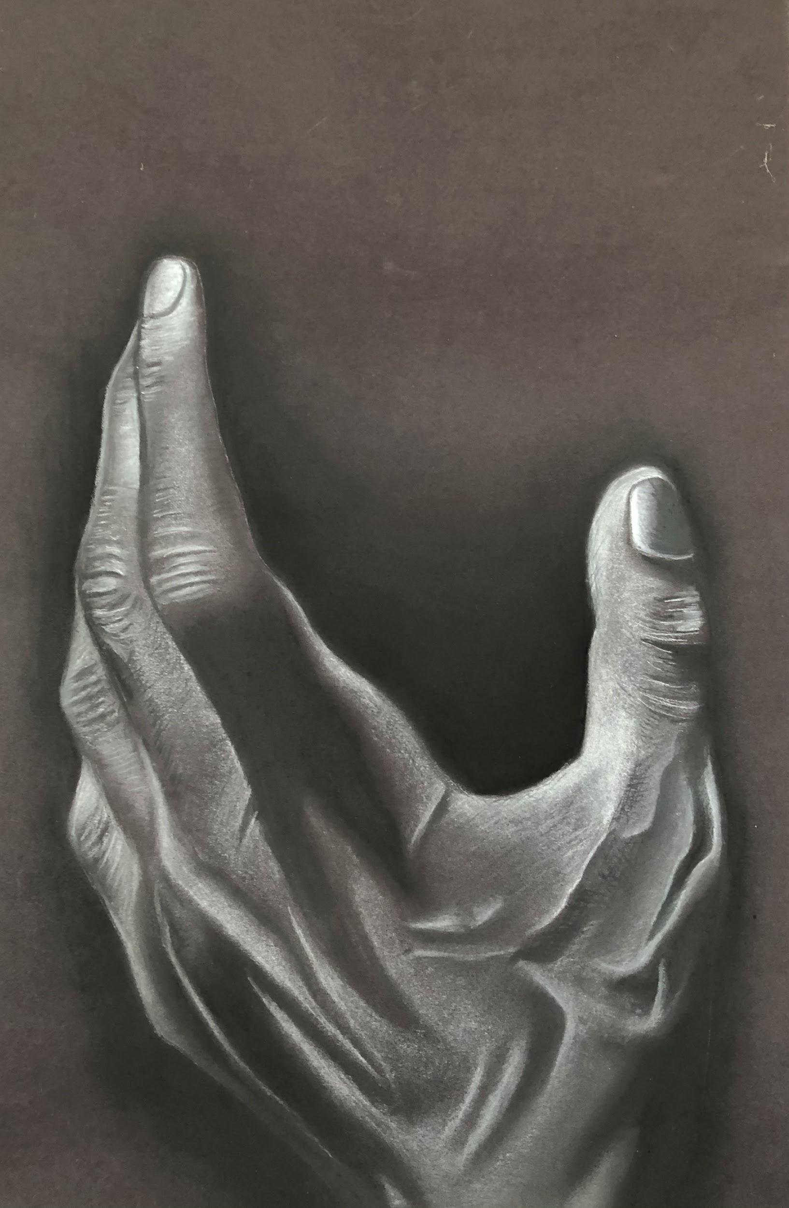
Alyssa Russell, 11th Grade

Slide 48
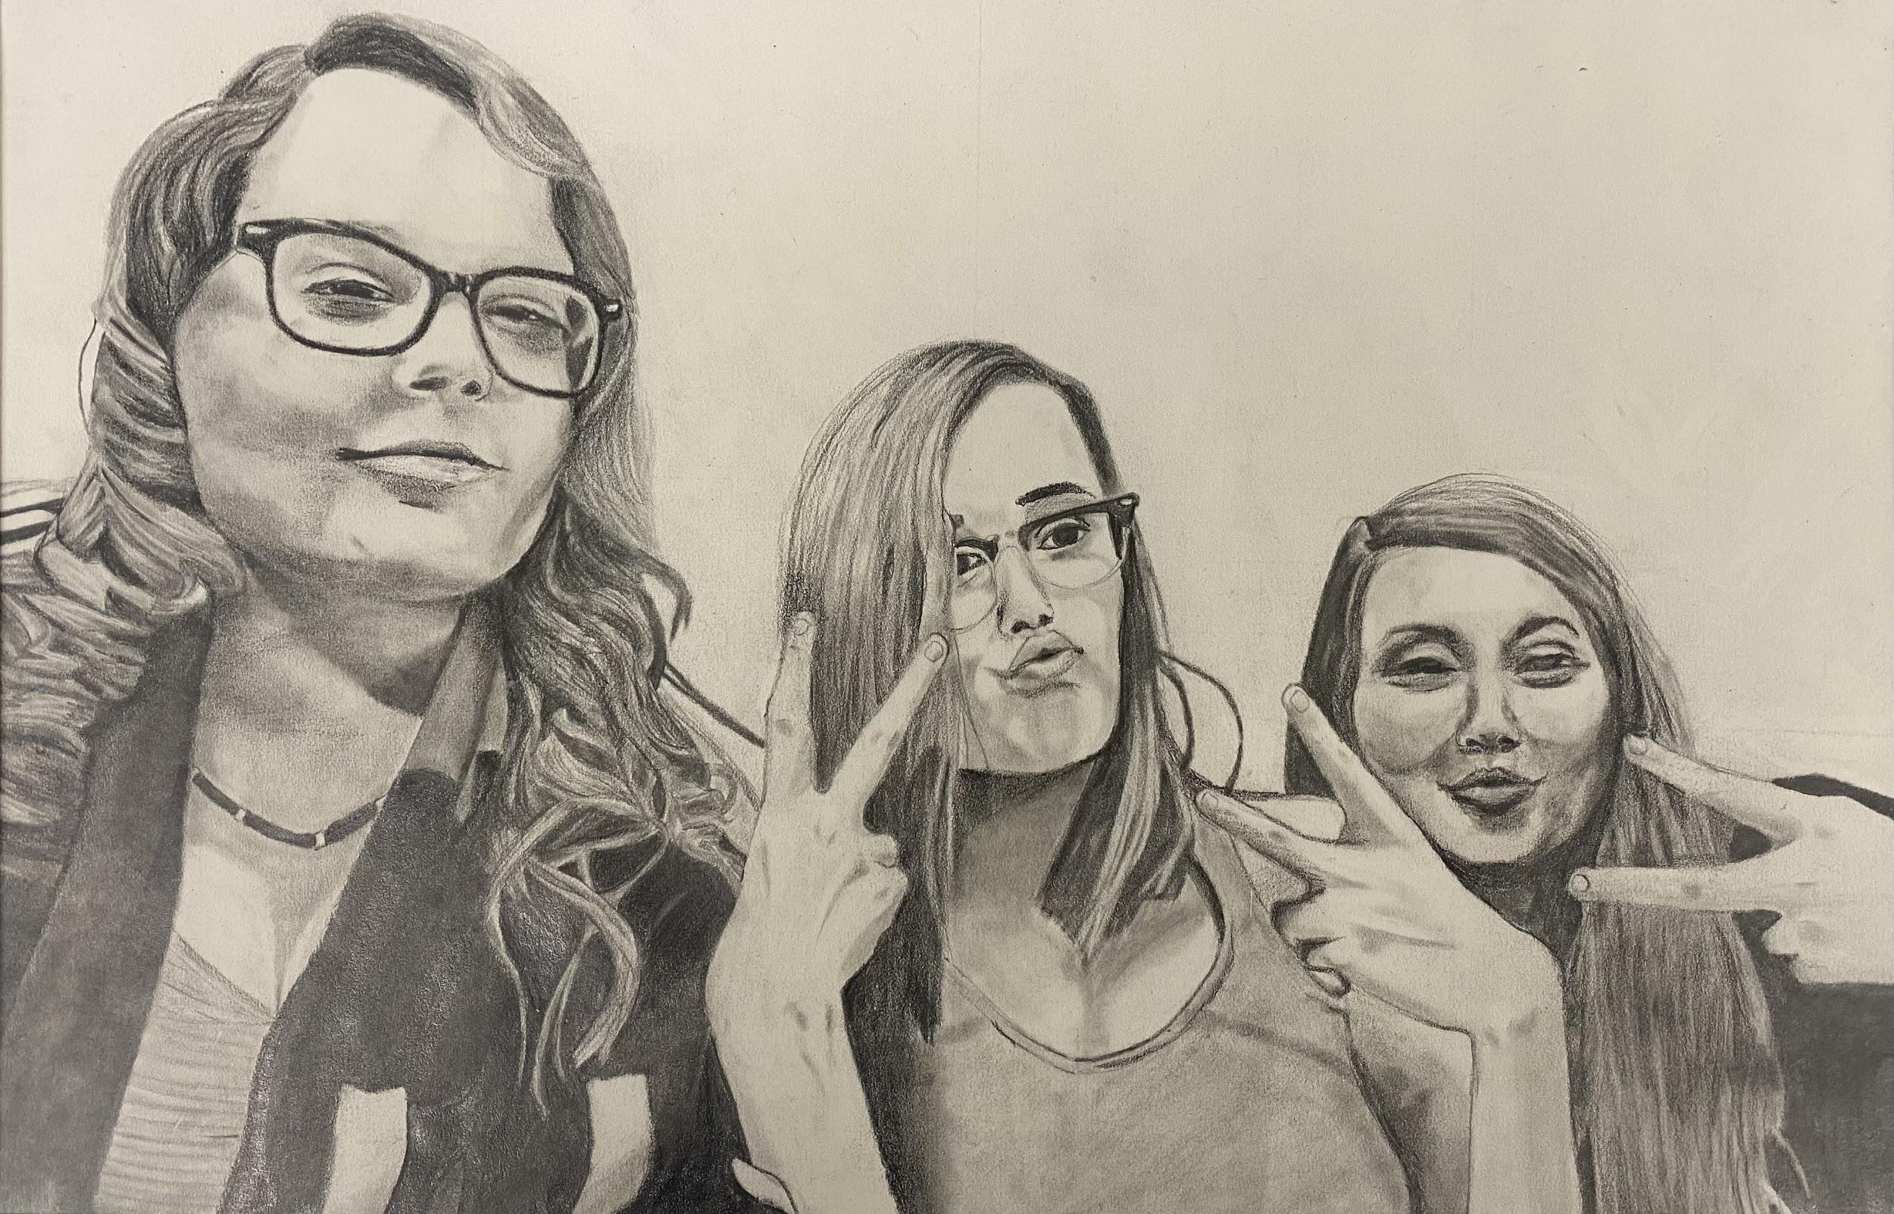
Jordan Schneider, 11th Grade

Slide 49
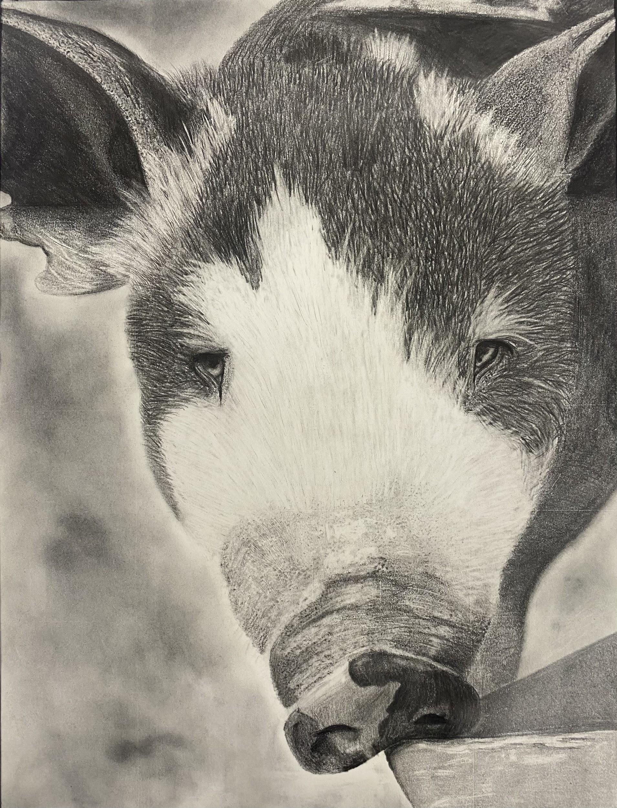
Olivia Wisdom, 10th Grade

Slide 50
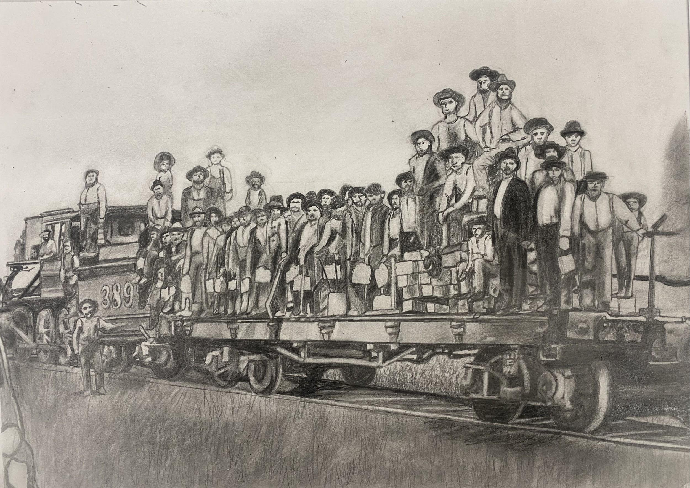
Dylan Seabaugh, 11th Grade

Slide 51
Richland R-IV Elementary
Richland R-IV School District
Art Educator: Cherie Peters
MAEA District #6

Slide 52
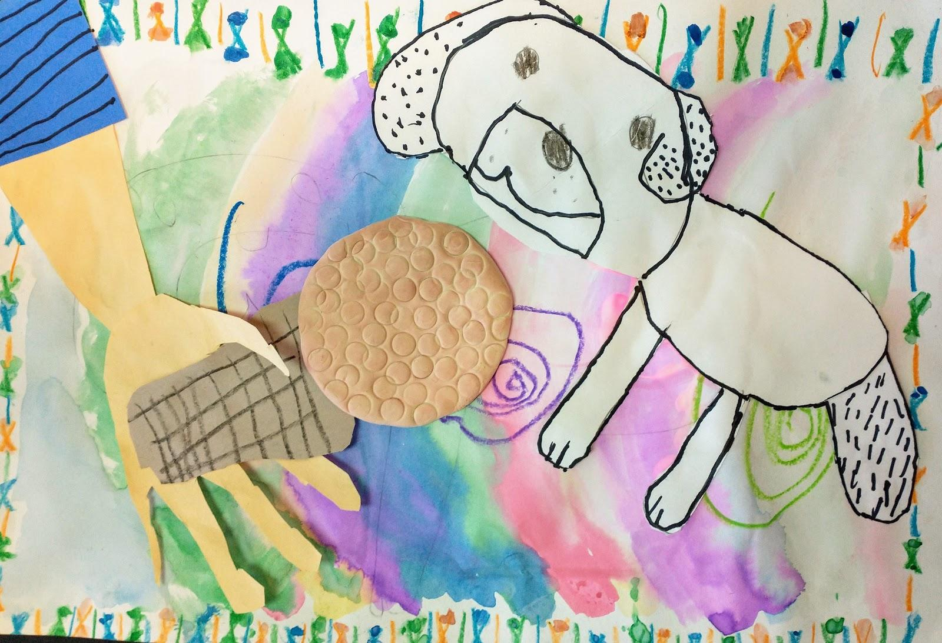
Warren Schneider, 2nd Grade - “My Dog”
Notes:
WarrenSchneiderYAMPermission

Slide 53
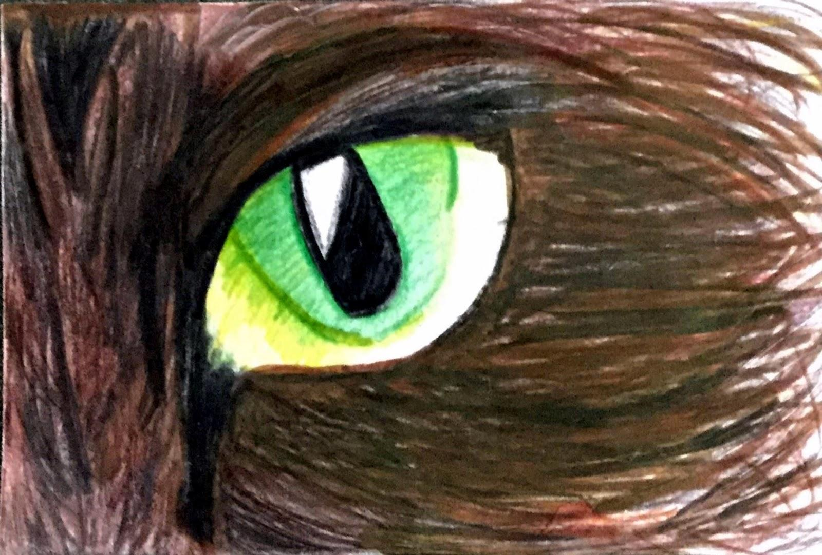
Brooklynn Lercher, 6th Grade
“This is my drawing of a Maine Coon cat eye.”
Notes:
Brooklynn.Lercher.YAM.Permission

Slide 54
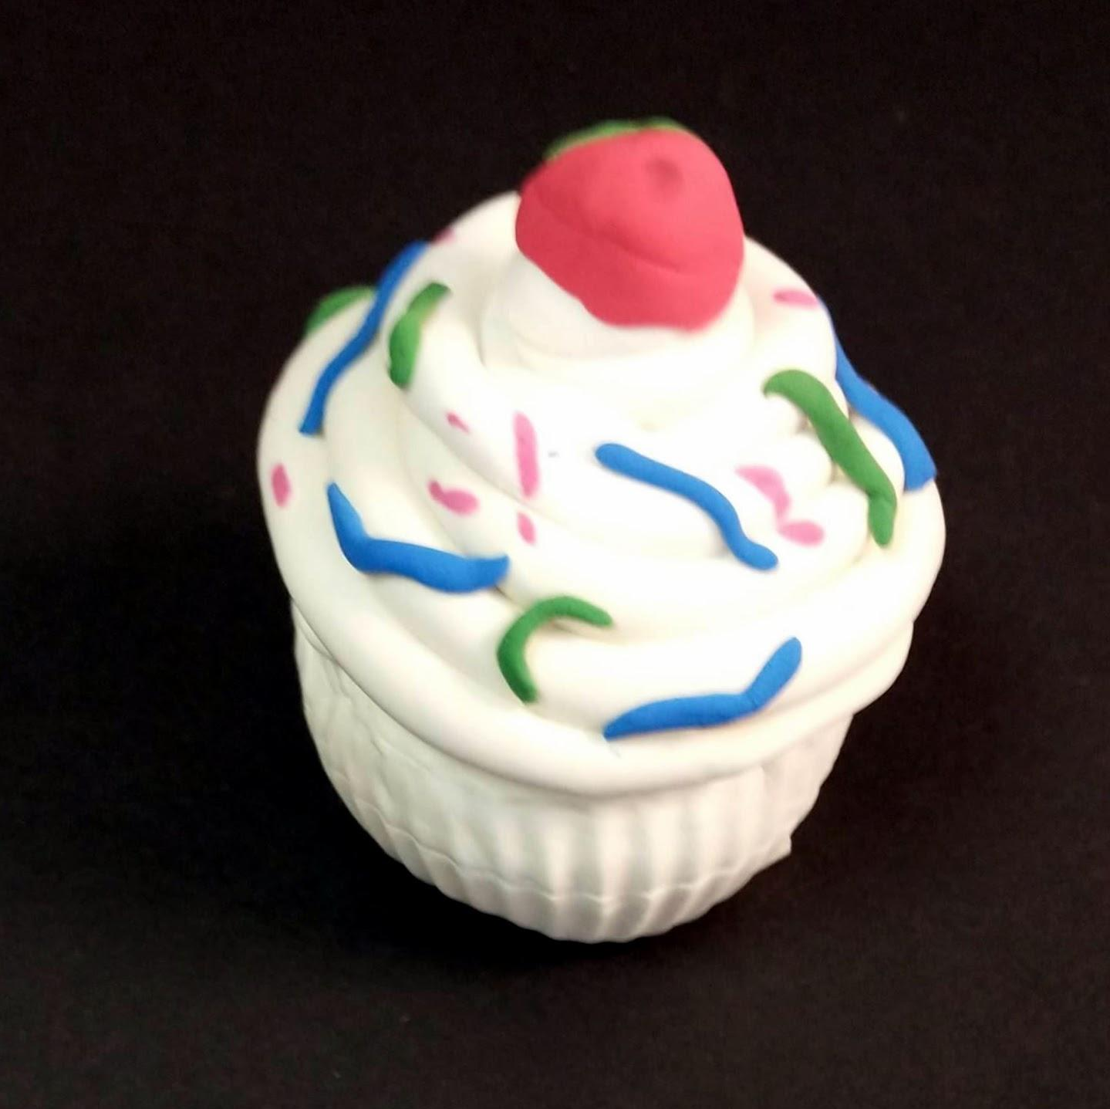
Molly Alexander, 3rd Grade “Cupcake Sculpture”
Notes:
Molly.Alexander.YAM.Permission

Slide 55
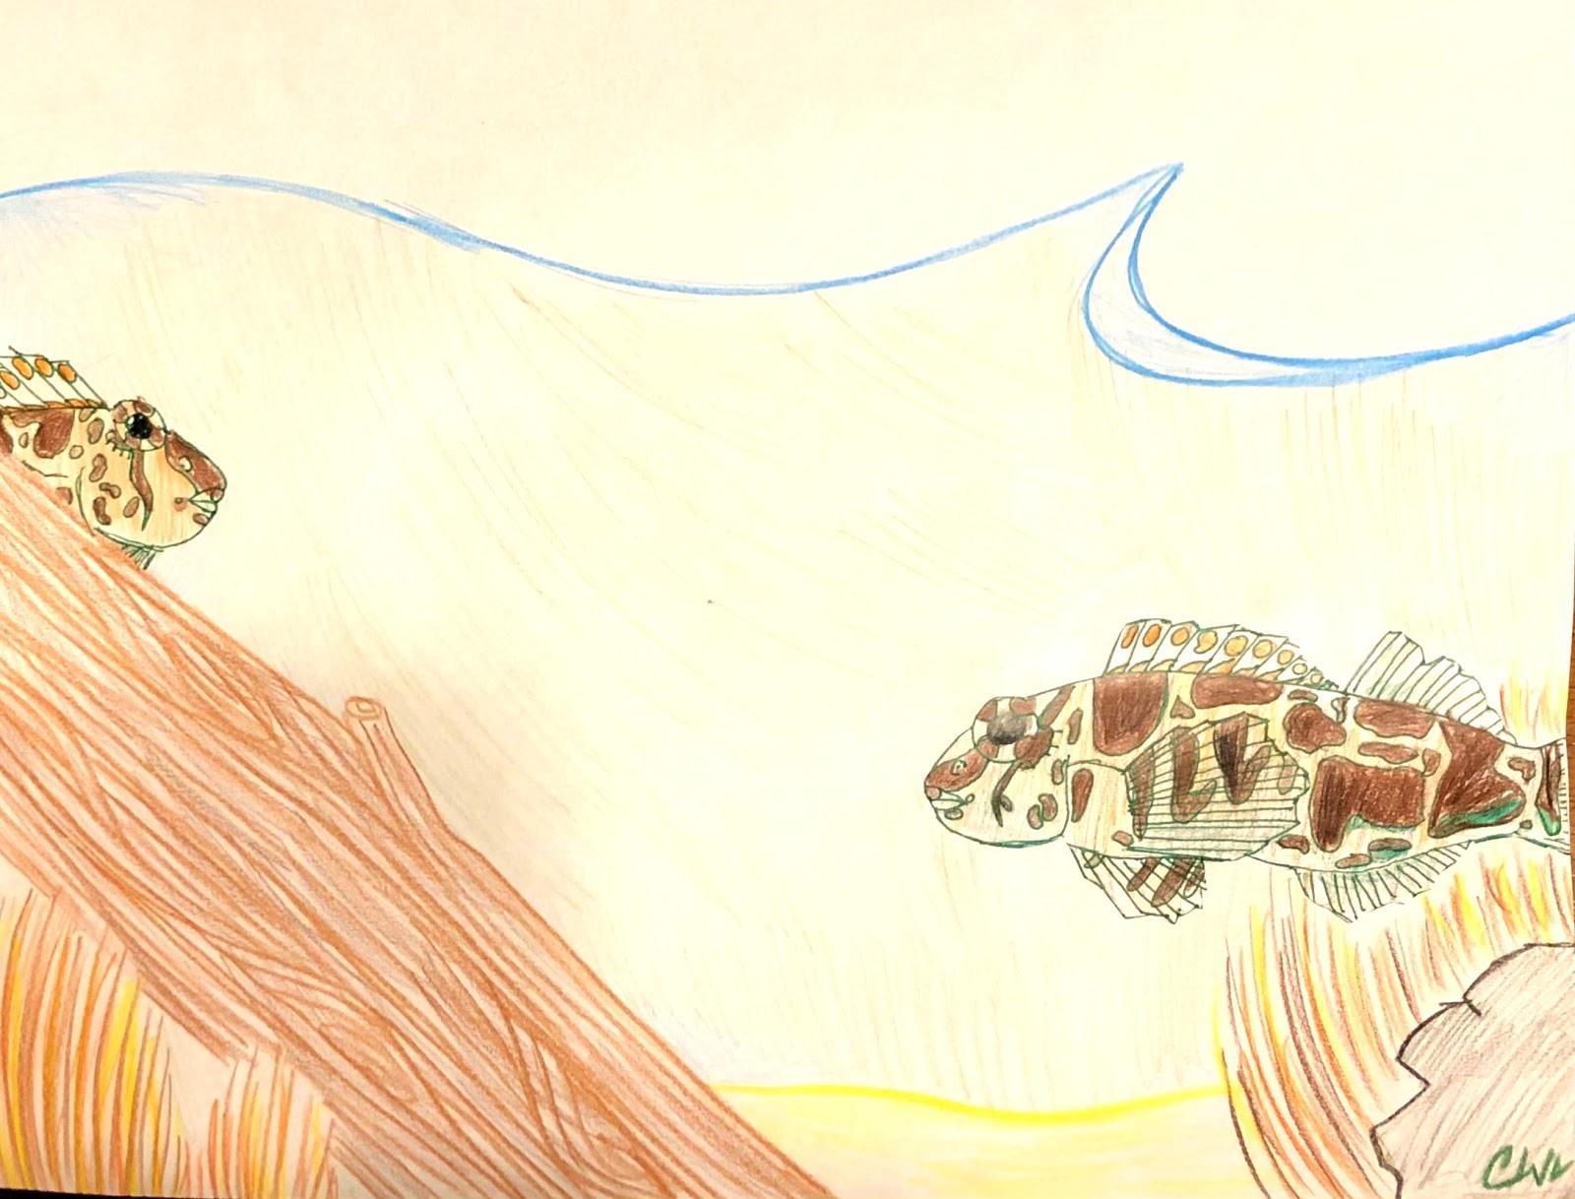
Cameron Williamson, 6th Grade
Title: “La Two Fish”
Notes:
CameronWIlliamson.YAMPermission

Slide 56
K-8 Building
Cole R-1 School District
Amy Potts
MAEA District # 6

Slide 57
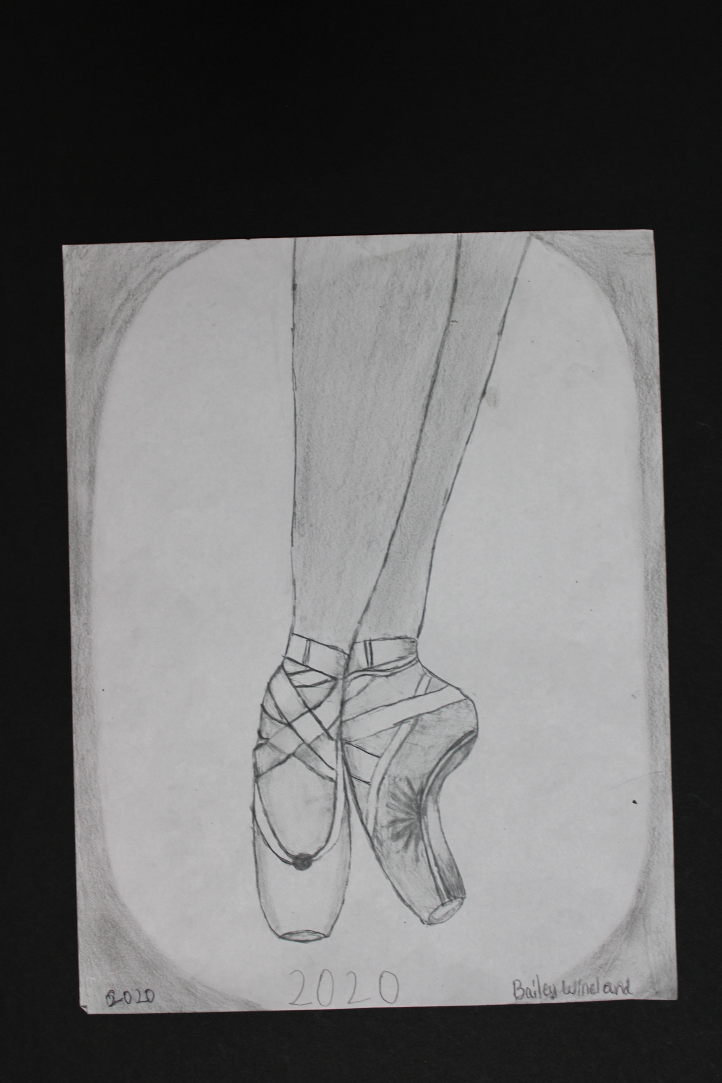
Bailey Wineland, 6th Grade

Slide 58
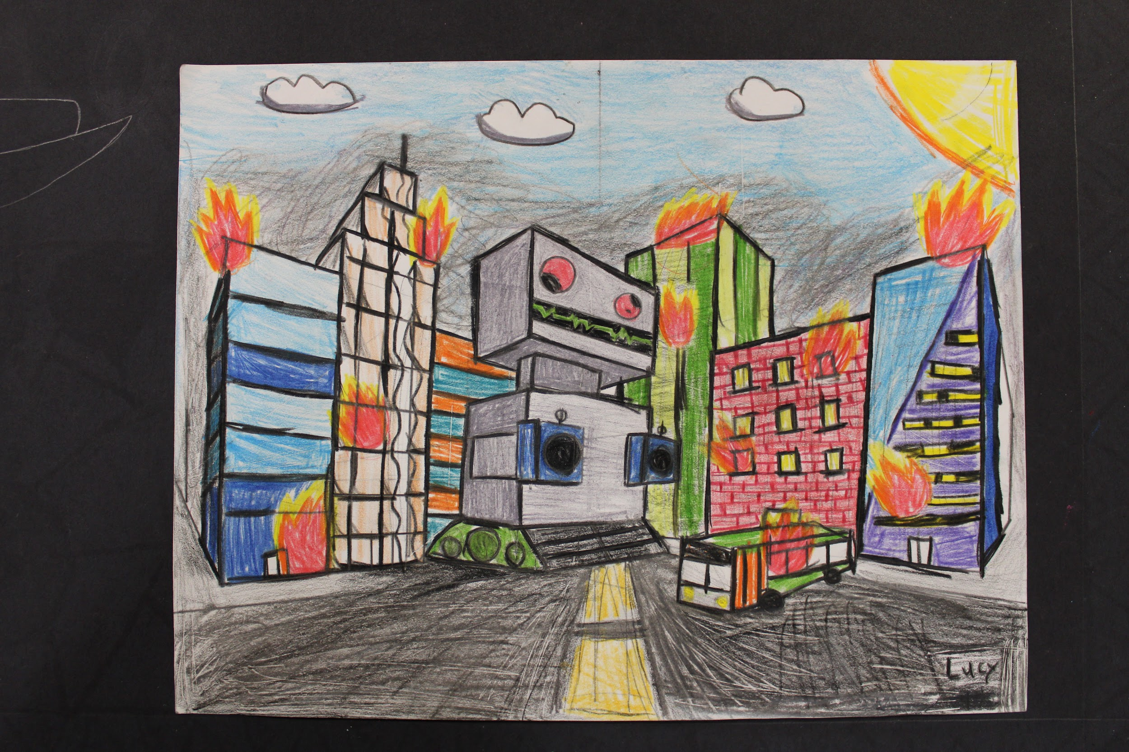
Lucy Wyss, 7th Grade

Slide 59
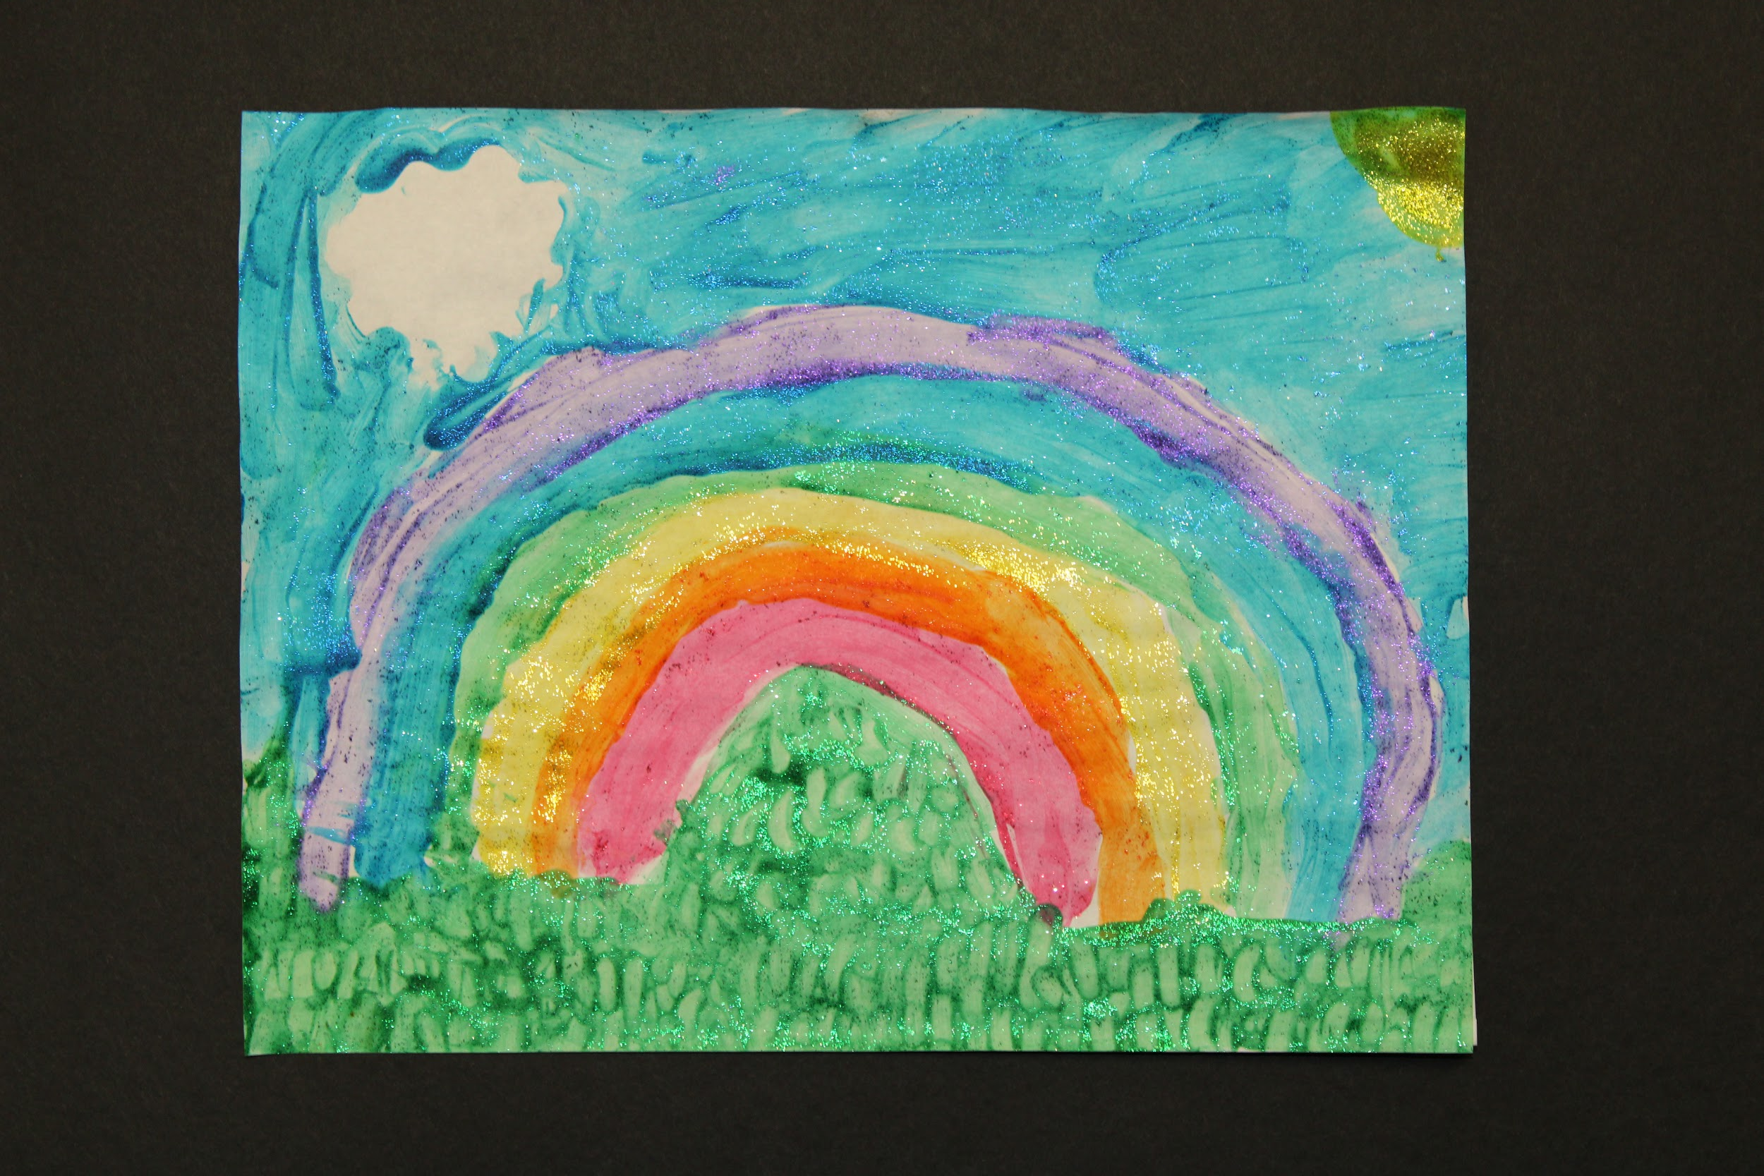
Abby Forsee, 5th Grade

Slide 60
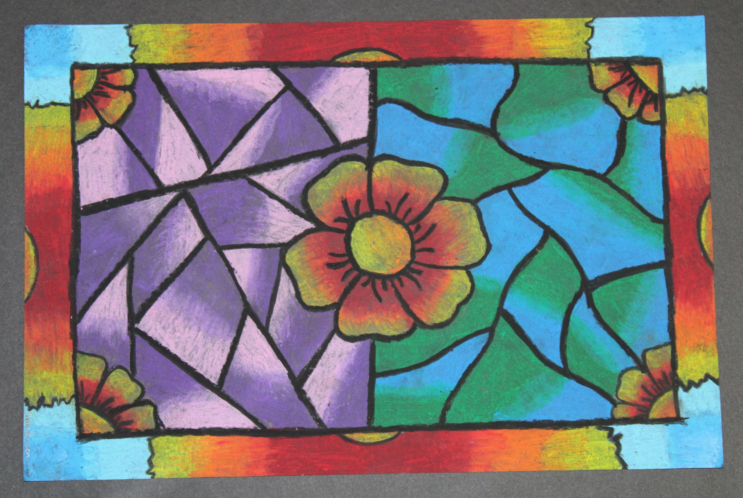
Addison Brizendine,

Slide 61
Osage Co. R-1 Chamois
Osage County R-1 School District
Joyce Wright
MAEA District #6

Slide 62
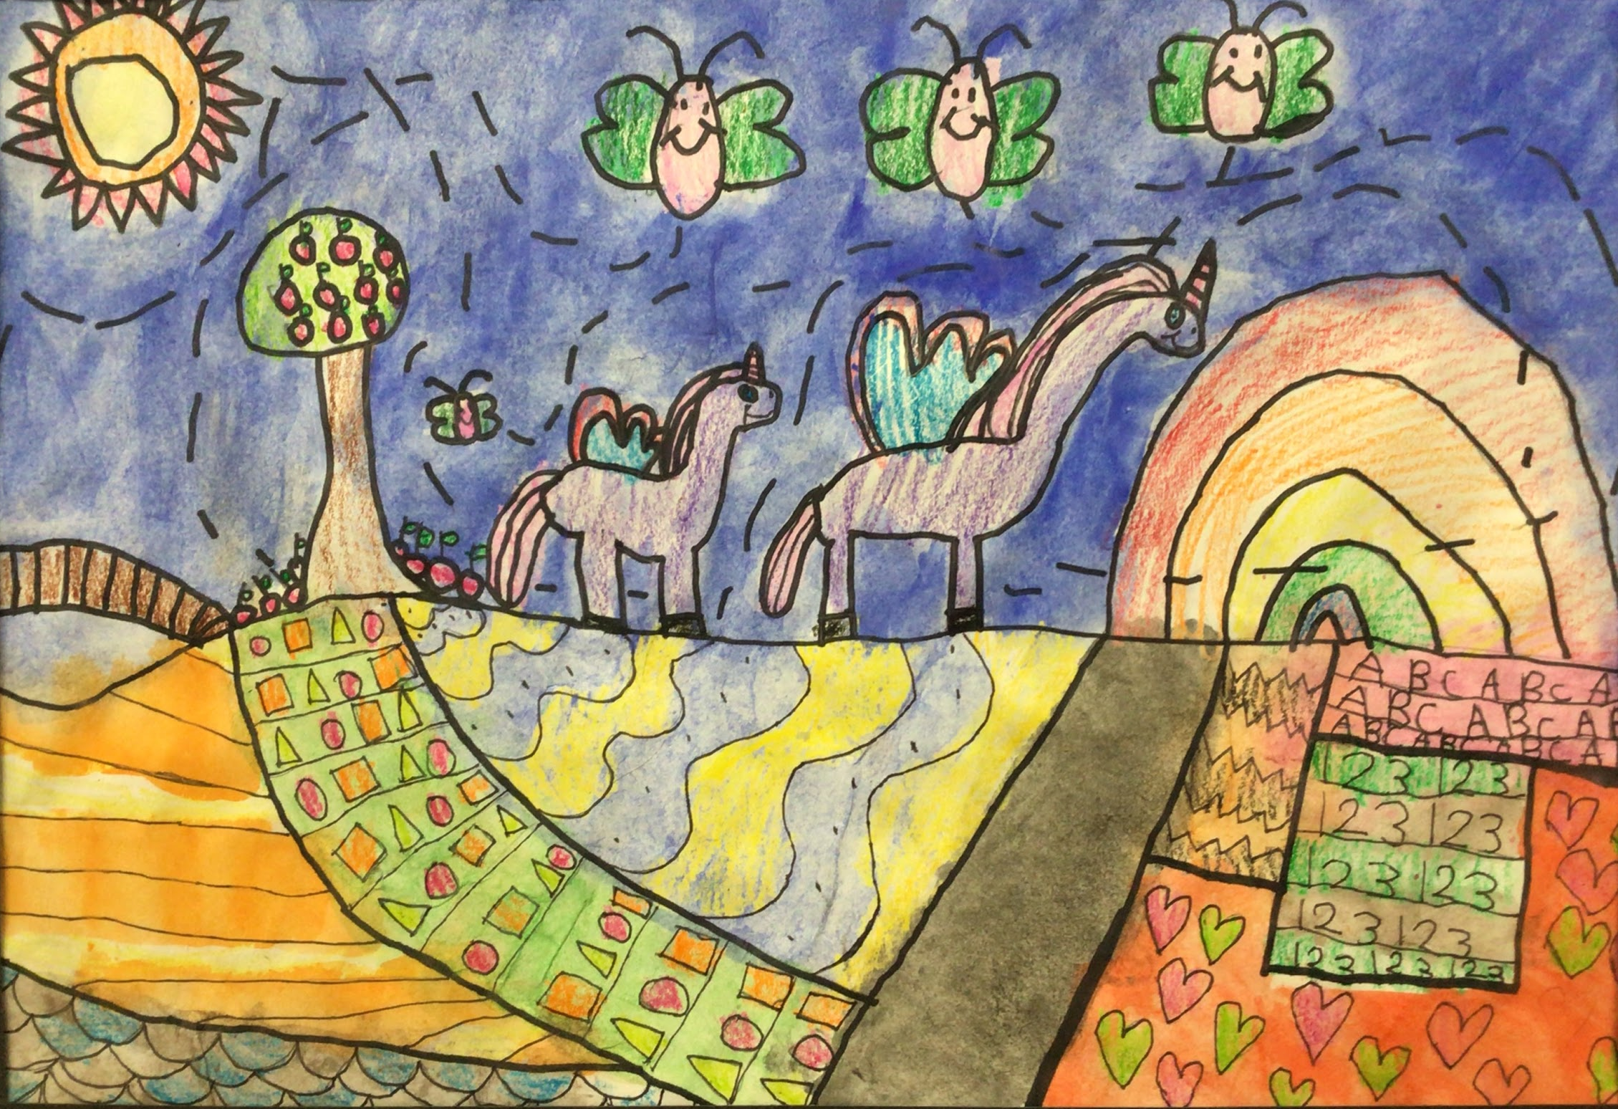
Olivia Kuschel, 1st Grade

Slide 63
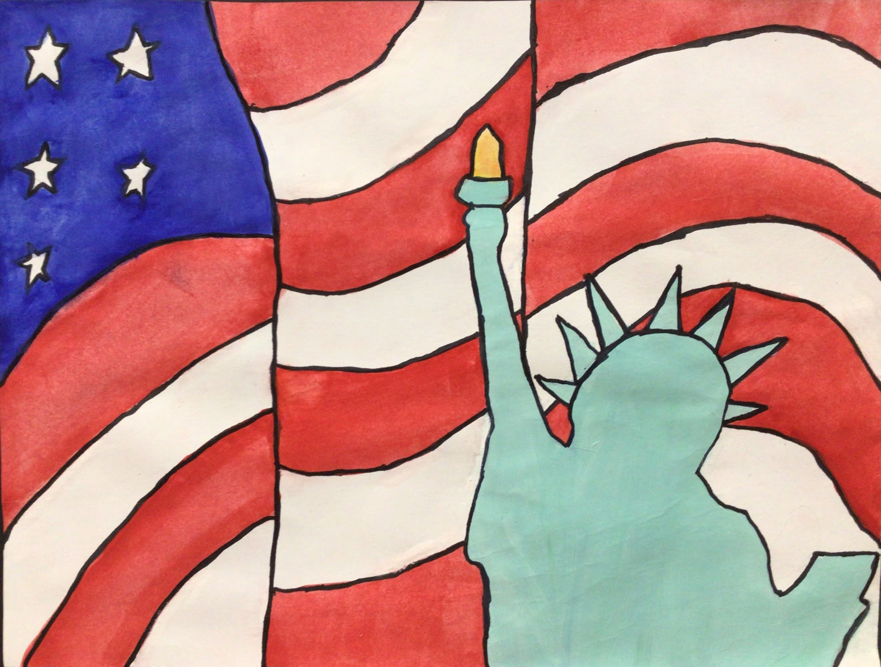
Grayson Gerloff, 5th Grade

Slide 64
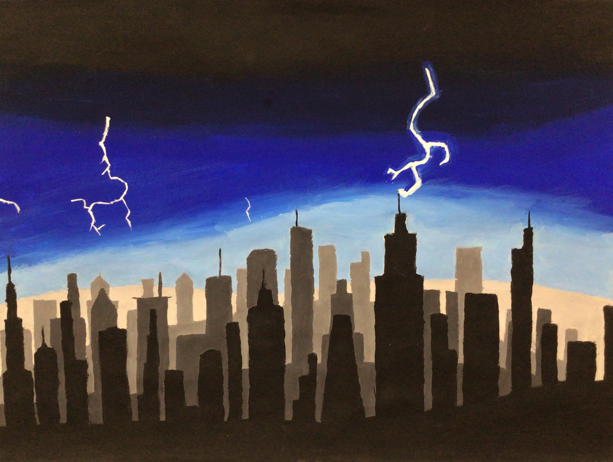
Rylee Davis, 8th Grade

Slide 65
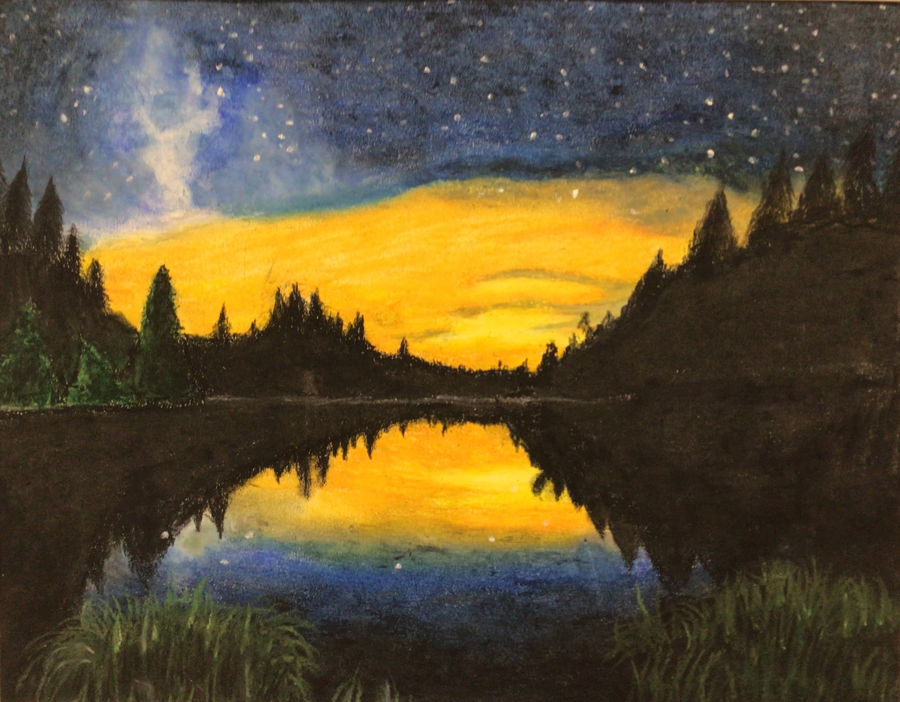
Brittney Patridge, 10th Grade

Slide 66
House Springs
Elementary
Northwest R-1
Michelle Howard
MAEA District #7

Slide 67
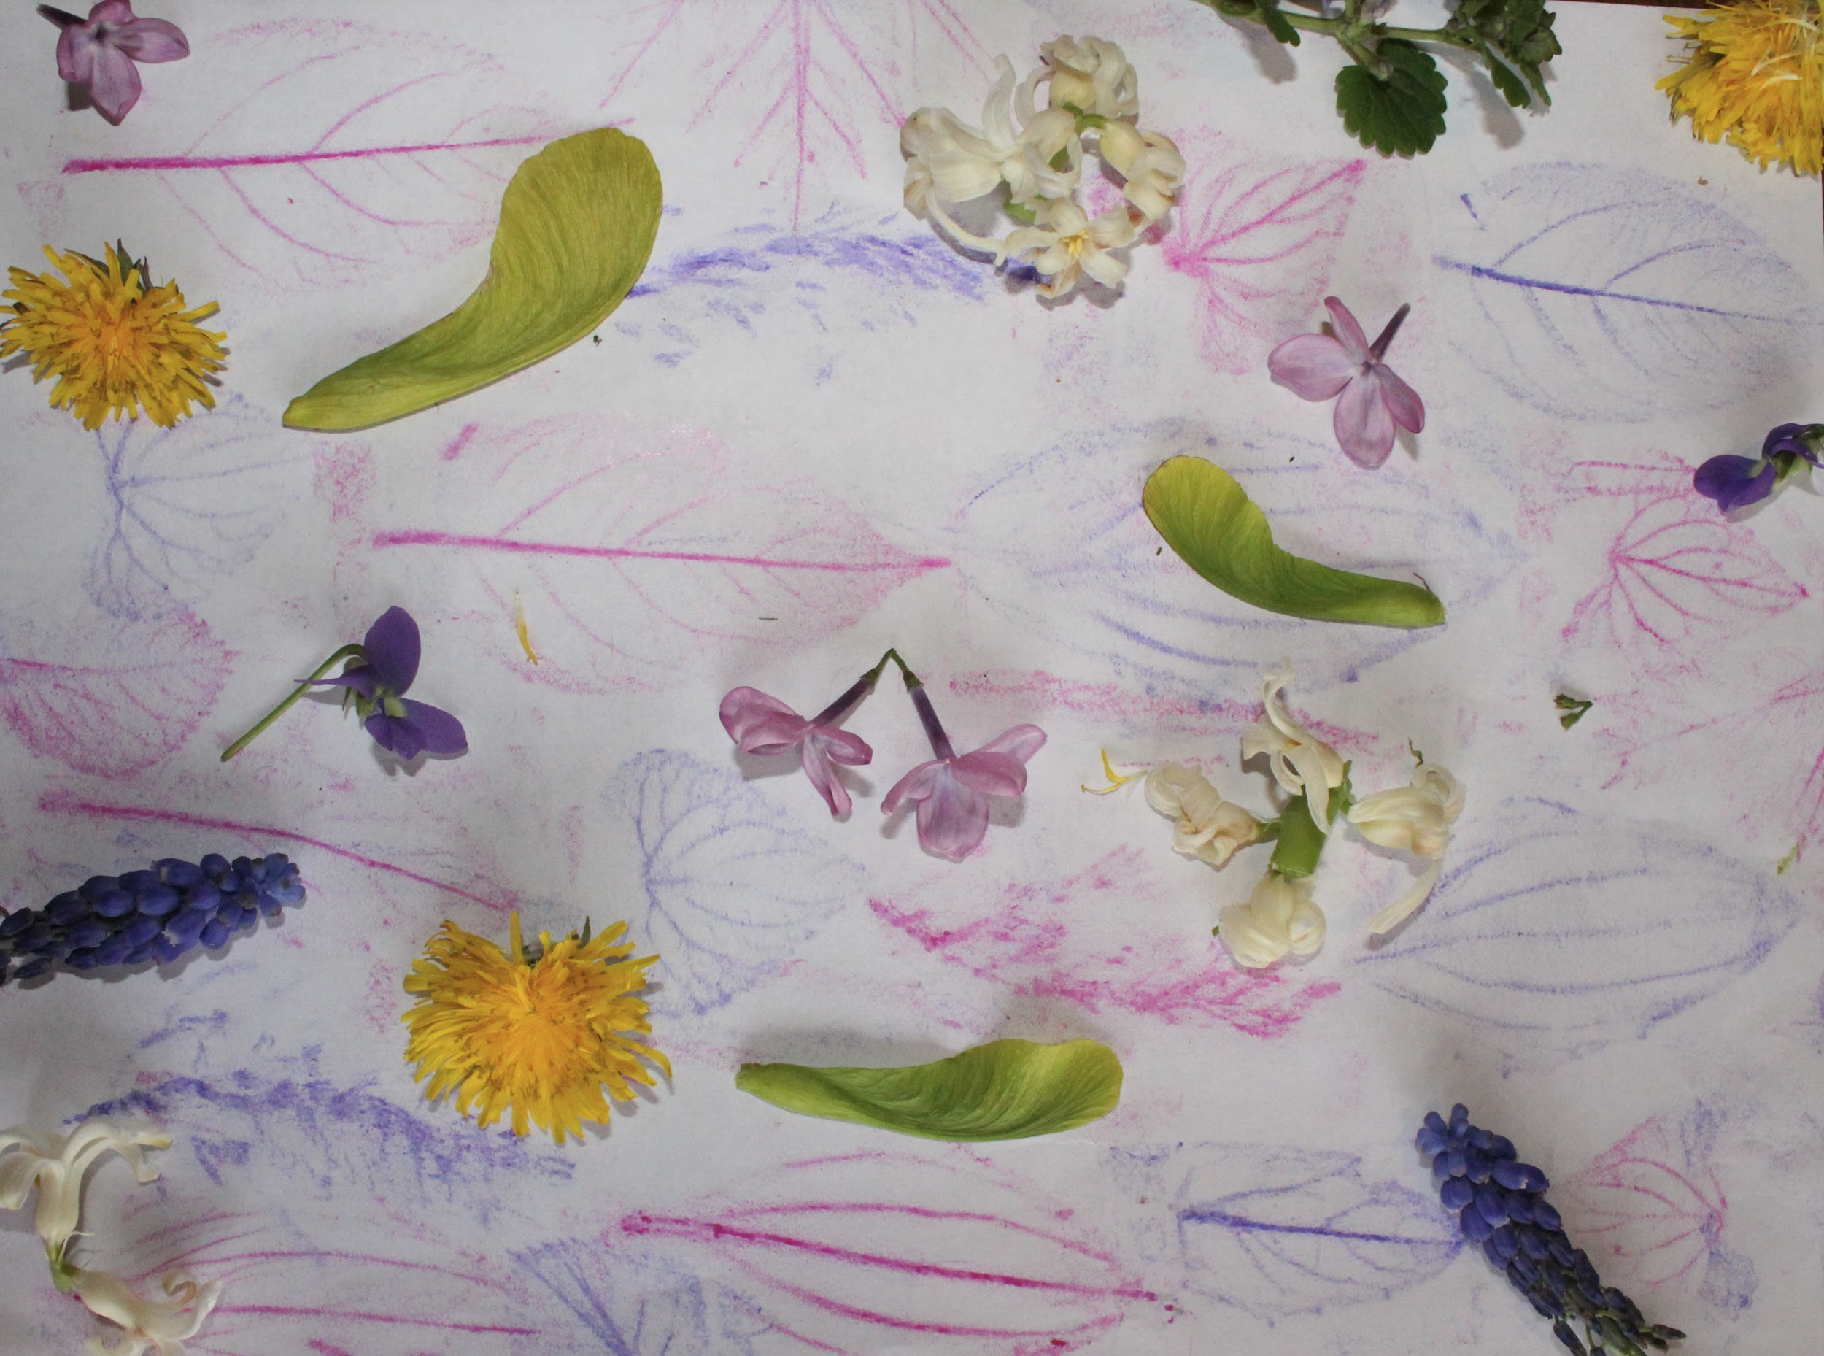
Anona Brouk
2nd Grade
I had fun collecting objects from nature to create my
Earth Day project.

Slide 68
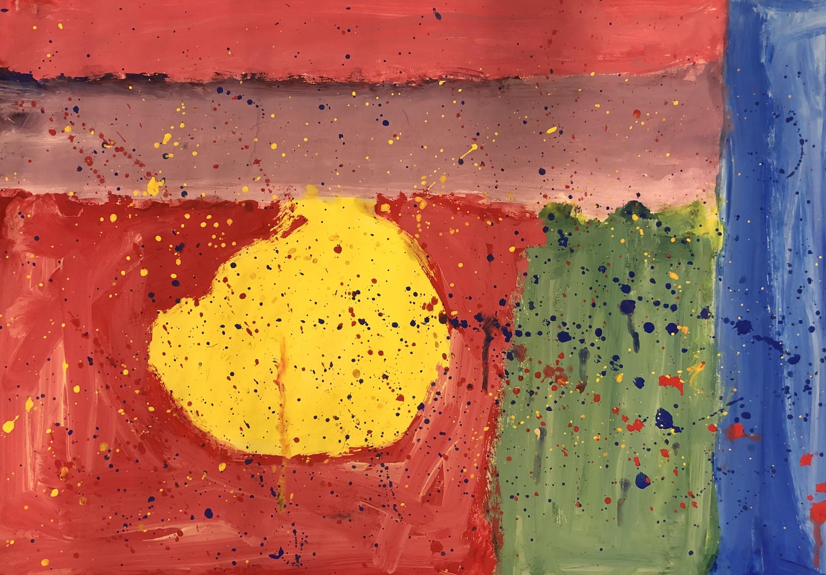
Daviya
Shabazz
3rd Grade
I love mixing colors and creating tints!

Slide 69

Daphne
Williams
3rd Grade
I had fun learning about highlights and lowlights!

Slide 70

Isaac Whaley
5th Grade
I really enjoyed making this art project. I had fun designing the moon and painting my picture.

Slide 71
Cedar Springs Elementary
Northwest R-1
Melanie Robinson
MAEA District #7

Slide 72

Gracie Brand, 5th Grade

Slide 73

Avery Britton, 5th Grade

Slide 74

Shealyn Reinken, 4th Grade

Slide 75

Eloise Geatley, 4th Grade

