Slide 1

MAEA Youth Art Month Exhibition
2021

Slide 2




Thank you to our sponsors

Slide 3
John Evans Middle School
Potosi R-3
Keeli Singer
MAEA District #7

Slide 4

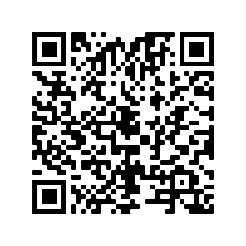
Shannon Riddle, 7th grade

Slide 5
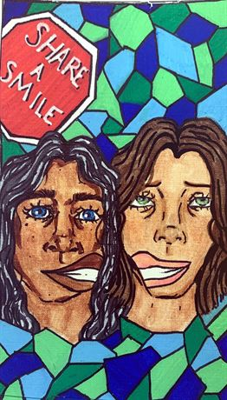
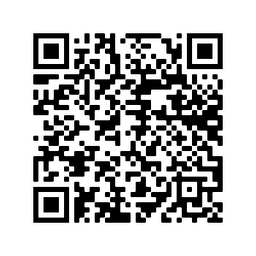
Macy Saunders, 7th grade

Slide 6
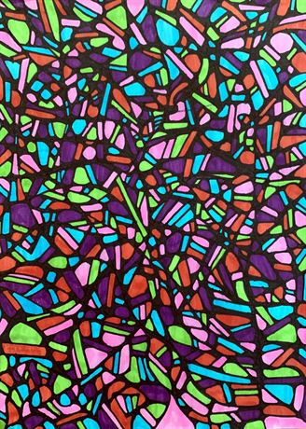
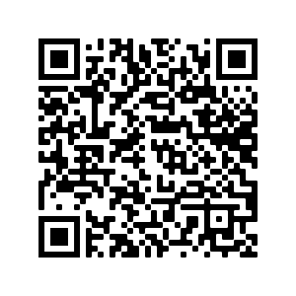
Faith Russell, 7th grade

Slide 7
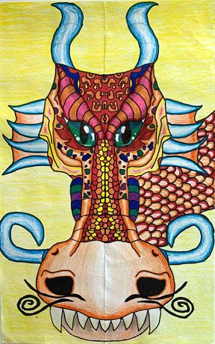
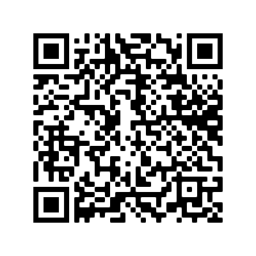
Skyleah Courtway, 8th grade

Slide 8
ETS @ Madison
Saint Louis Public Schools
Ms. Shawn Trent
MAEA District #8

Slide 9
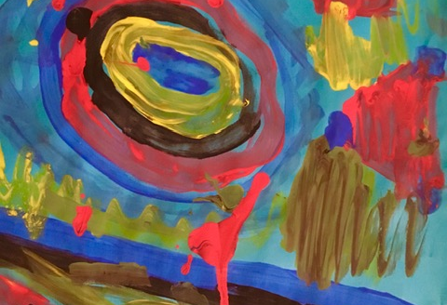
Gavin Steed, Grade 3

Slide 10
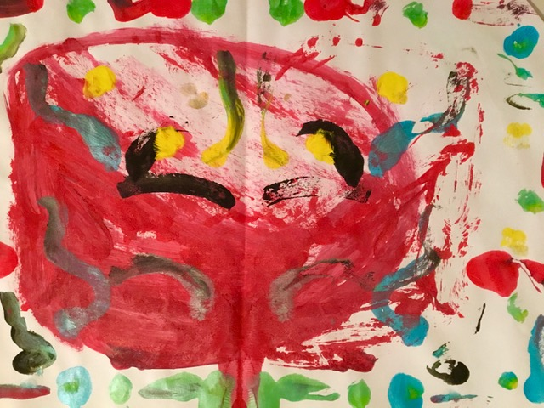
Elijah Samuels, Grade 3

Slide 11
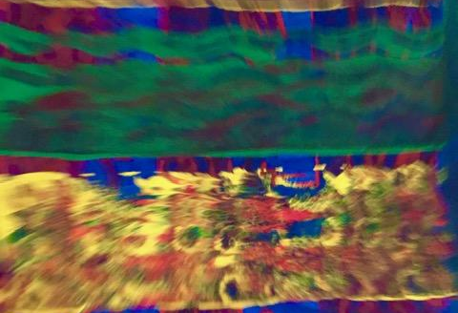
Jeremiah Roby, Grade 6

Slide 12
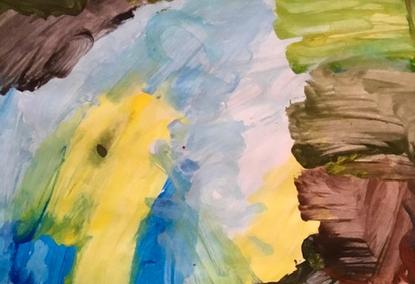
Corey Fleming, Grade 7

Slide 13
Stone Creek Elementary
Wentzville R-IV School District
Hester Menier- NBCT
MAEA District #8

Slide 14
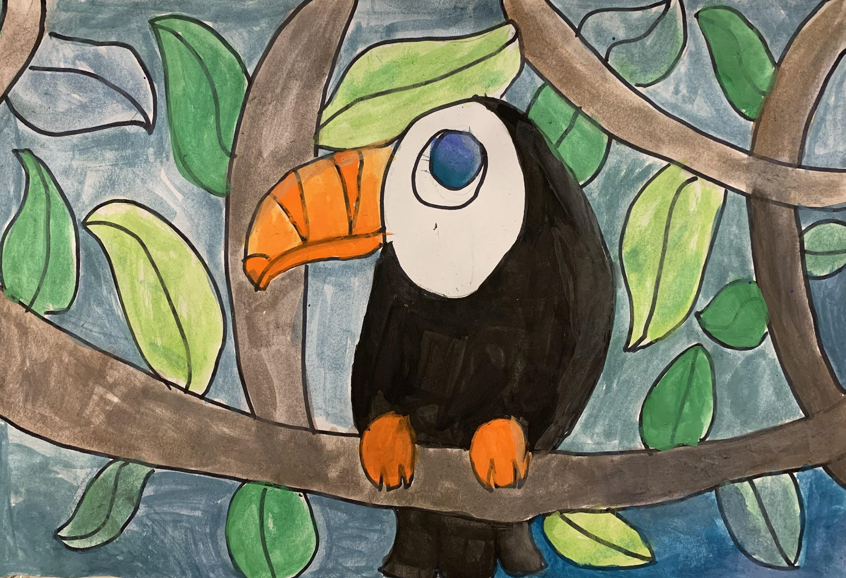
Braelyn Satkowski, Grade 5

Slide 15
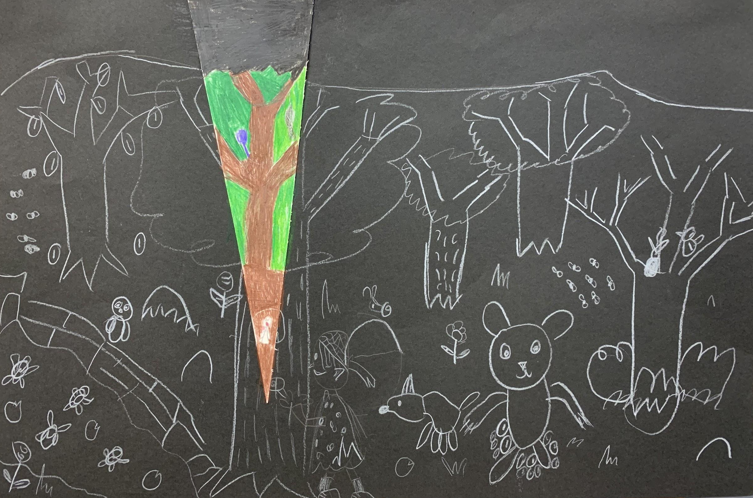
Carter Tierney, Grade 2

Slide 16
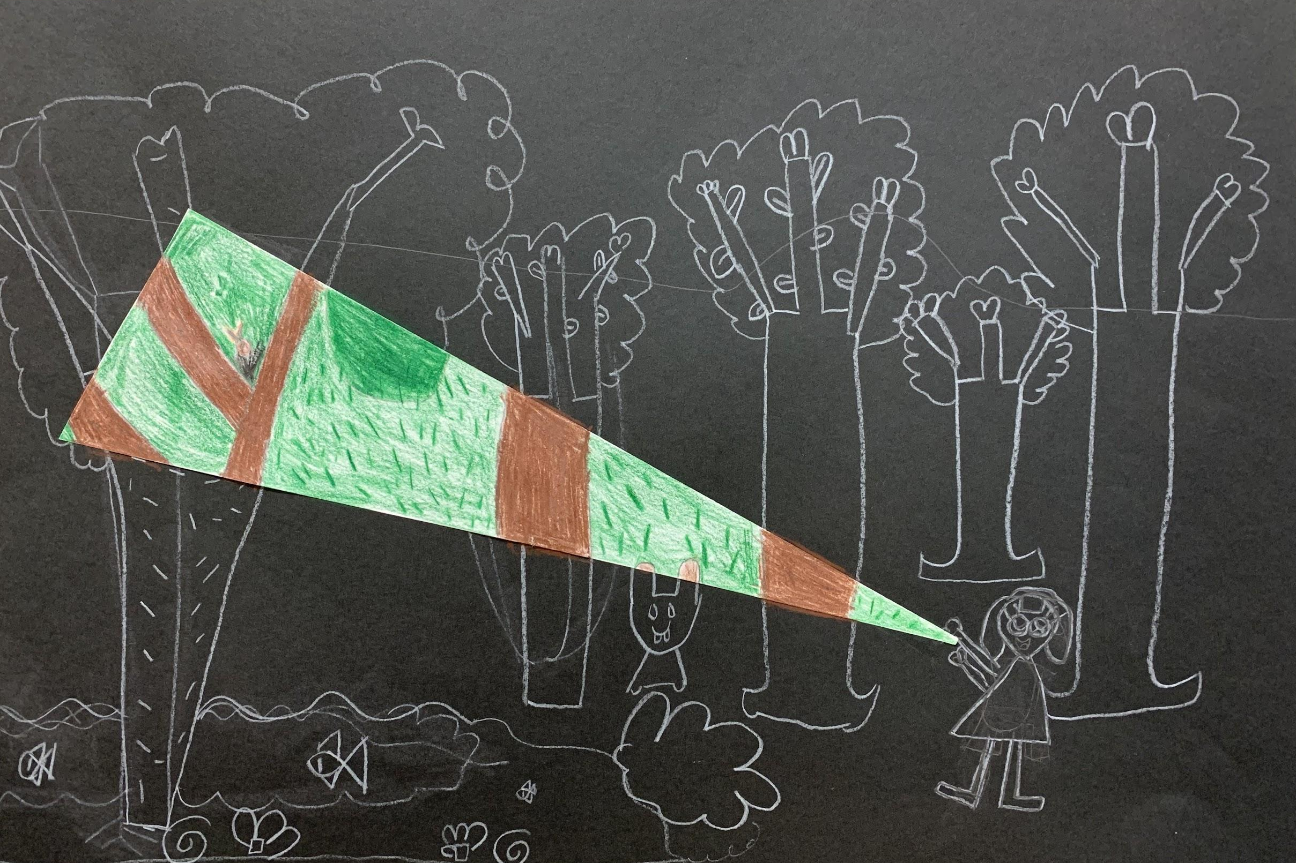
Molly Snell, Grade 2

Slide 17
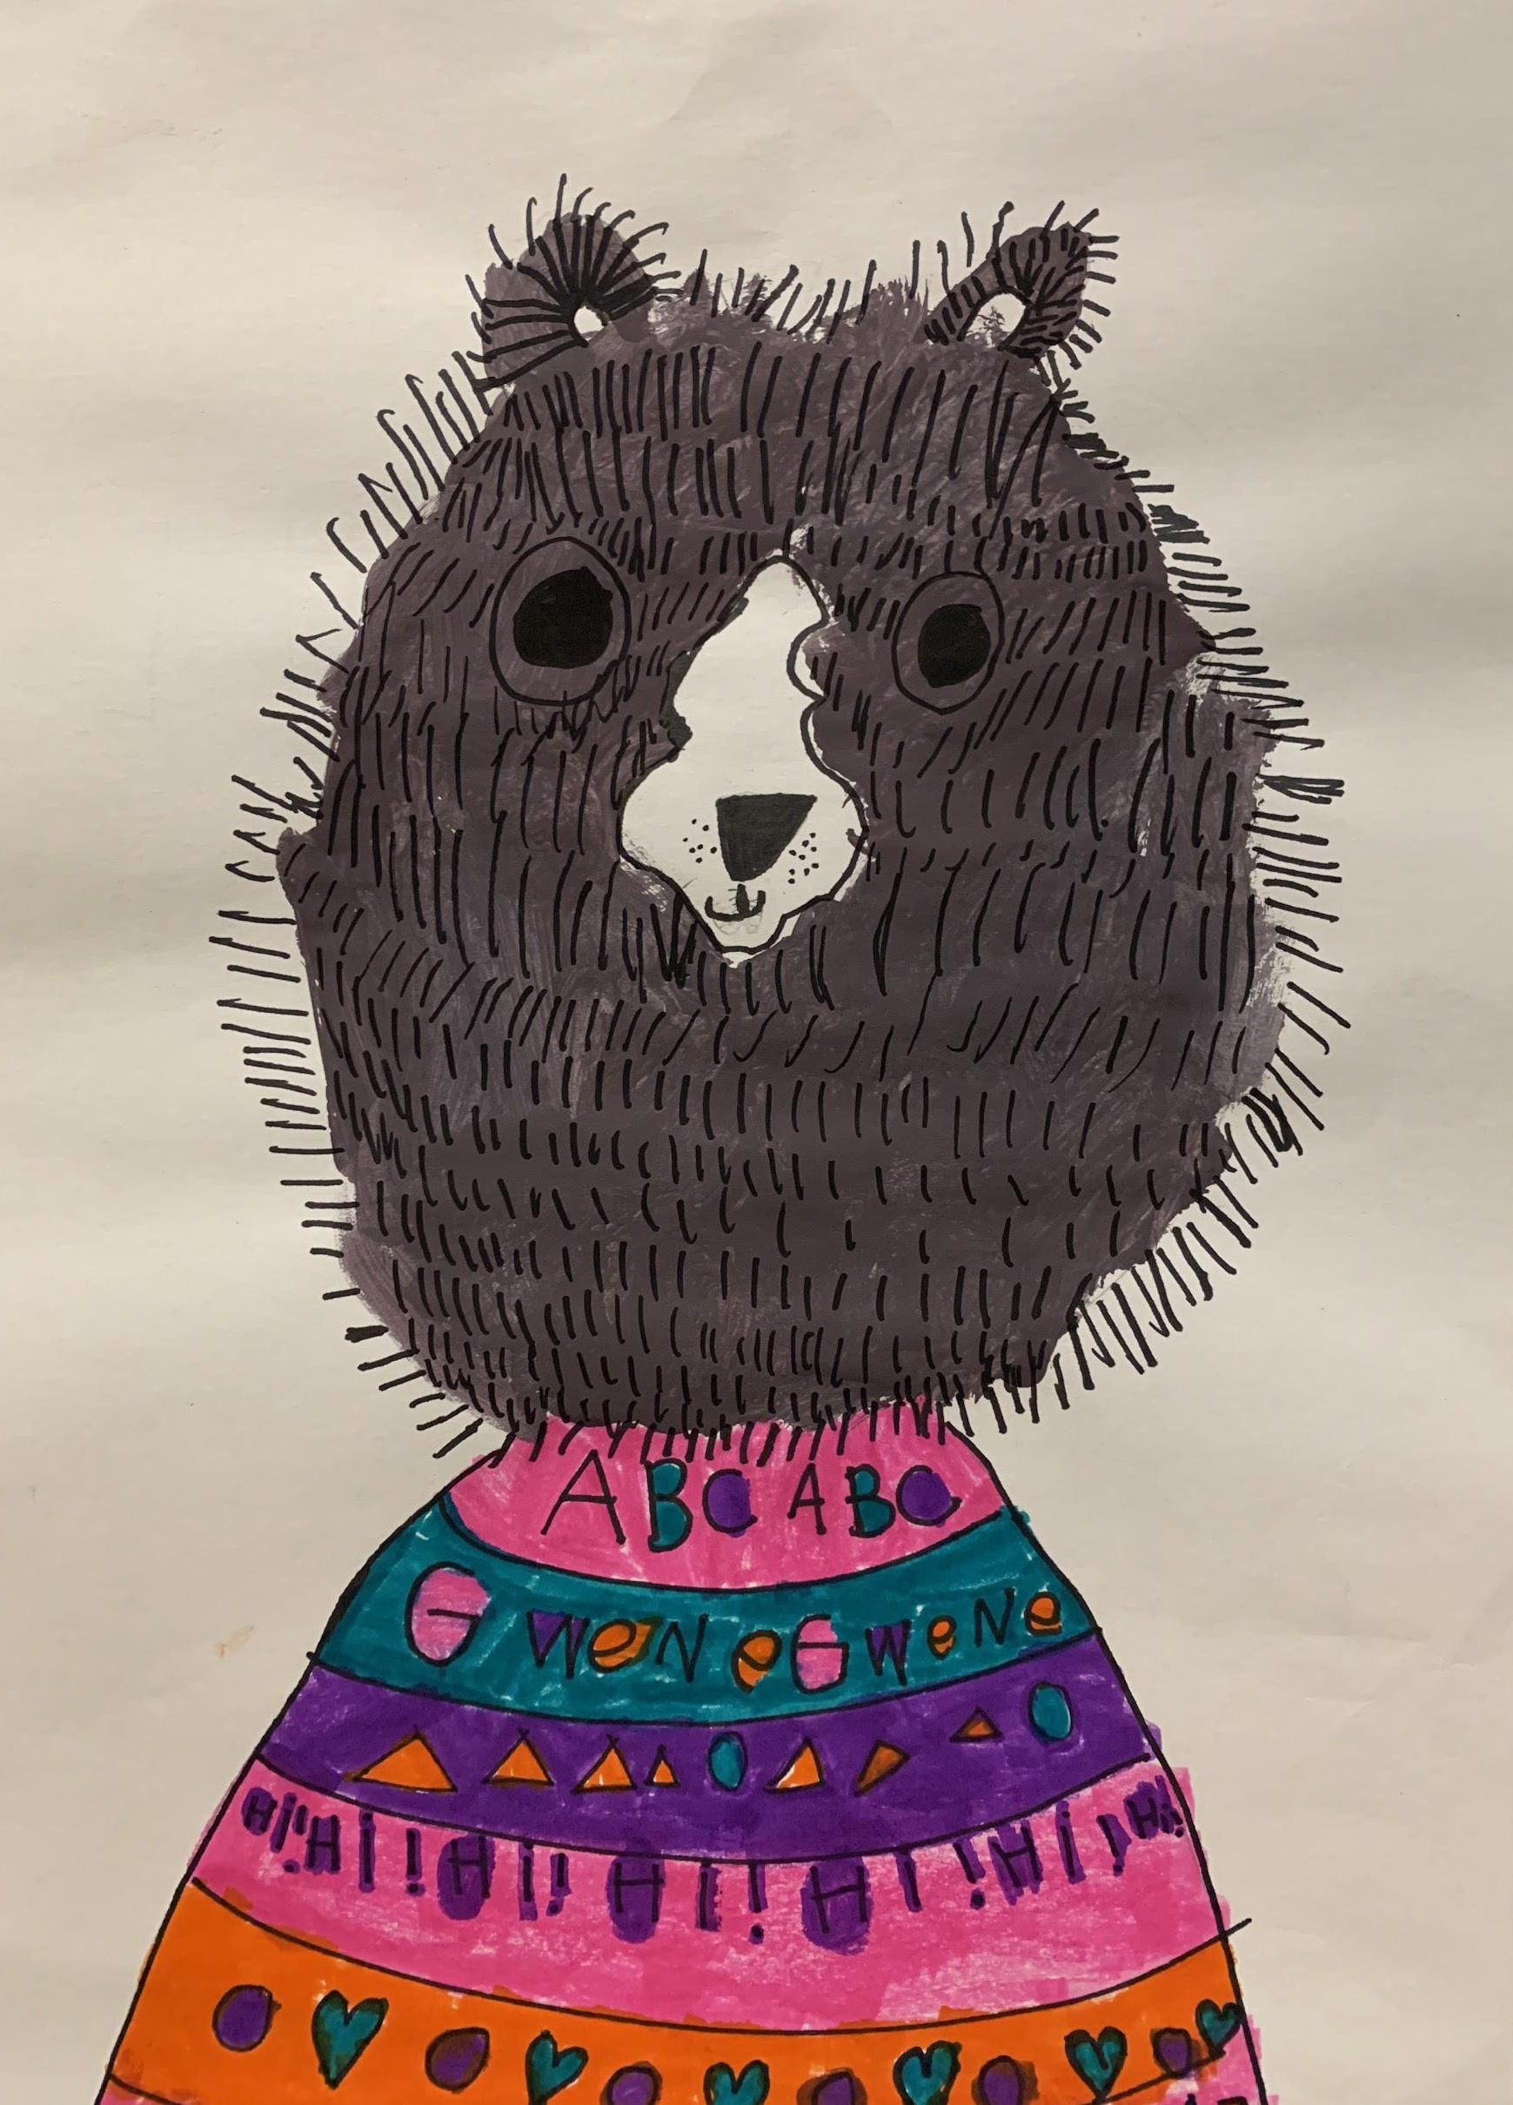
Gwen Adkinson, Grade 1

Slide 18
Notre Dame High School
Notre Dame High School
Ellen Royal
MAEA District #8

Slide 19
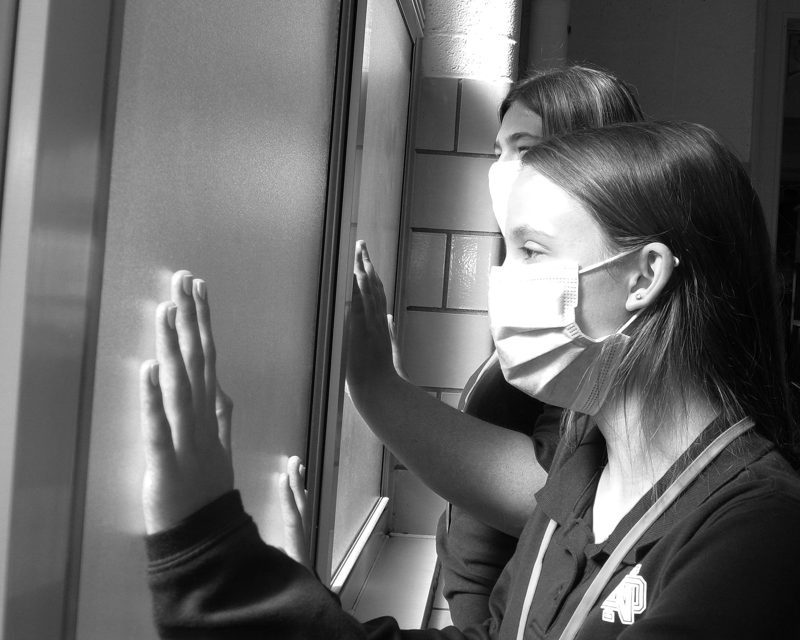
Maya Wobbe, 10th Grade

Slide 20
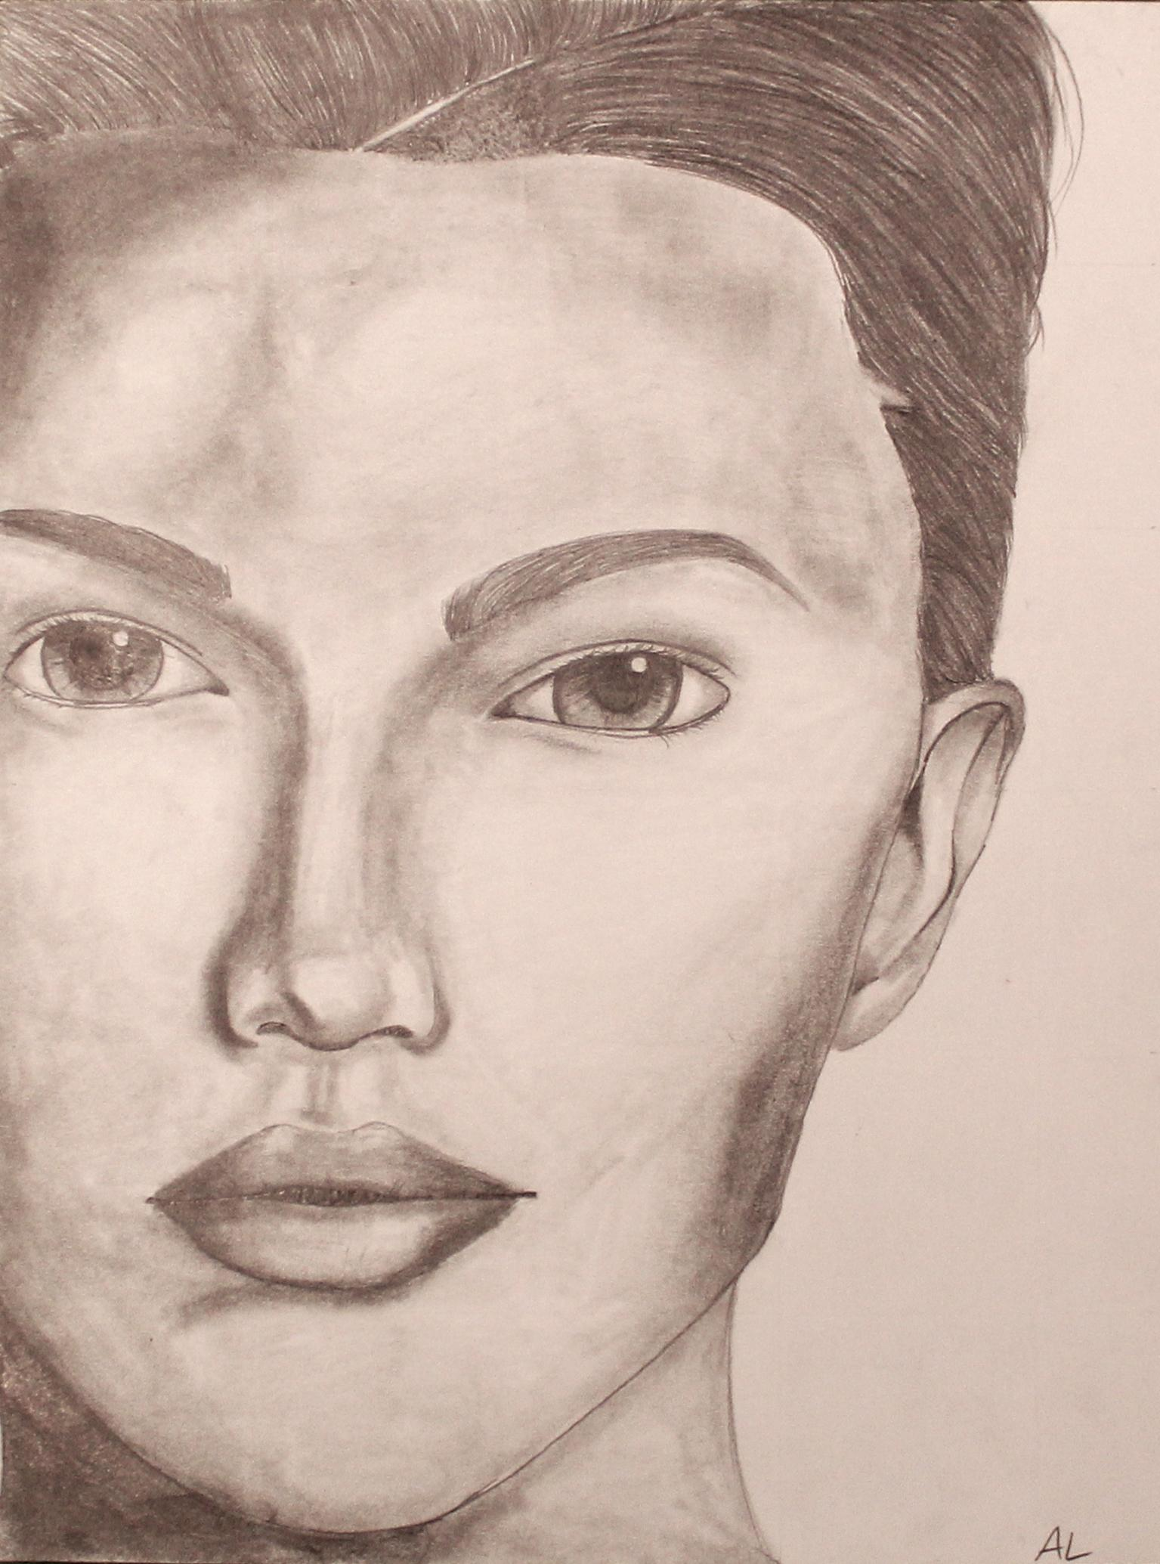
Abigail Love, 11th Grade

Slide 21
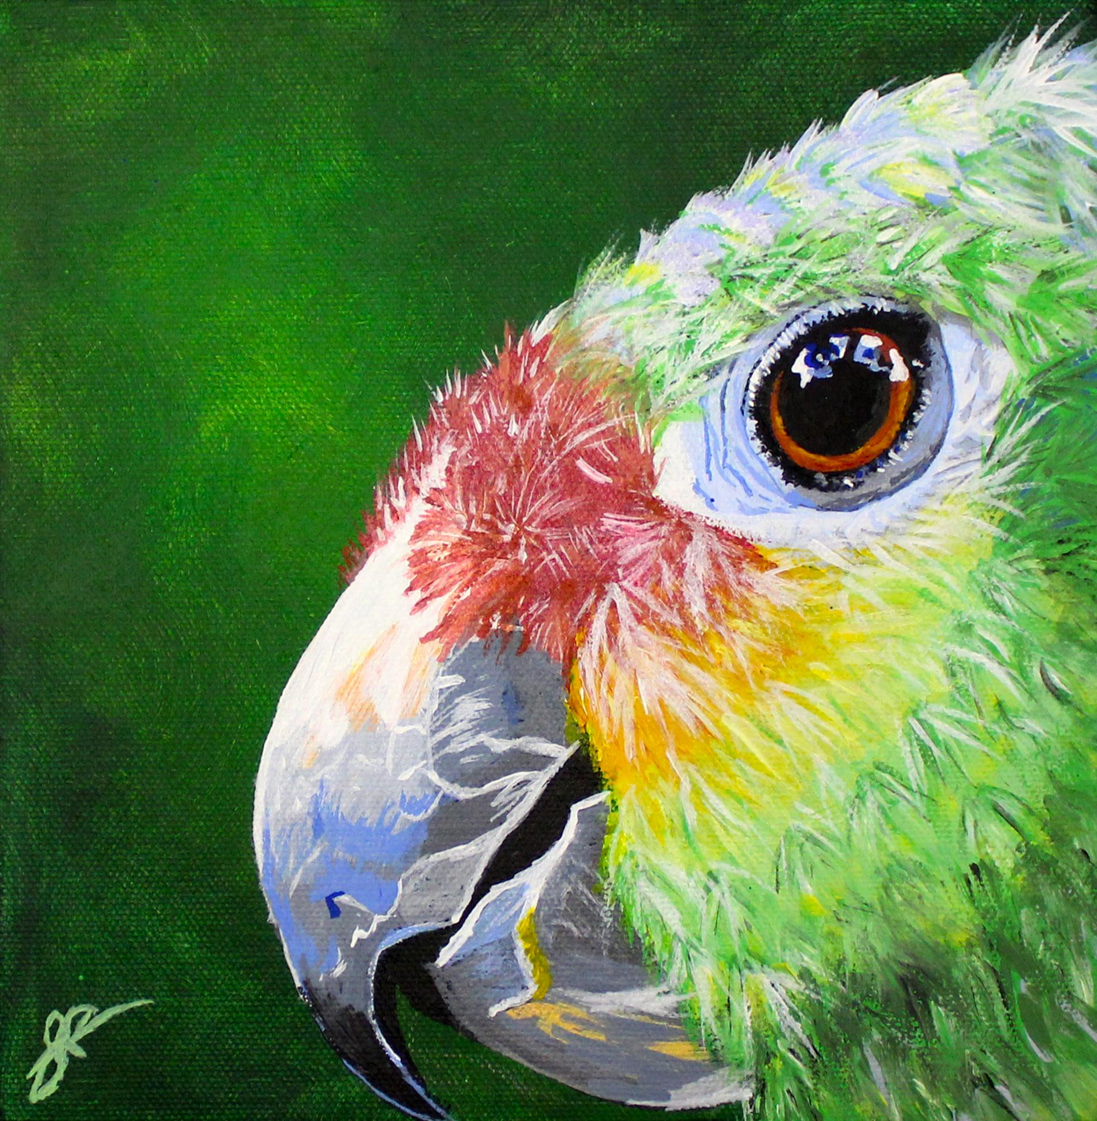
Shelby Roeder, 12th Grade

Slide 22
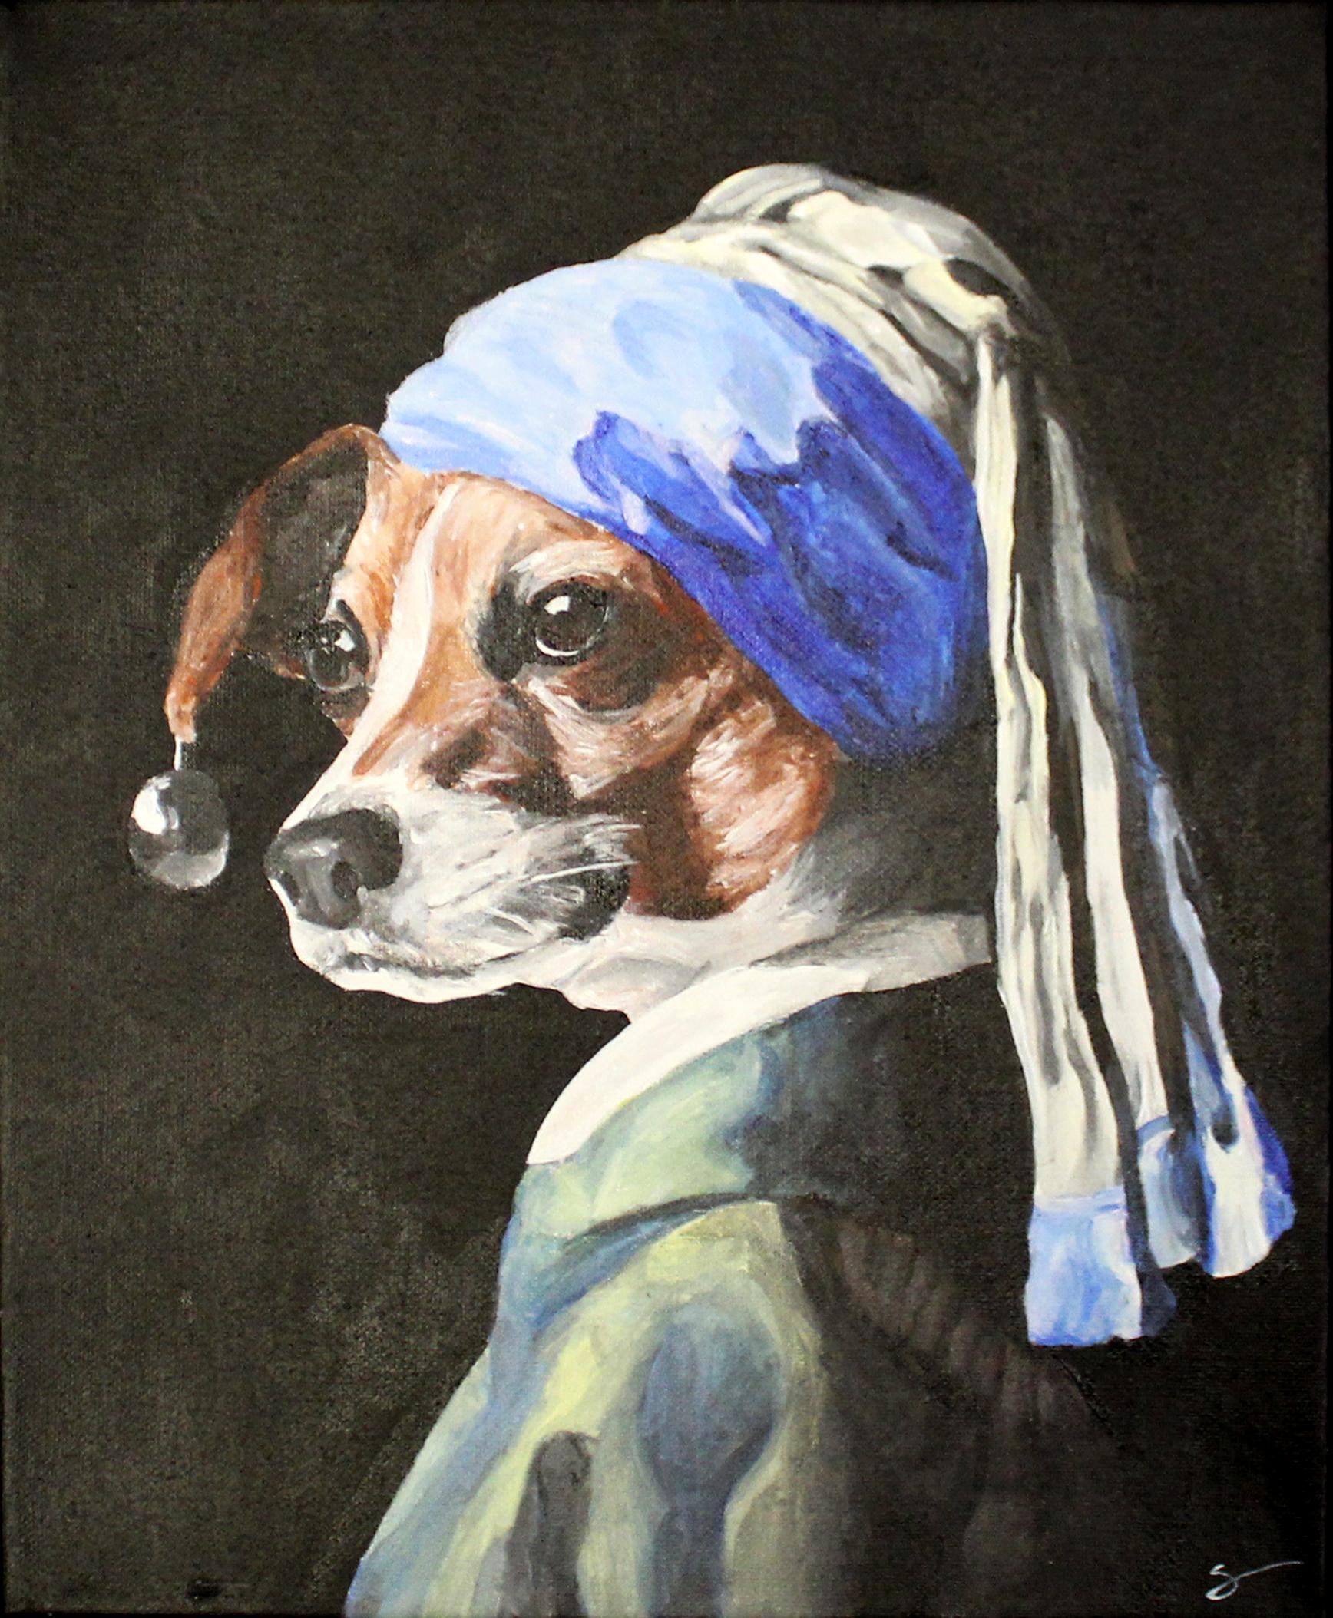
Samantha Ramay, 12th Grade

Slide 23
Carl Junction High School
Carl Junction
Nellie Mitchell
MAEA District #9

Slide 24
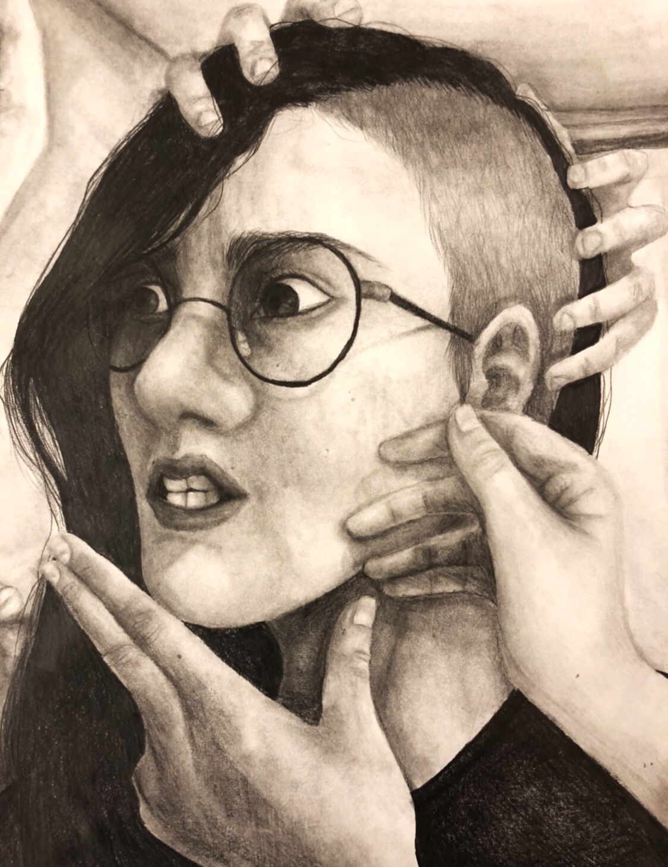
Kayden Sees, 10th Grade

Slide 25
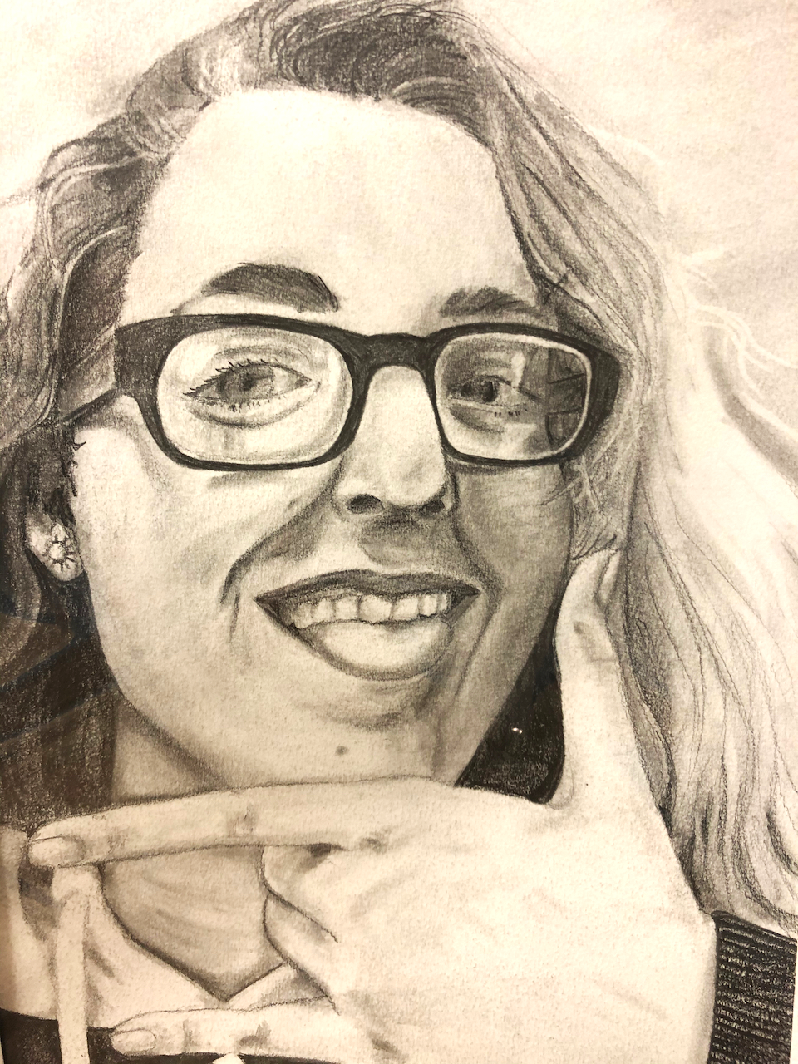
Bailey Harrison, 11th Grade

Slide 26
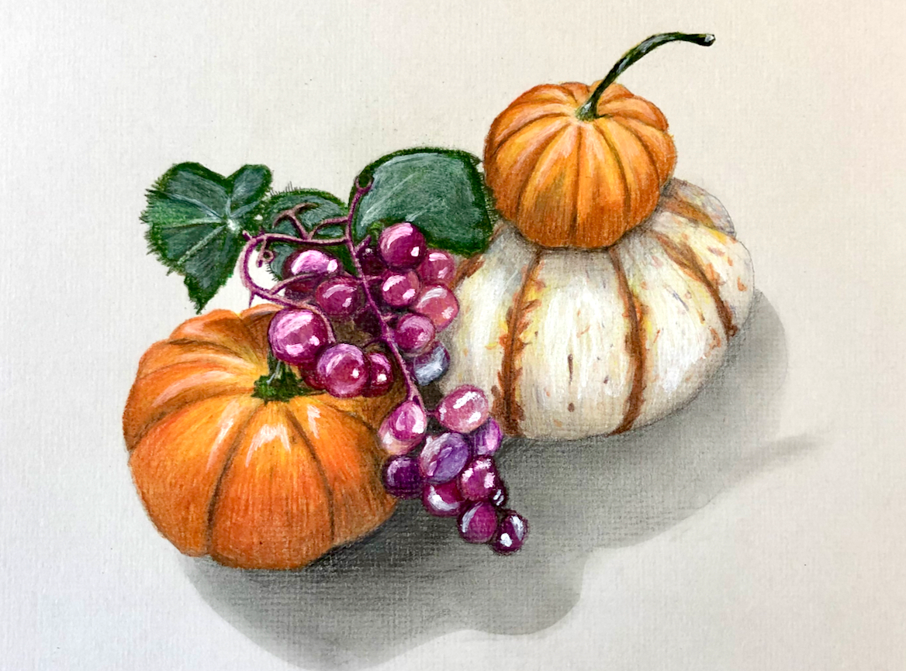
Alexandra Boman, 12th Grade

Slide 27
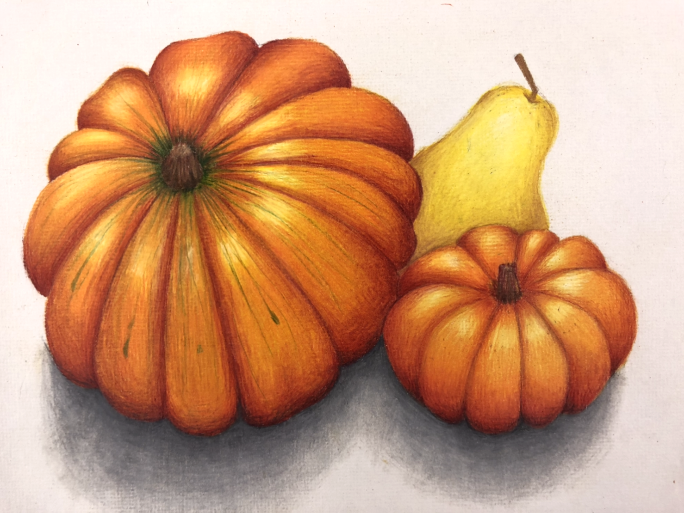
Anna-Kaye Vangilder, 11th Grade

Slide 28
Immaculate Conception School
Springfield Catholic Schools
Glad Eyerman
MAEA District #10

Slide 29
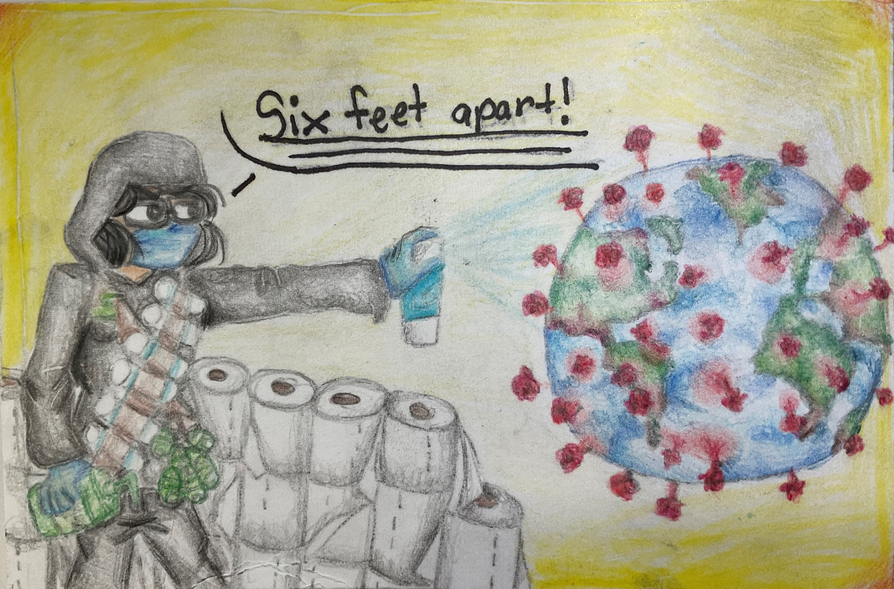
Sonja Samala, 8th Grade

Slide 30
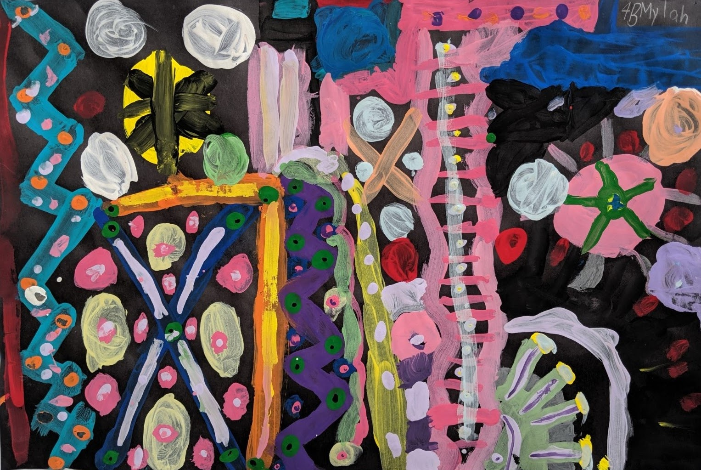
Mylah Wright, 4th Grade

Slide 31
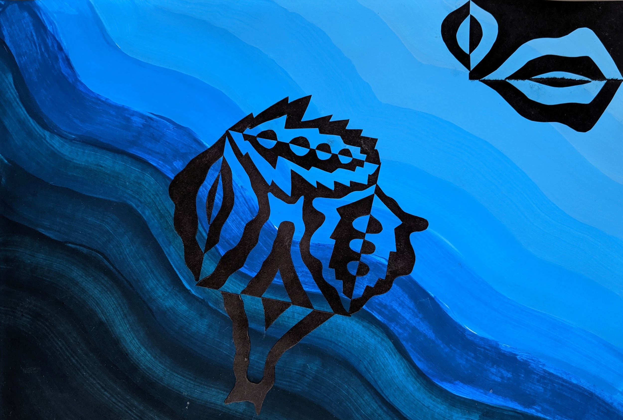
Peyton Wiseman, 8th Grade

Slide 32
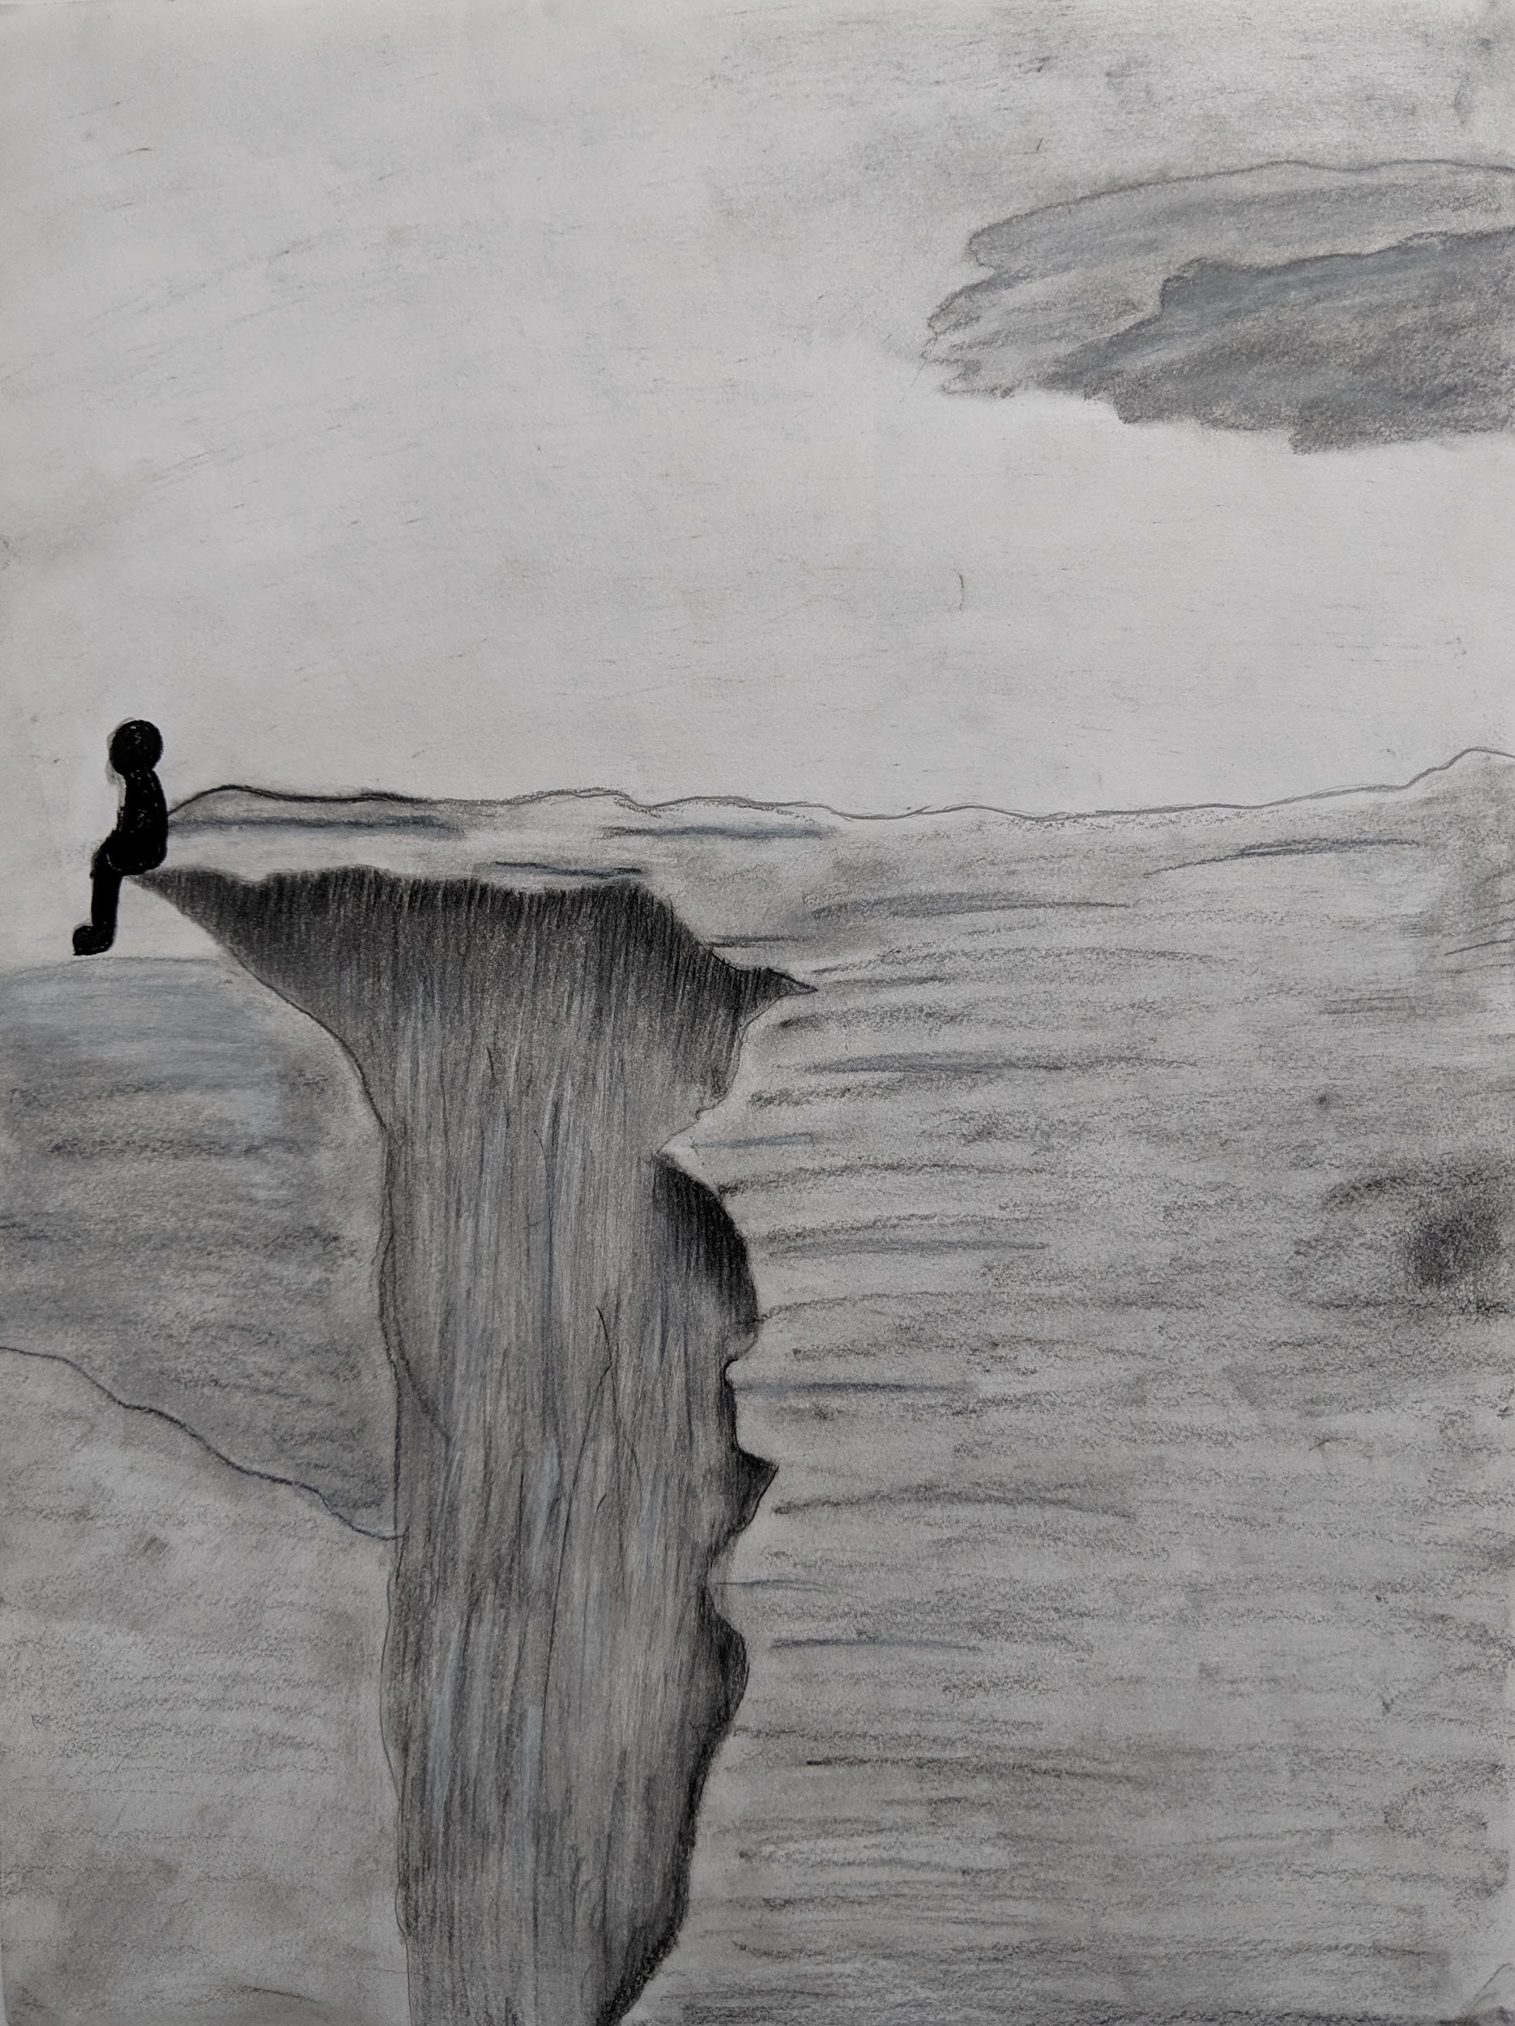
Dorothy Reisner, 6th Grade

Slide 33
Marshfield High School
Marshfield R-1
Tina Hyde
MAEA District #10

Slide 34
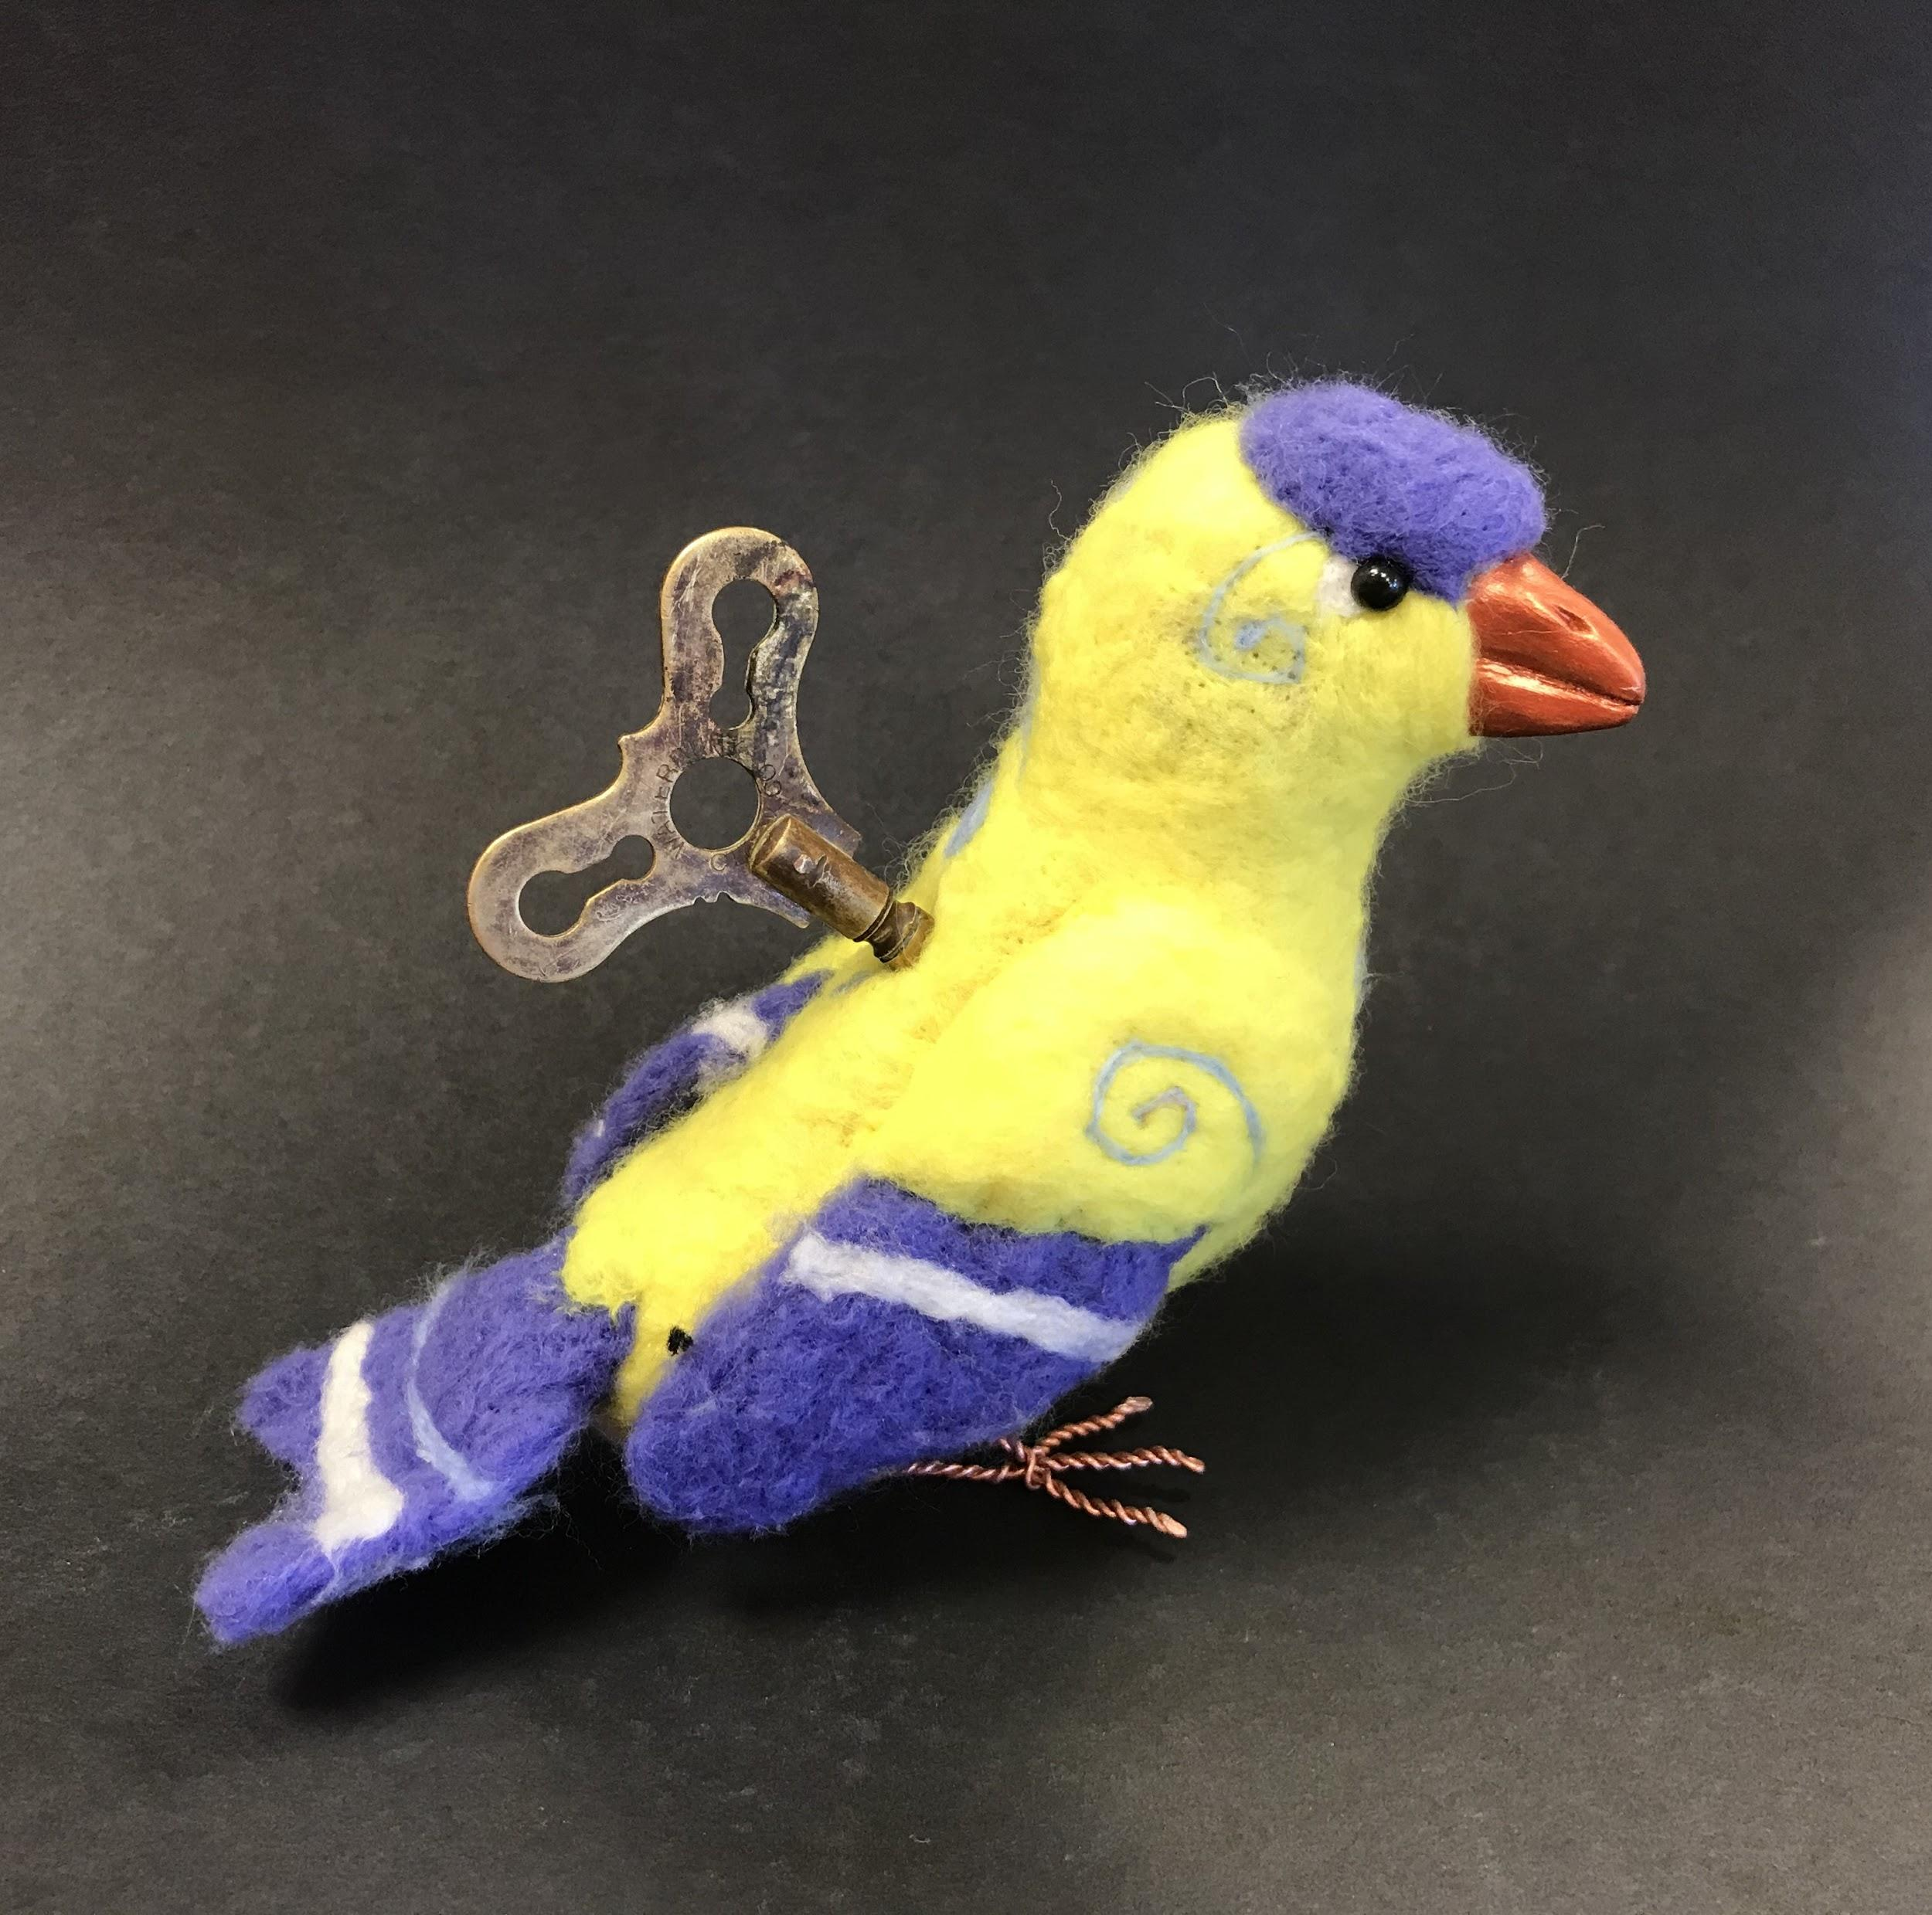
Madison Phillips, 10th Grade

Slide 35
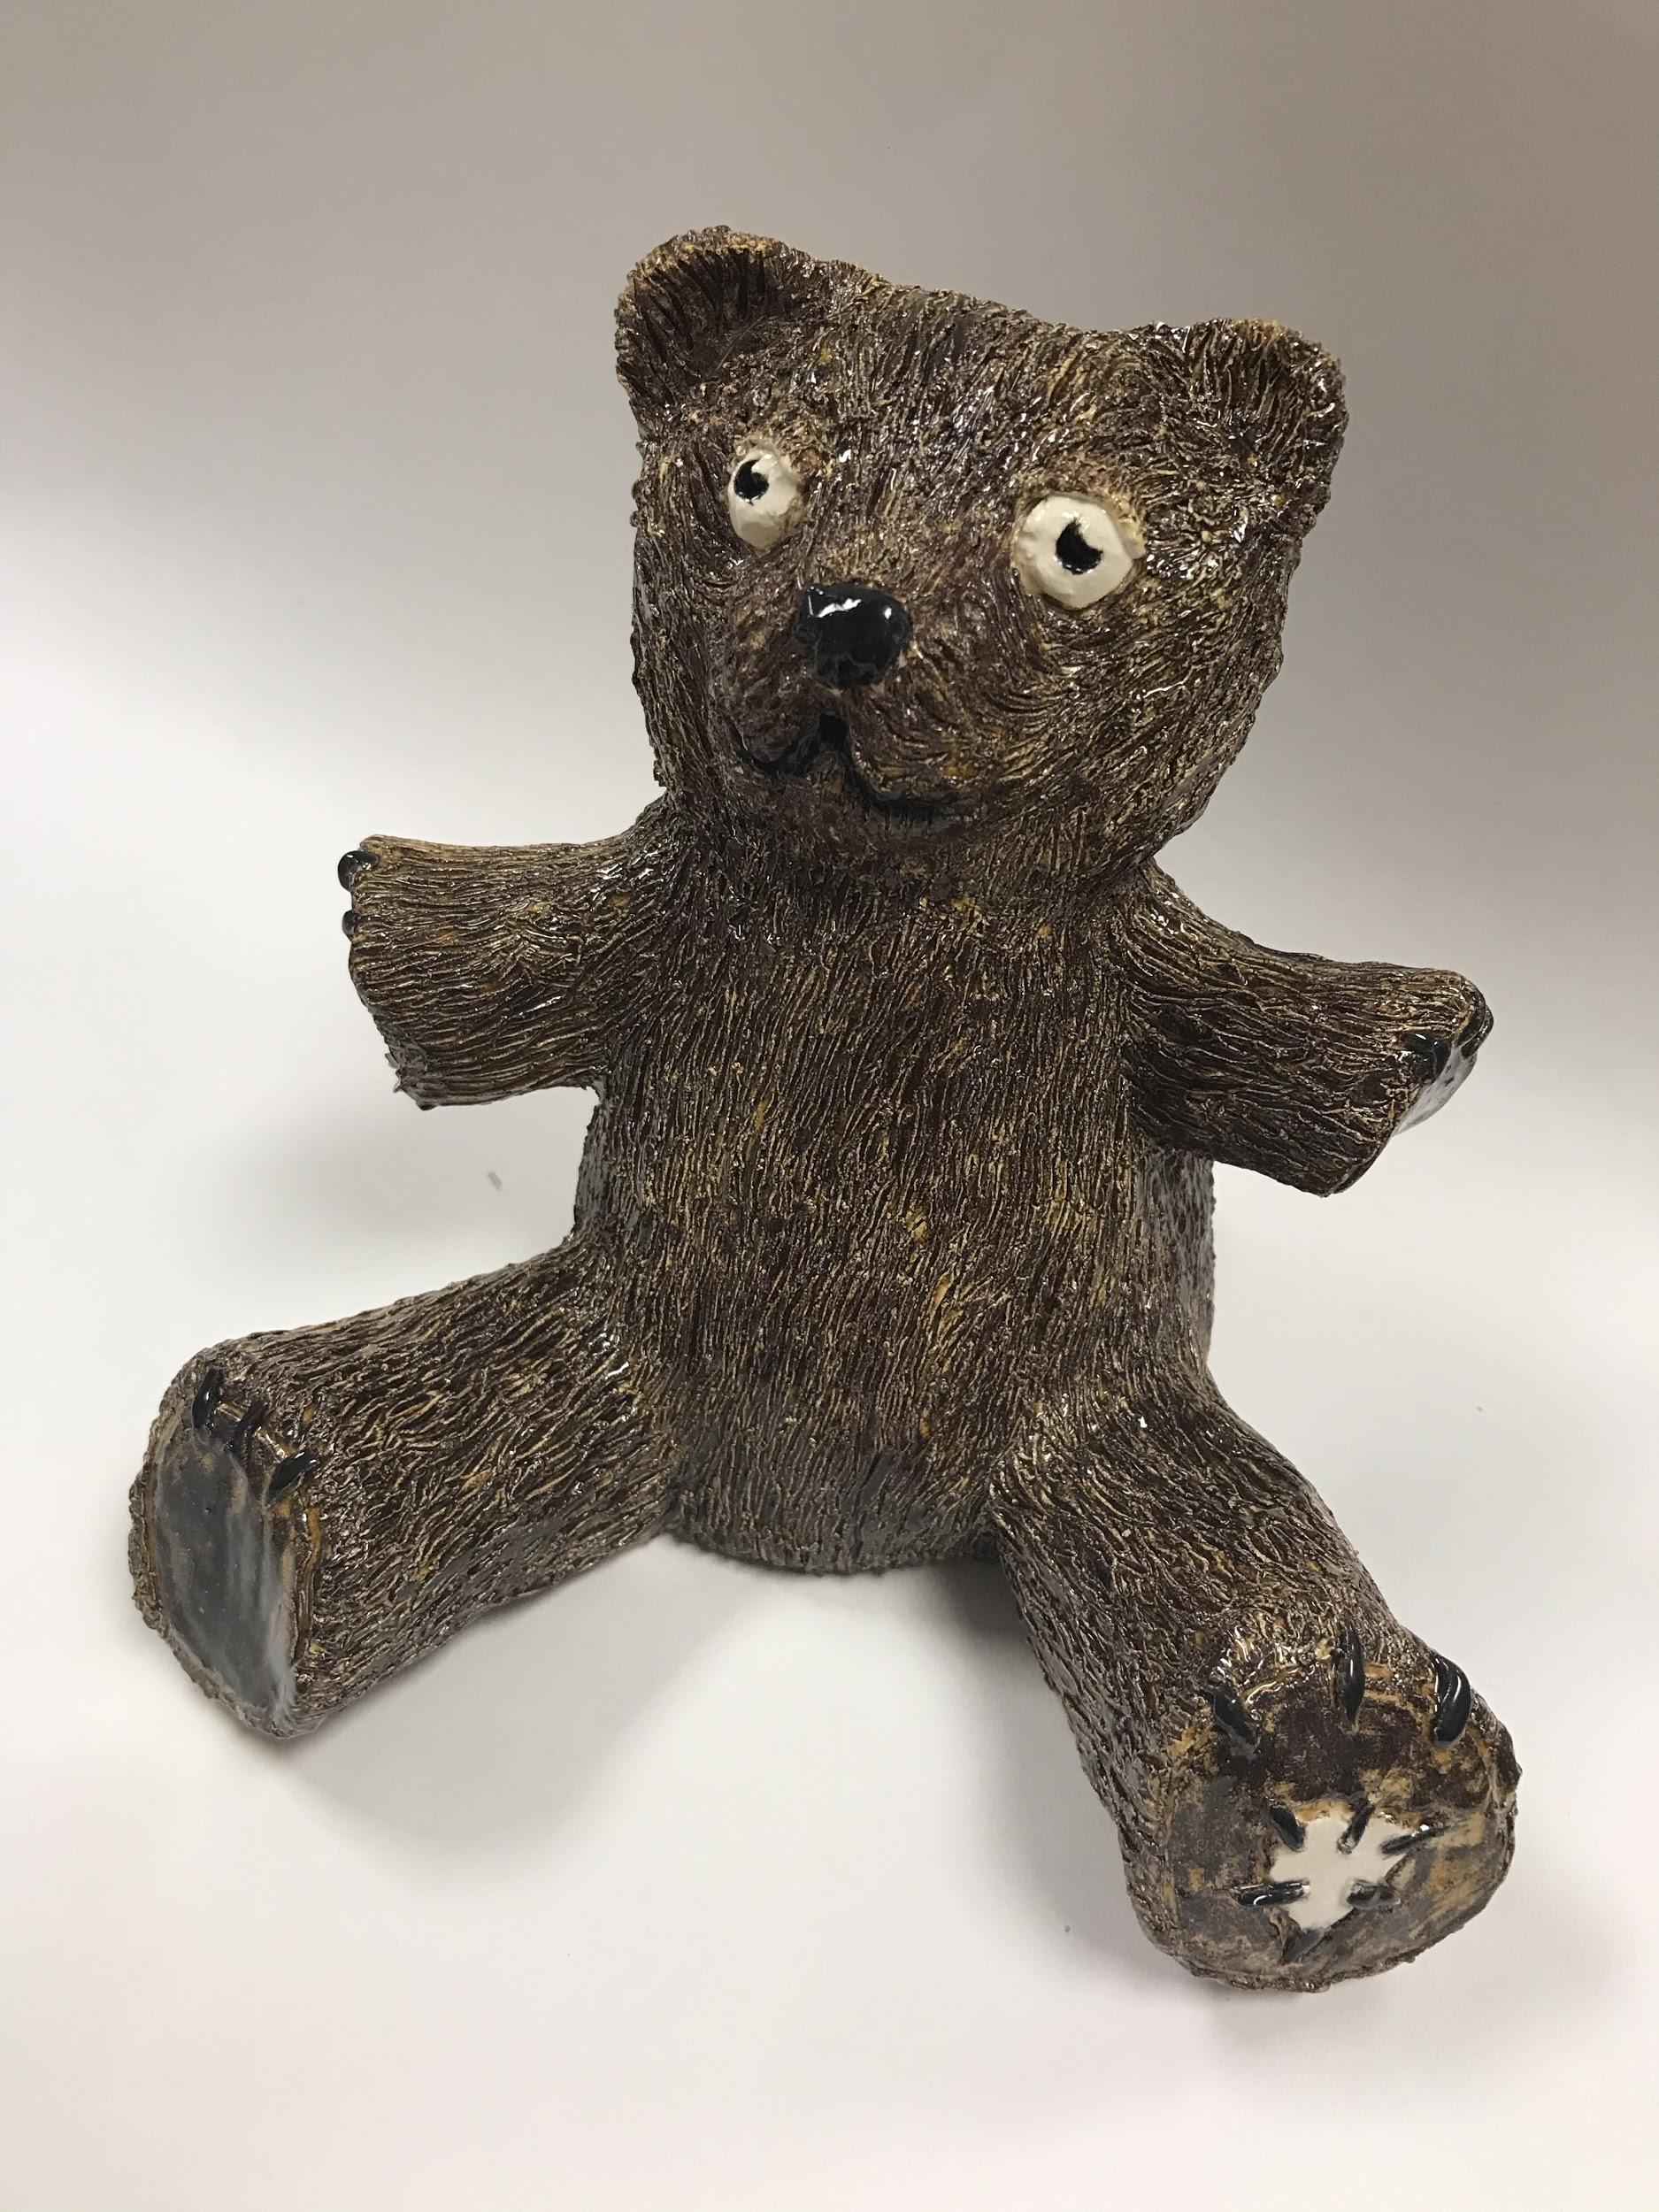
Jackie Shockley, 11th Grade

Slide 36
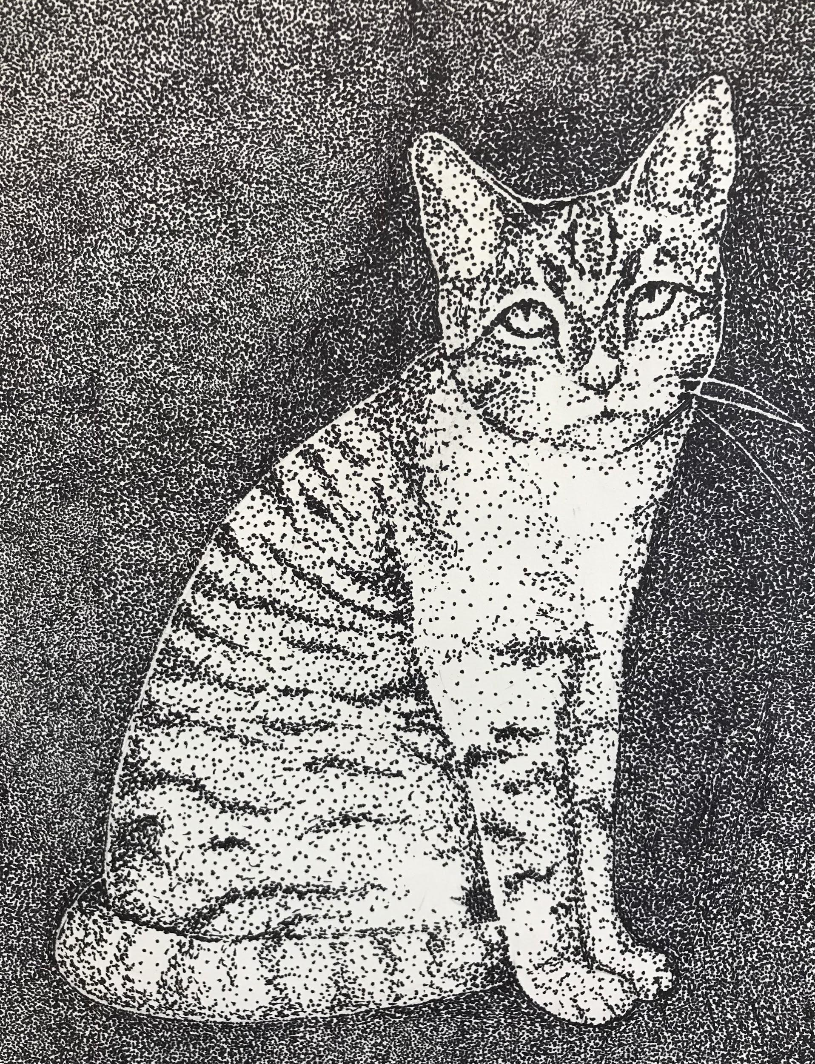
Lauren Replogle, 9th Grade

Slide 37
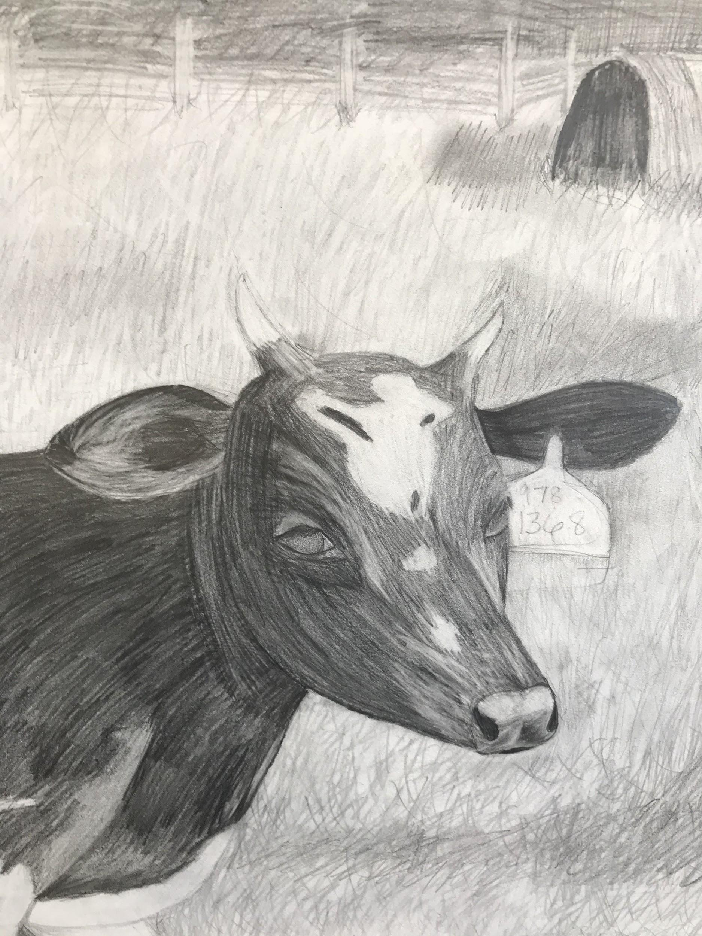
Jazmen Vinyard, 9th Grade

Slide 38
Nixa High School
Nixa Public Schools
Megan Johnson
MAEA District #10

Slide 39
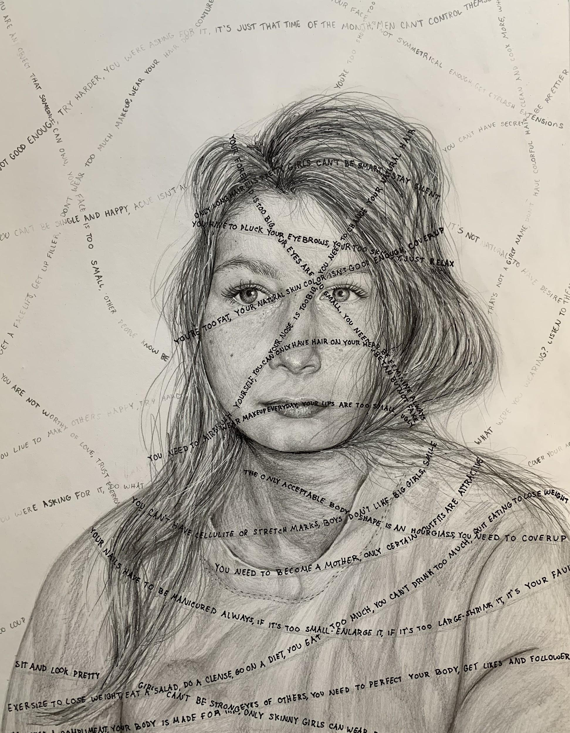
Taylor Golmen, 12th grade
Artist statement

Slide 40
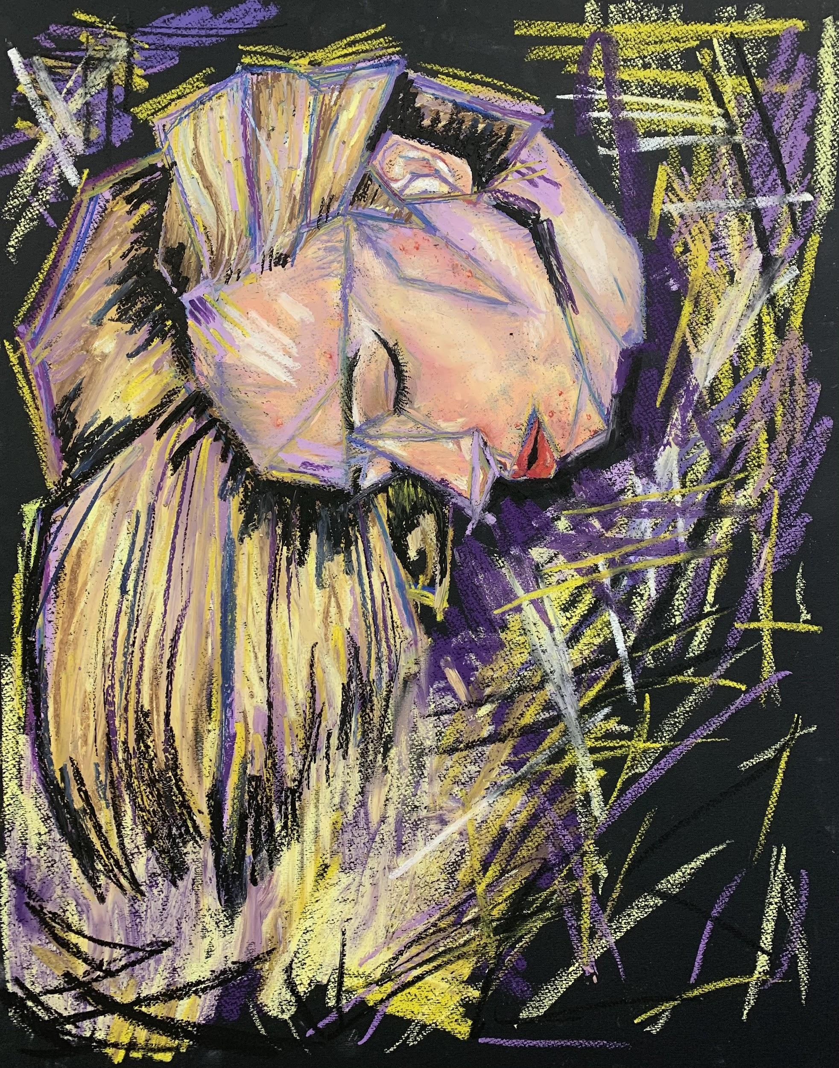
Parri McCroskey, 12th grade

Slide 41
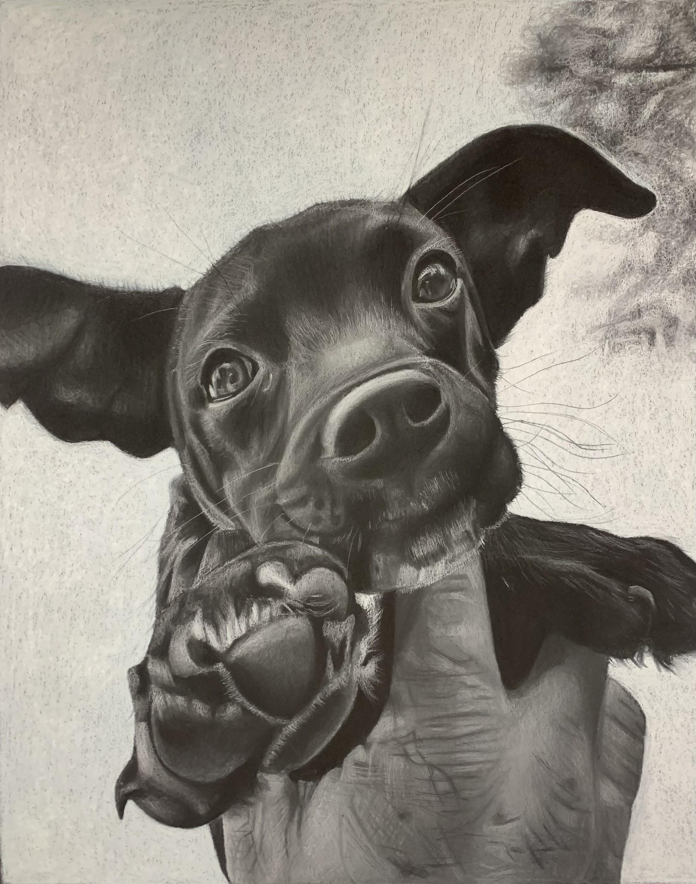
Tori Carter, 11th grade

Slide 42
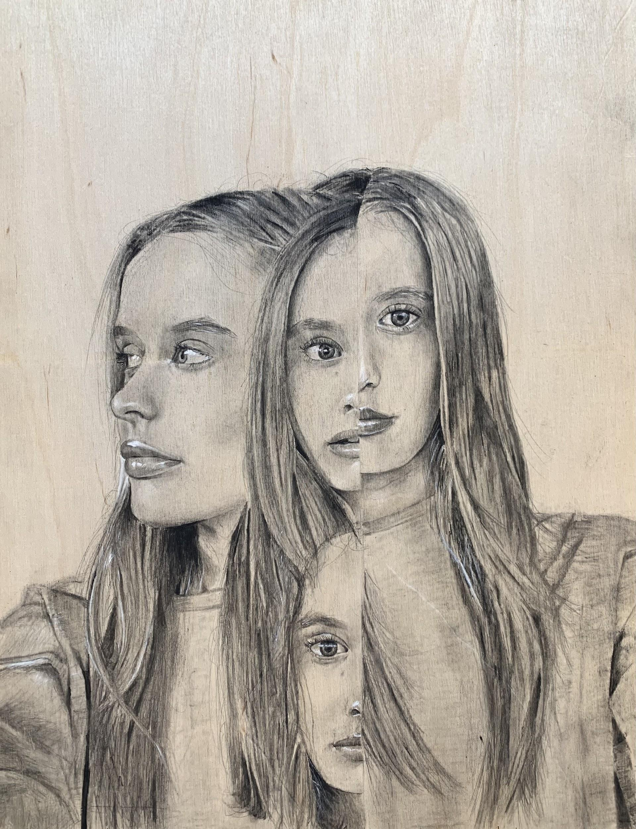
Alicen Ashley, 11th grade
Artist Statement

Slide 43
Esther Elementary
Lebanon R-III School District
Lisa Mutchler
MAEA District #10

Slide 44
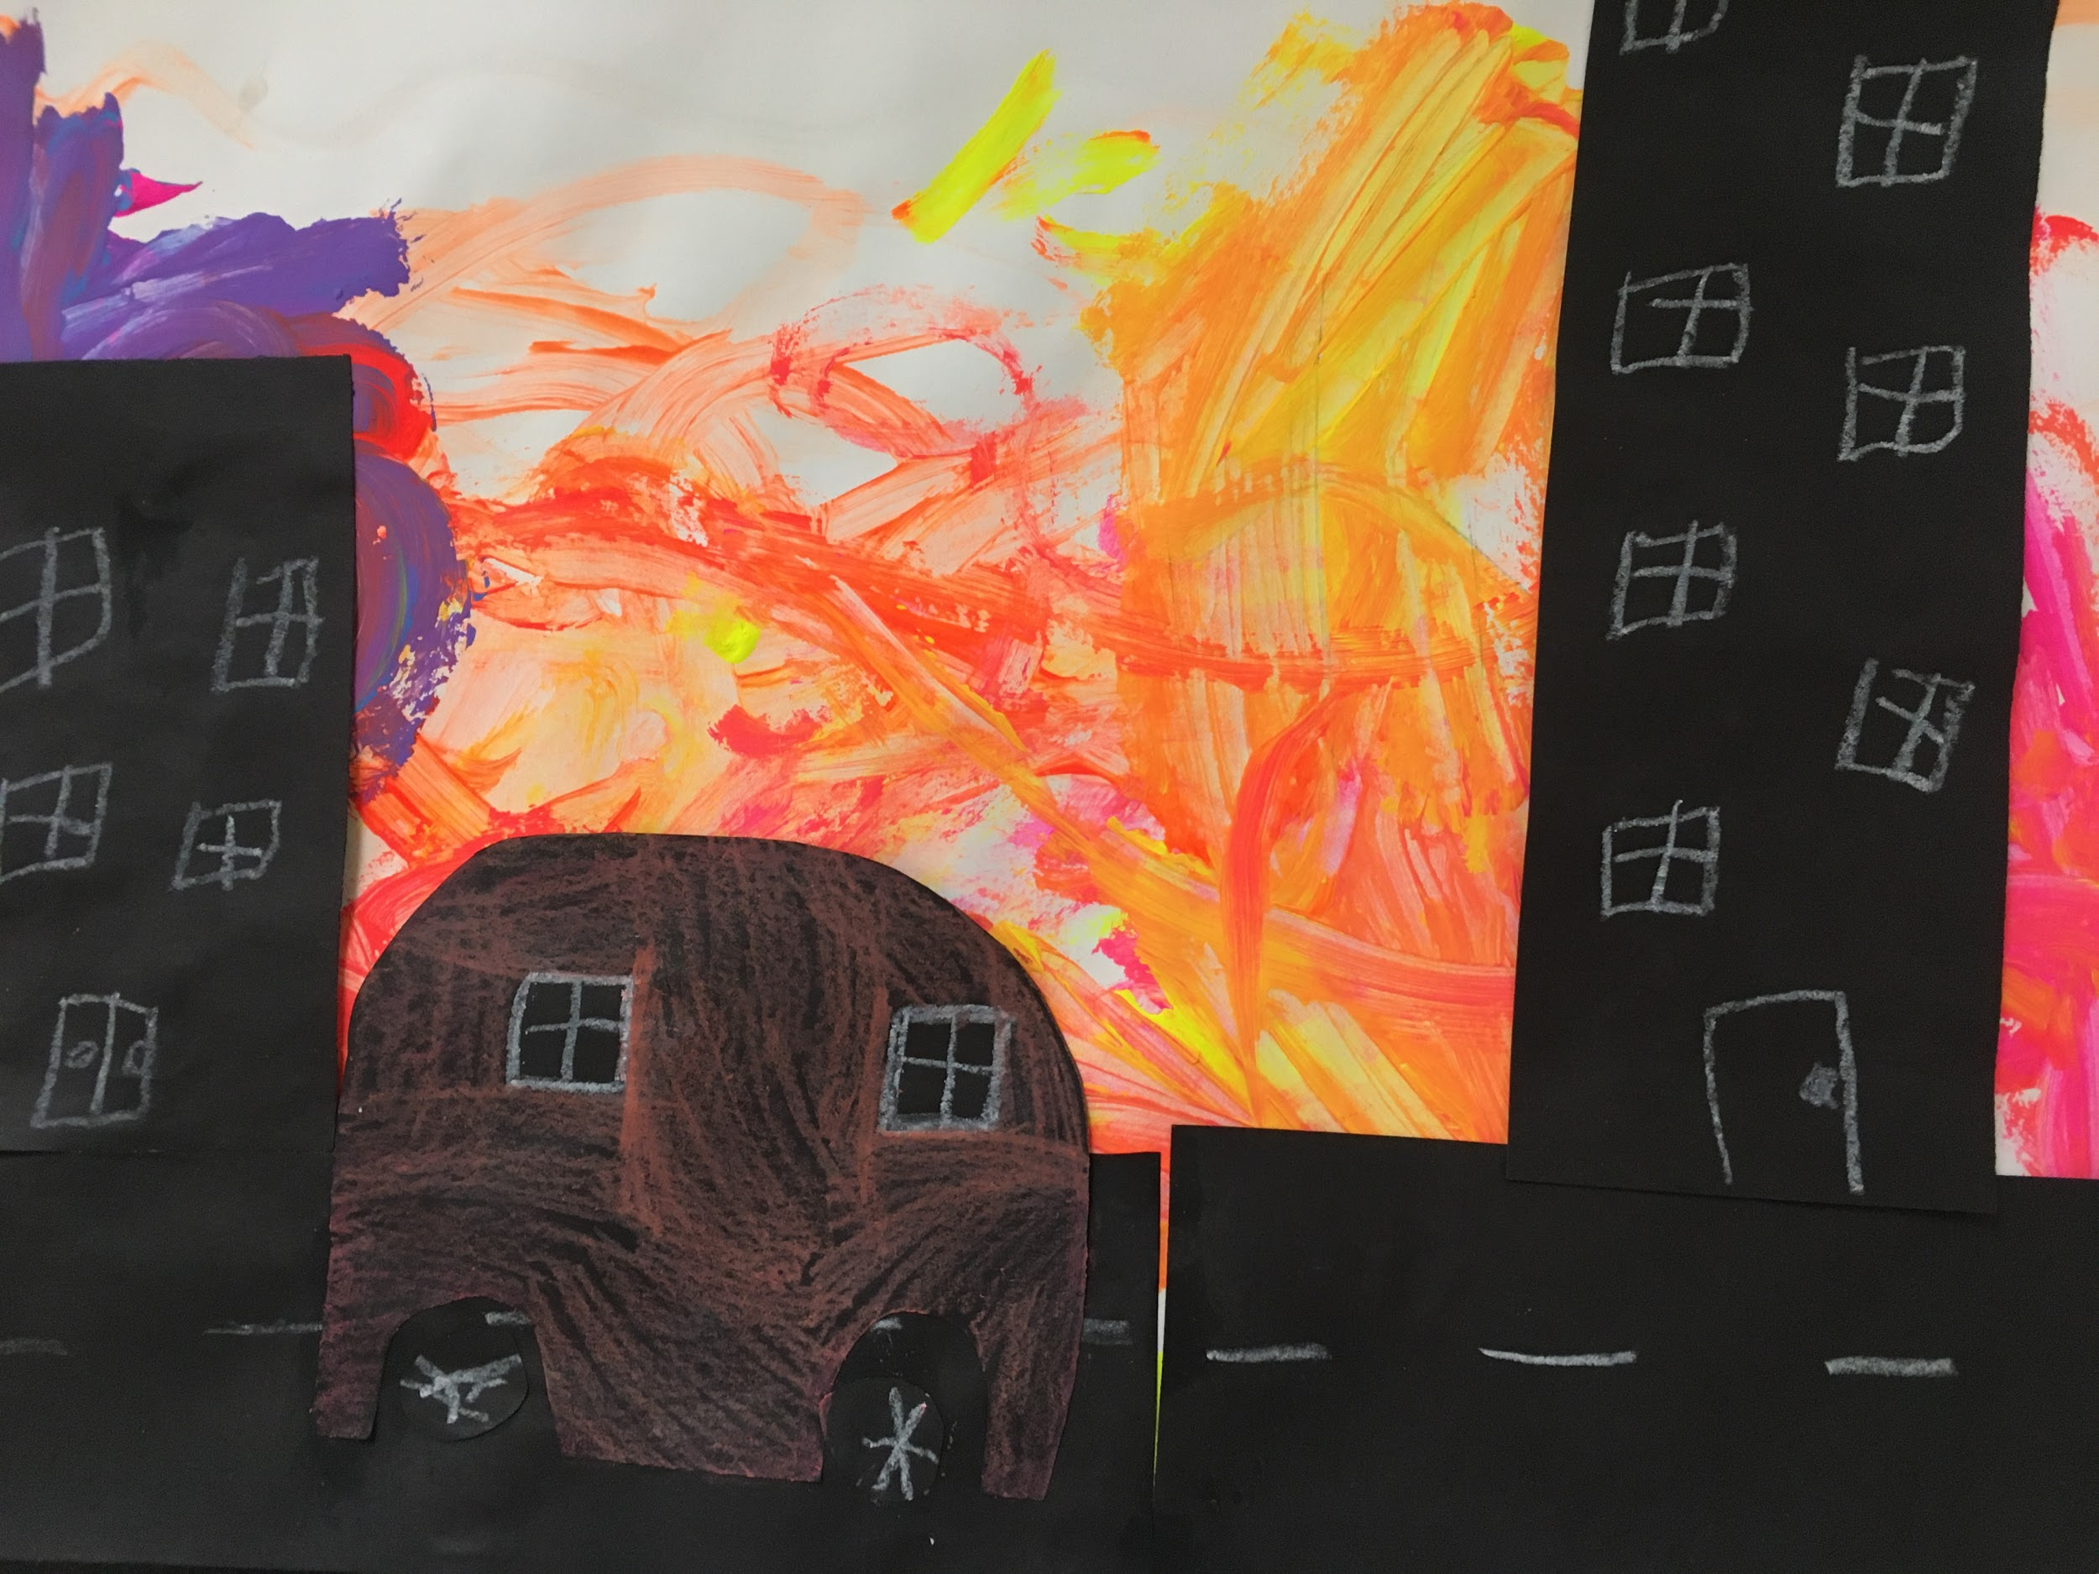

Keaton Rutledge, Grade 1

Slide 45
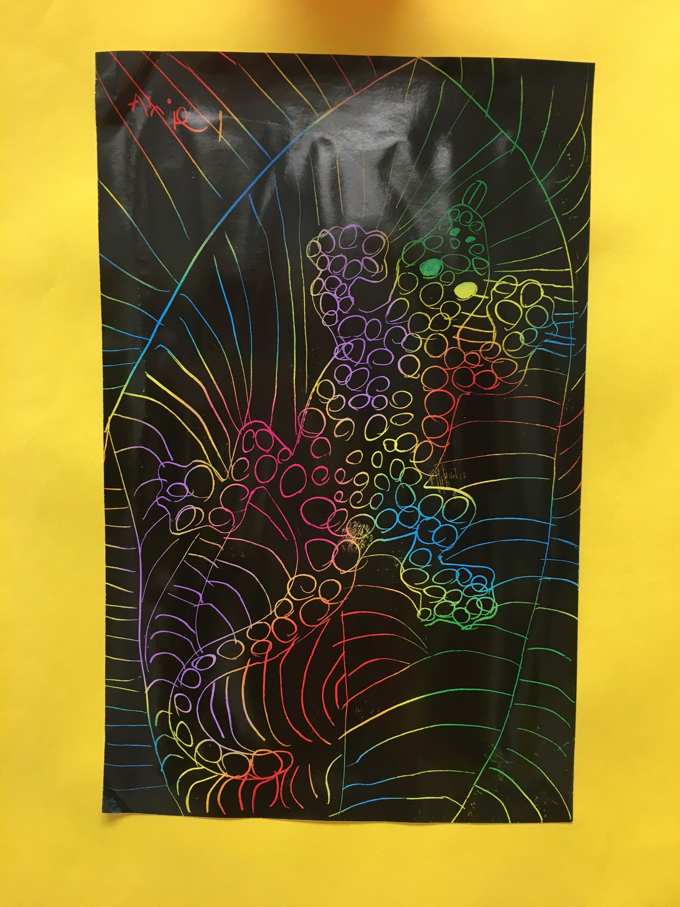
Ariel Dinwiddie, Grade 1

Slide 46
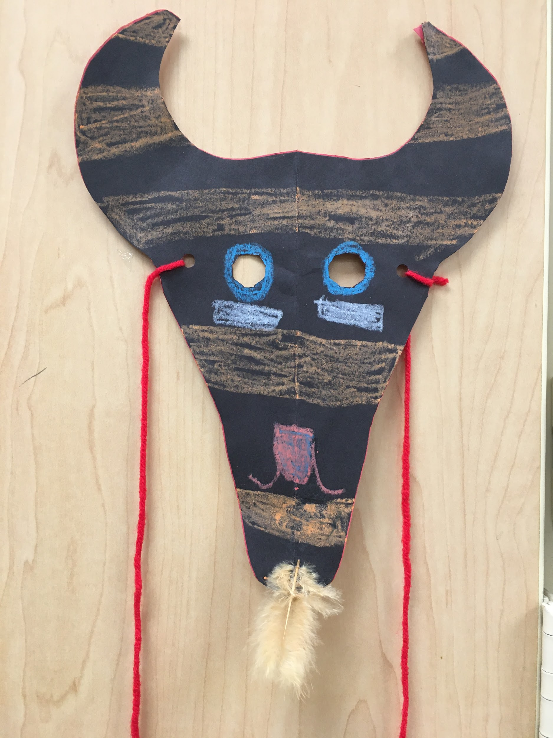
Creek Jones, Grade 1

Slide 47
Springfield Lutheran School
Private
Cyndi Shepard
MAEA District #10

Slide 48
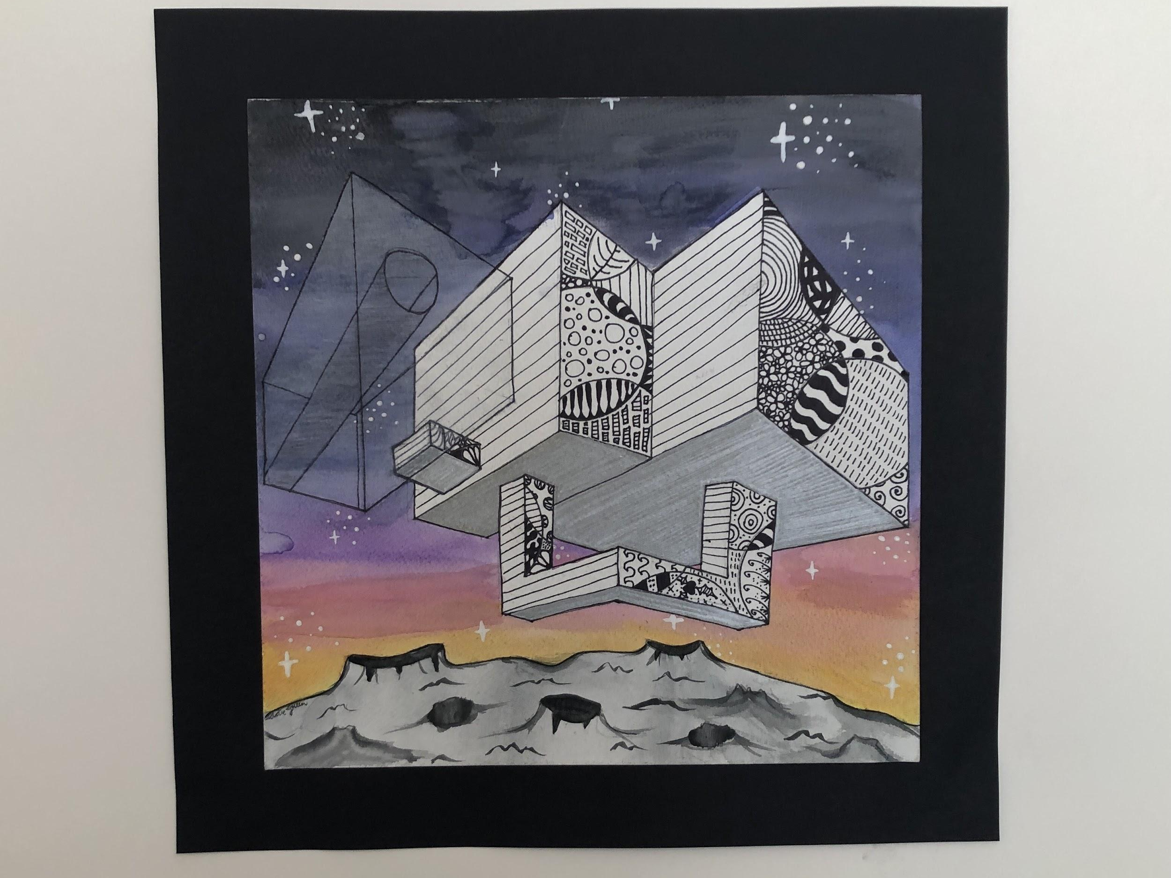
Addie Green, 8th Grade

Slide 49
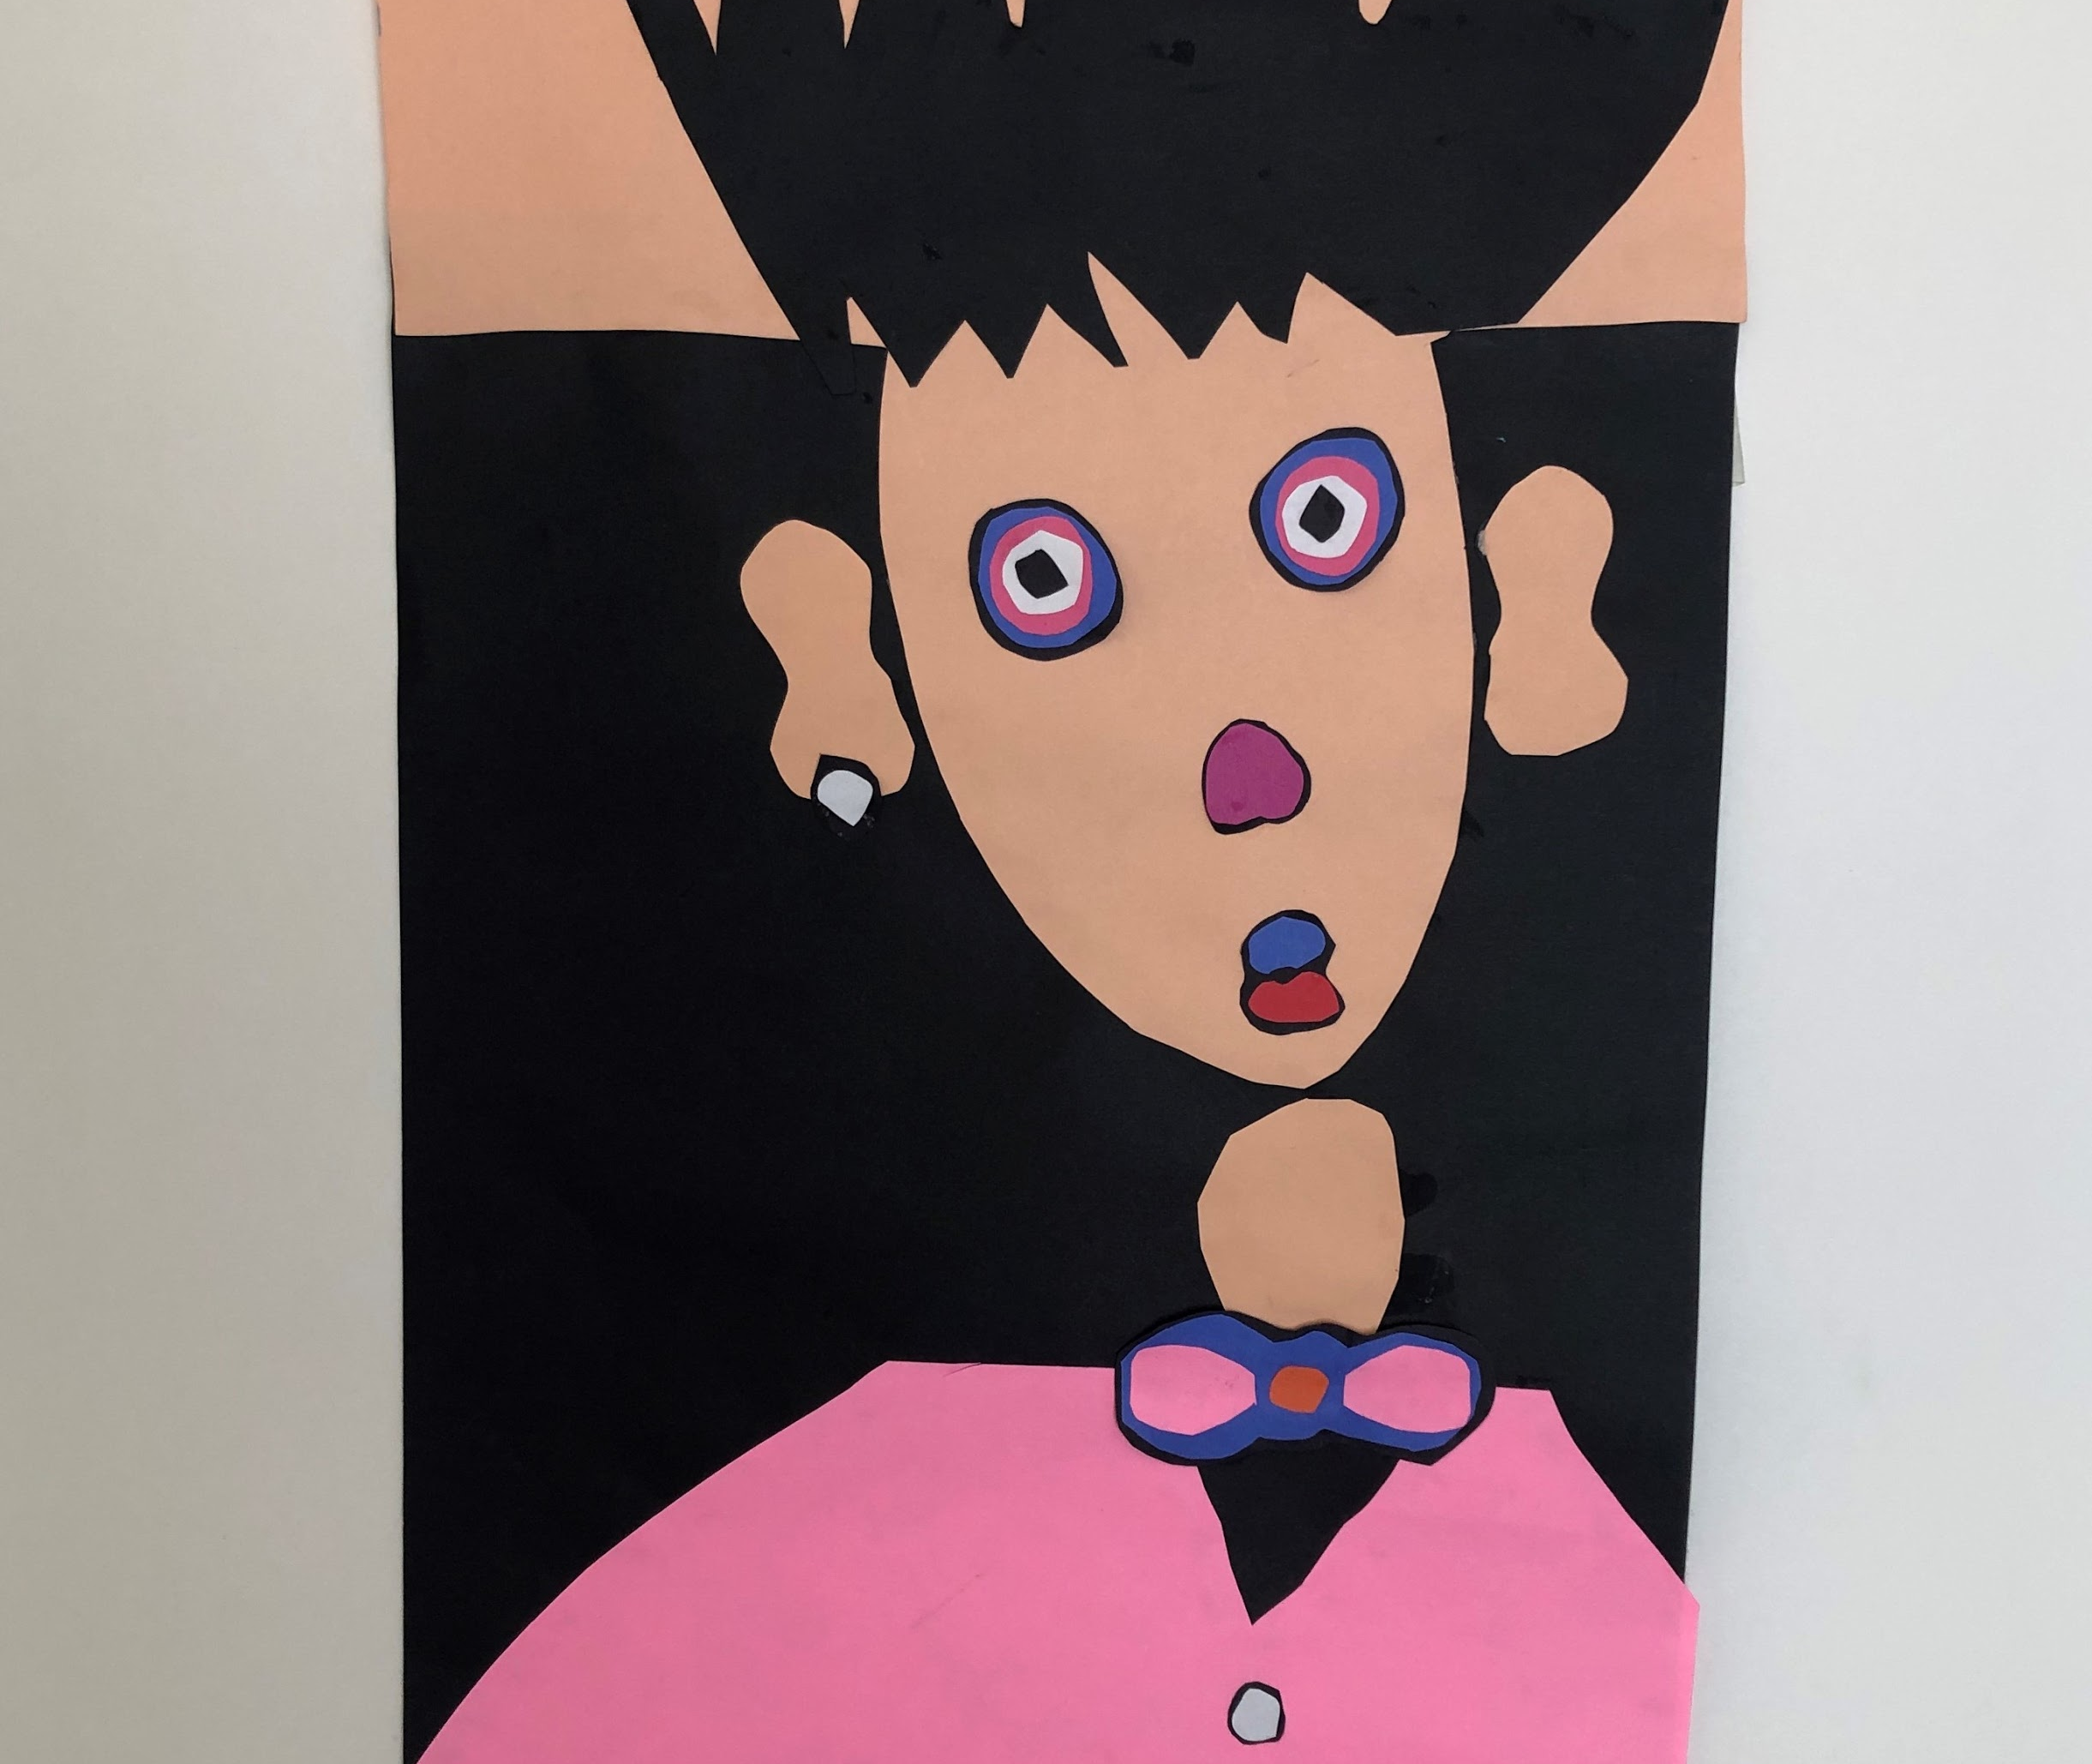
Amelia Green, 3rd Grade

Slide 50
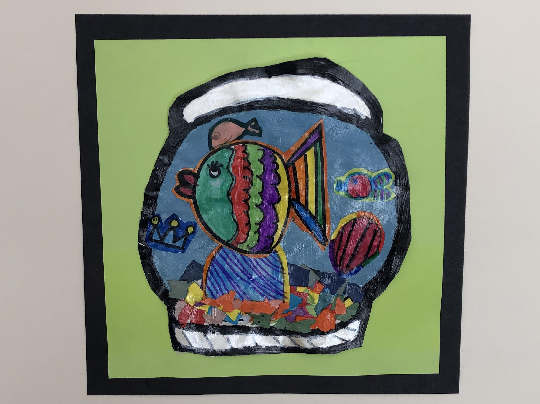
Evie Hargrave, 2nd Grade

Slide 51
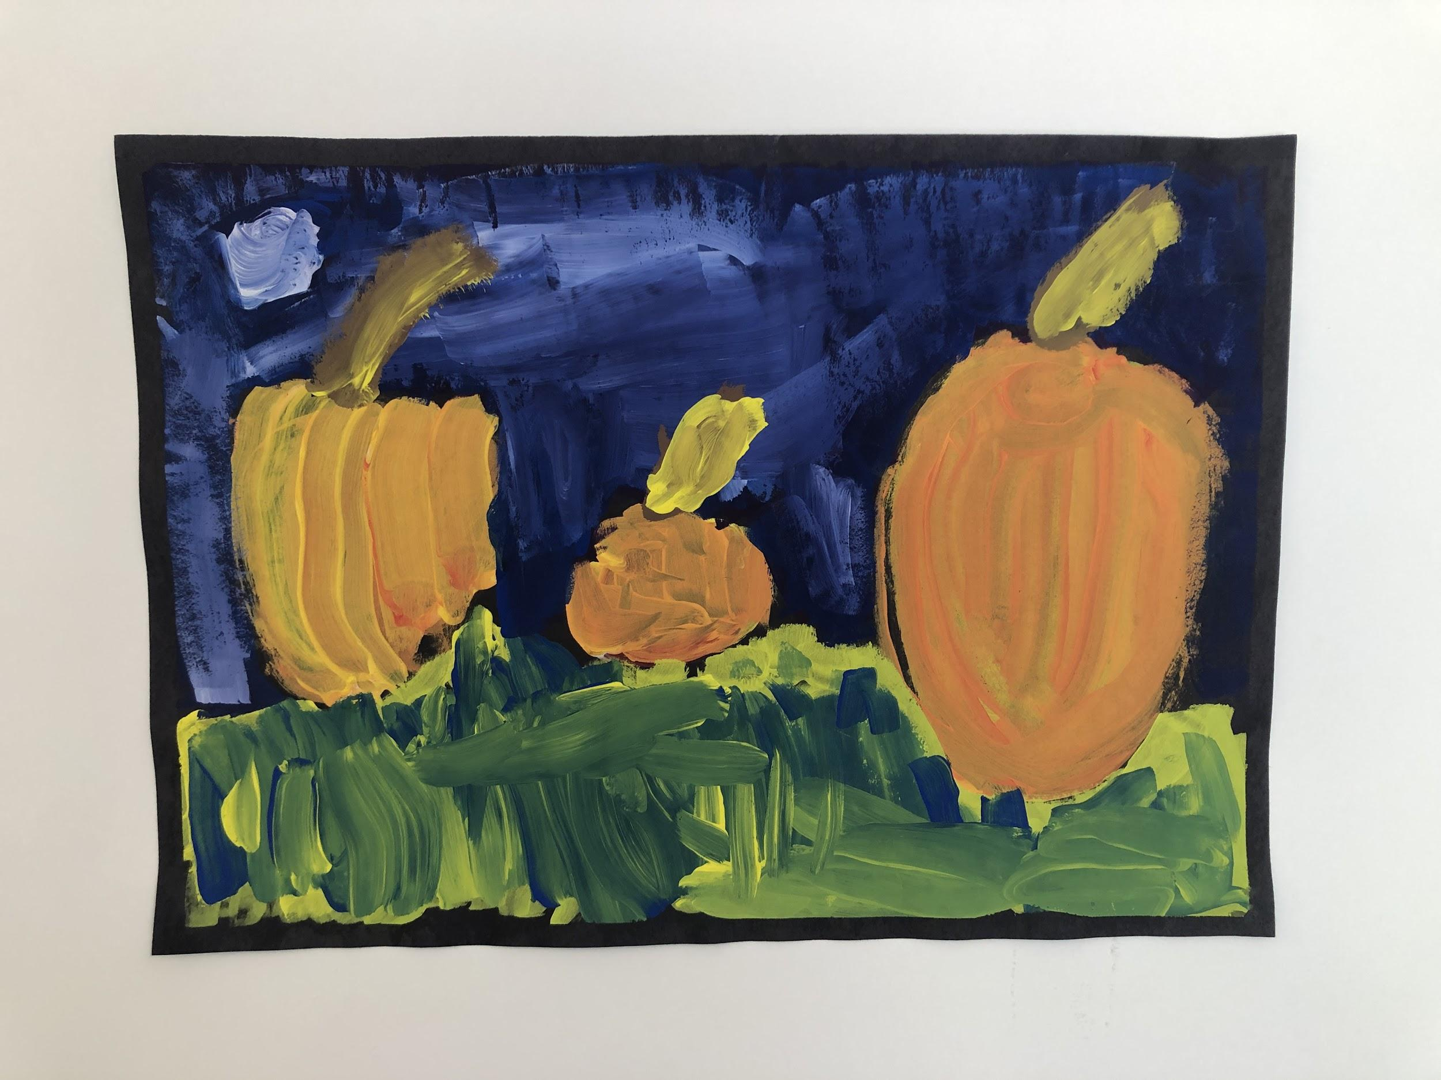
Brantlee Yount, Kindergarten

Slide 52
Kelly High School
Scott County R-IV School District
Nikki Heuring
MAEA District #11

Slide 53
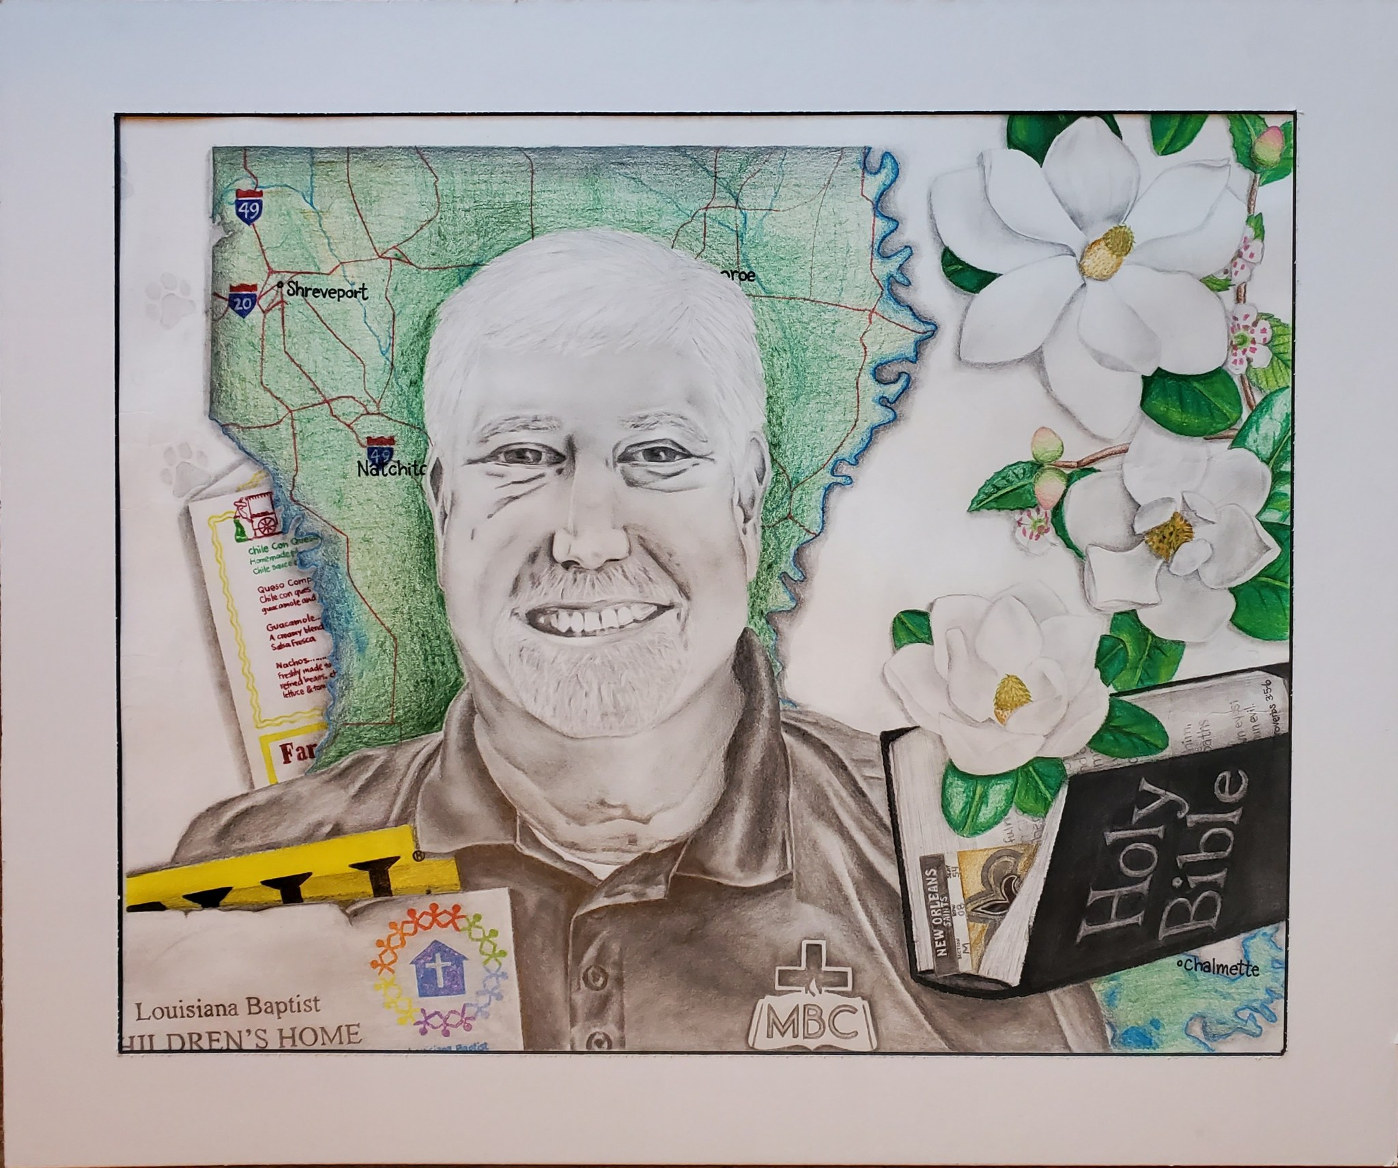
Mollie Bartlett, 12th grade

Slide 54
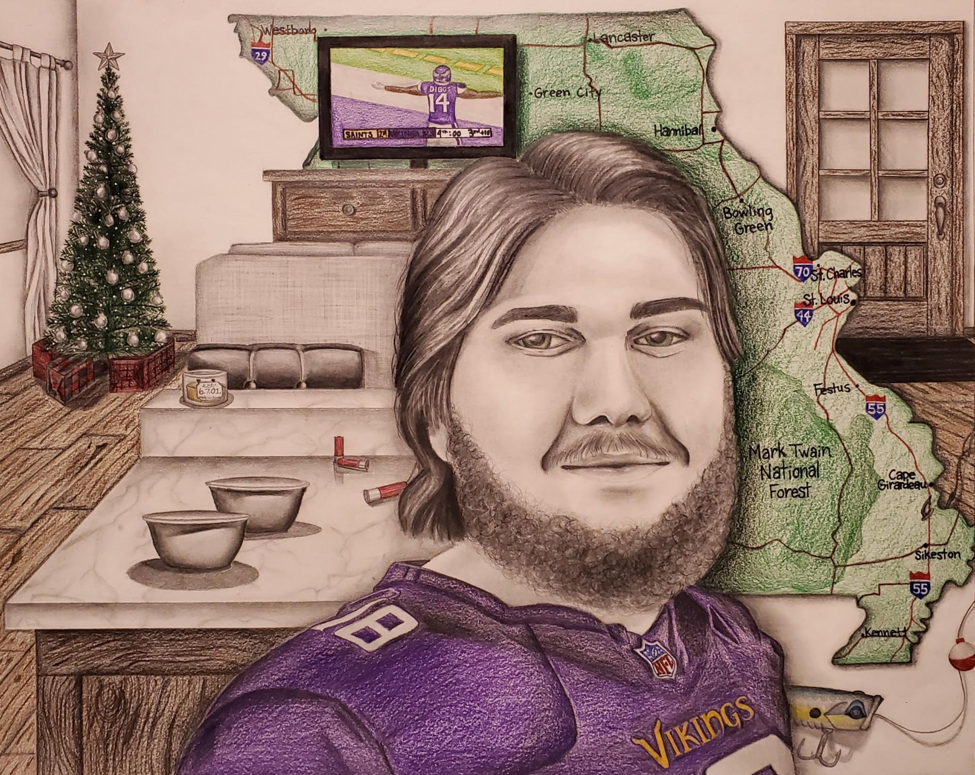
Mollie Bartlett, 12th grade

Slide 55
Awards & Recognition

Slide 56
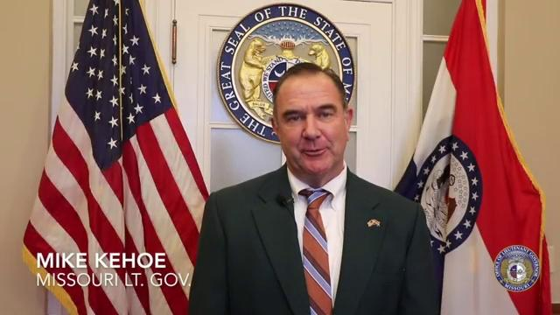

Slide 57
Governor’s Awards

Slide 58
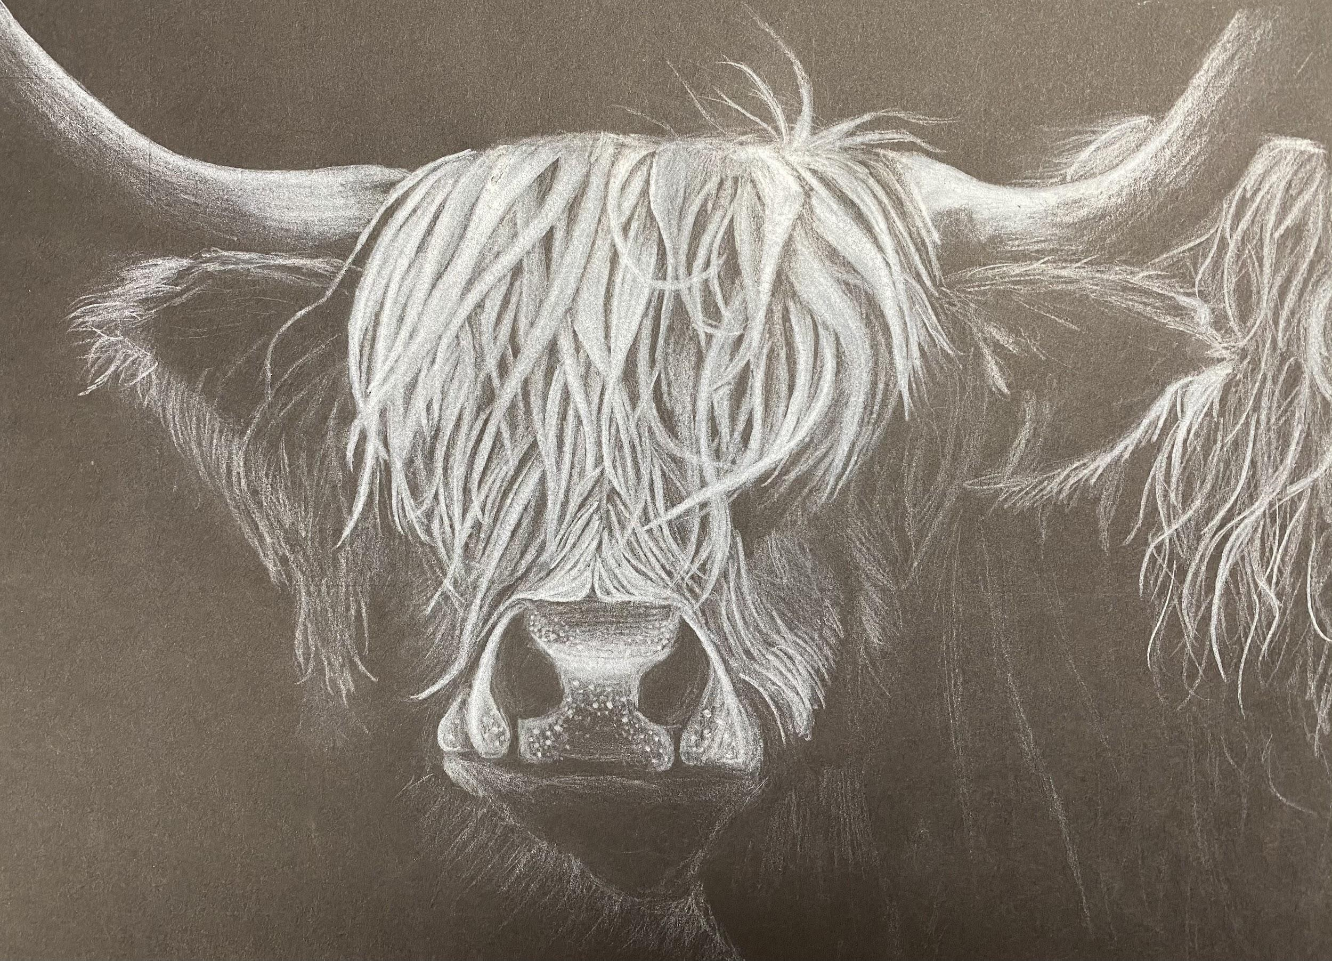
Governor's Choice Award
Claire Galbraith, Grade 11

Slide 59
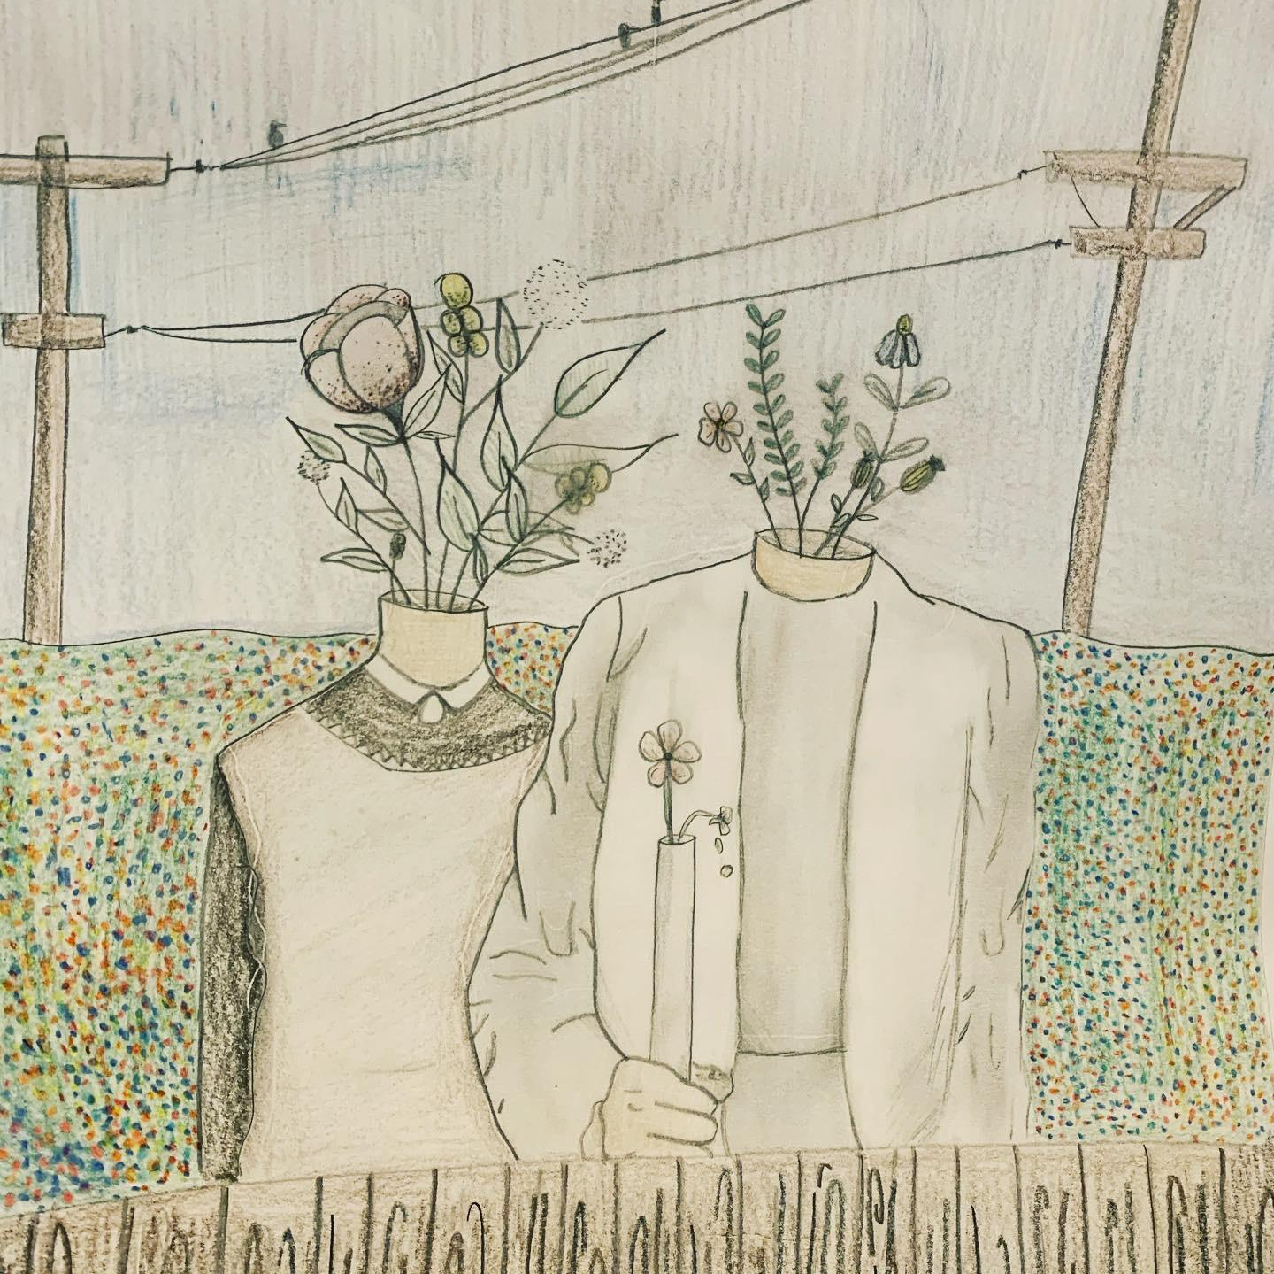
First Ladies Choice Award
Tori Guffey, 12th Grade

Slide 60
Chairperson’s Choice Award
Gavin Steed, Grade 3

Slide 61
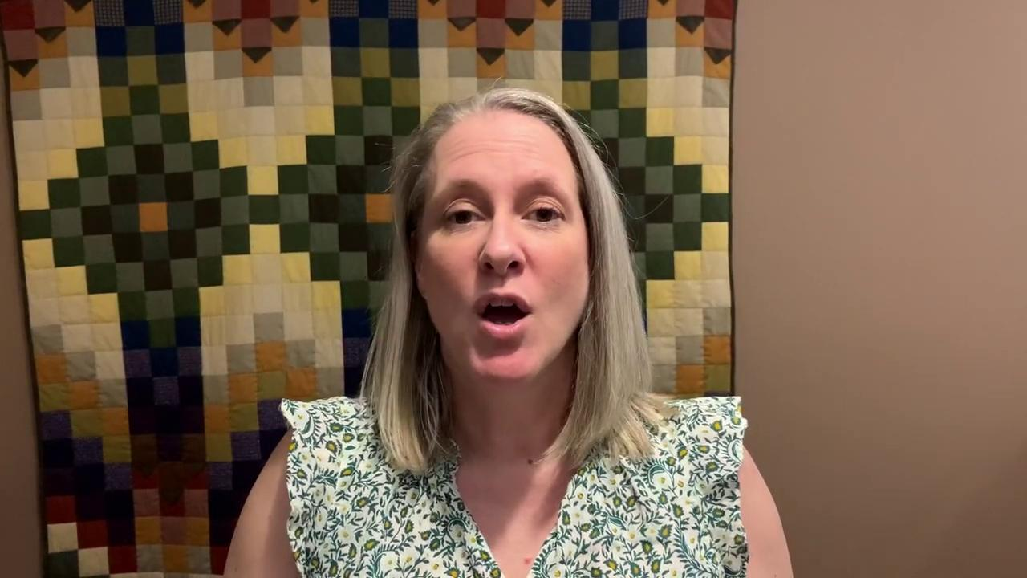
A message from MAEA President-
Hester Menier- NBCT

Slide 62

President’s Awards

Slide 63
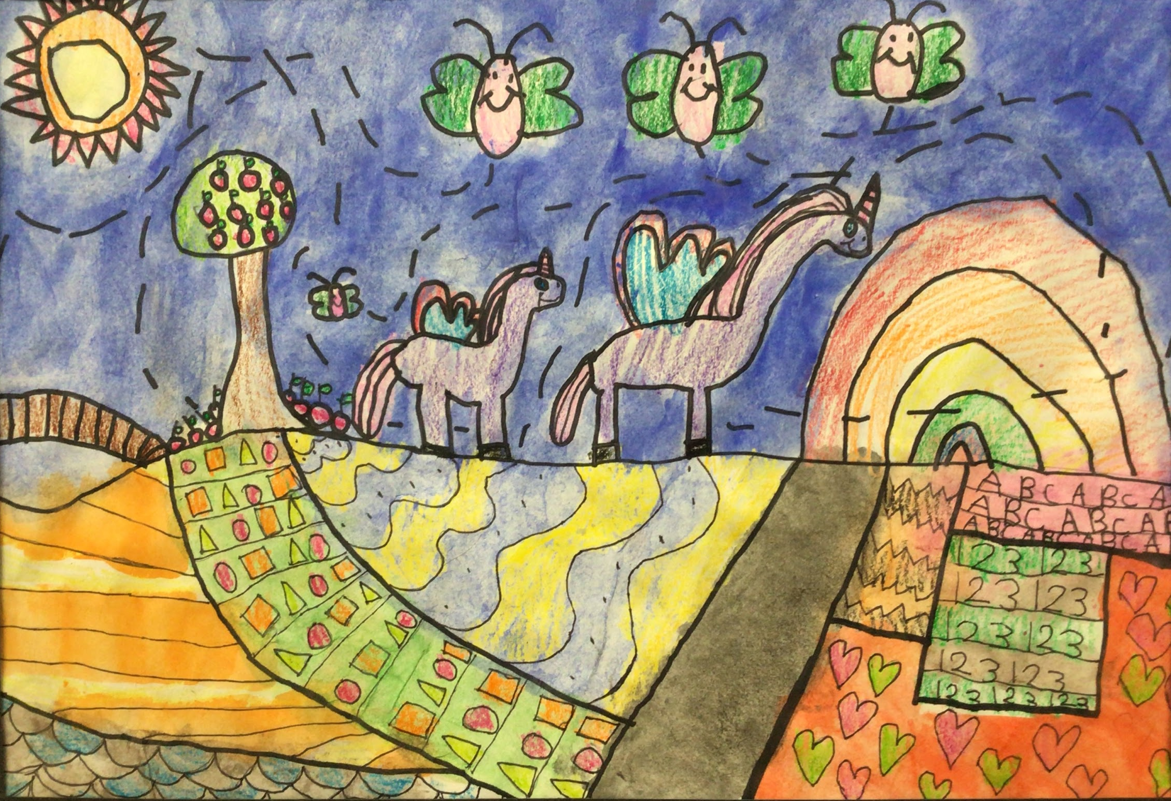
President’s Choice
Lower Elementary
Olivia Kuschel, 1st Grade

Slide 64
President’s Choice
Upper Elementary
Mylah Wright, 4th grade

Slide 65
President’s Choice
Middle School
Faith Russell, 7th grade

Slide 66
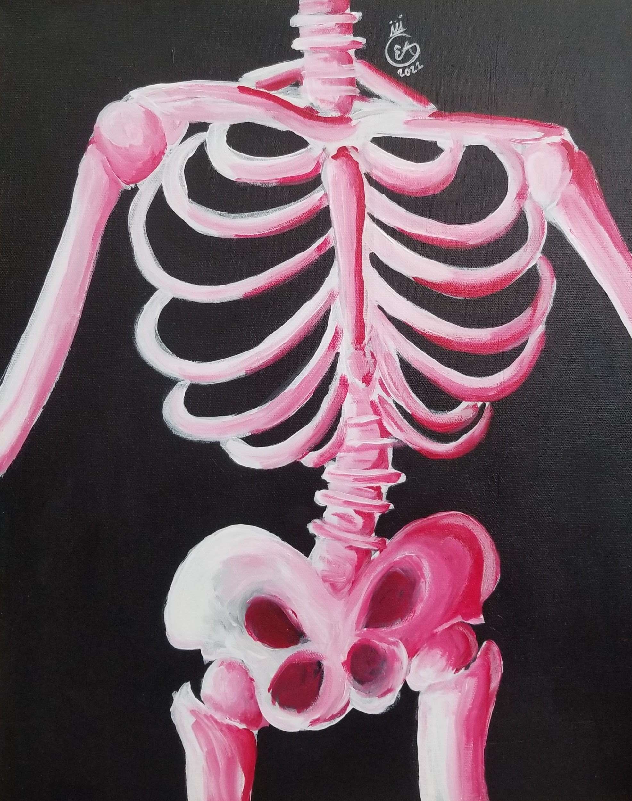
President’s Choice
High School
Emory Abbott, 10th grade

Slide 67
District Awards
Sponsored by the Missouri Alliance
for Arts Education

Slide 68

District 1
Maclin Limb, Grade 4

Slide 69

District 2
Drace Rowland, 12th Grade

Slide 70

District 4
Bennett Kueker, 4th Grade

Slide 71

District 5
Halie Mesko, 11th grade

Slide 72

District 6
Ellavy Cooper, 10th Grade

Slide 73

District 7
Avery Britton, 5th Grade

Slide 74
District 8
Samantha Ramay, 12th Grade

Slide 75
District 9
Alexandra Boman, 12th Grade

Slide 76
District 10
Tori Carter, 11th grade

Slide 77
District 11
Mollie Bartlett, 12th grade

